Slide 1
Curating Collaboration
From “Can” to “Want”
Felix Jahn
Lightning Talk at TNC26, Helsinki
11 June 2026
Notes:
Today, I want to talk about…
Because that is what we do, right?

Slide 2
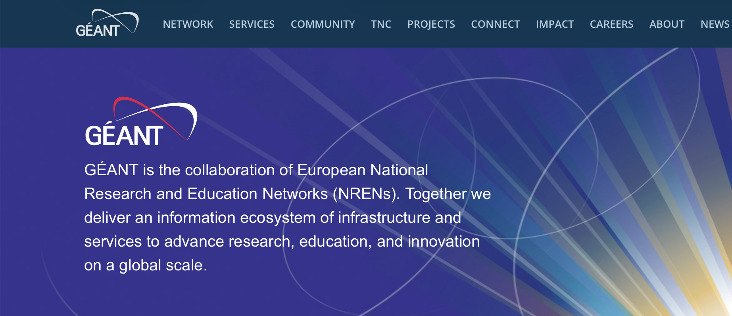
Collaboration is what we are.
GÉANT (2026, May 12). Landing Page [Screenshot]. GÉANT. Geant.org
Notes:
This is the first thing you see
“GEANT is the collaboration of European National Research and Education Networks”
What a statement!
That’s not all we do.

Slide 3
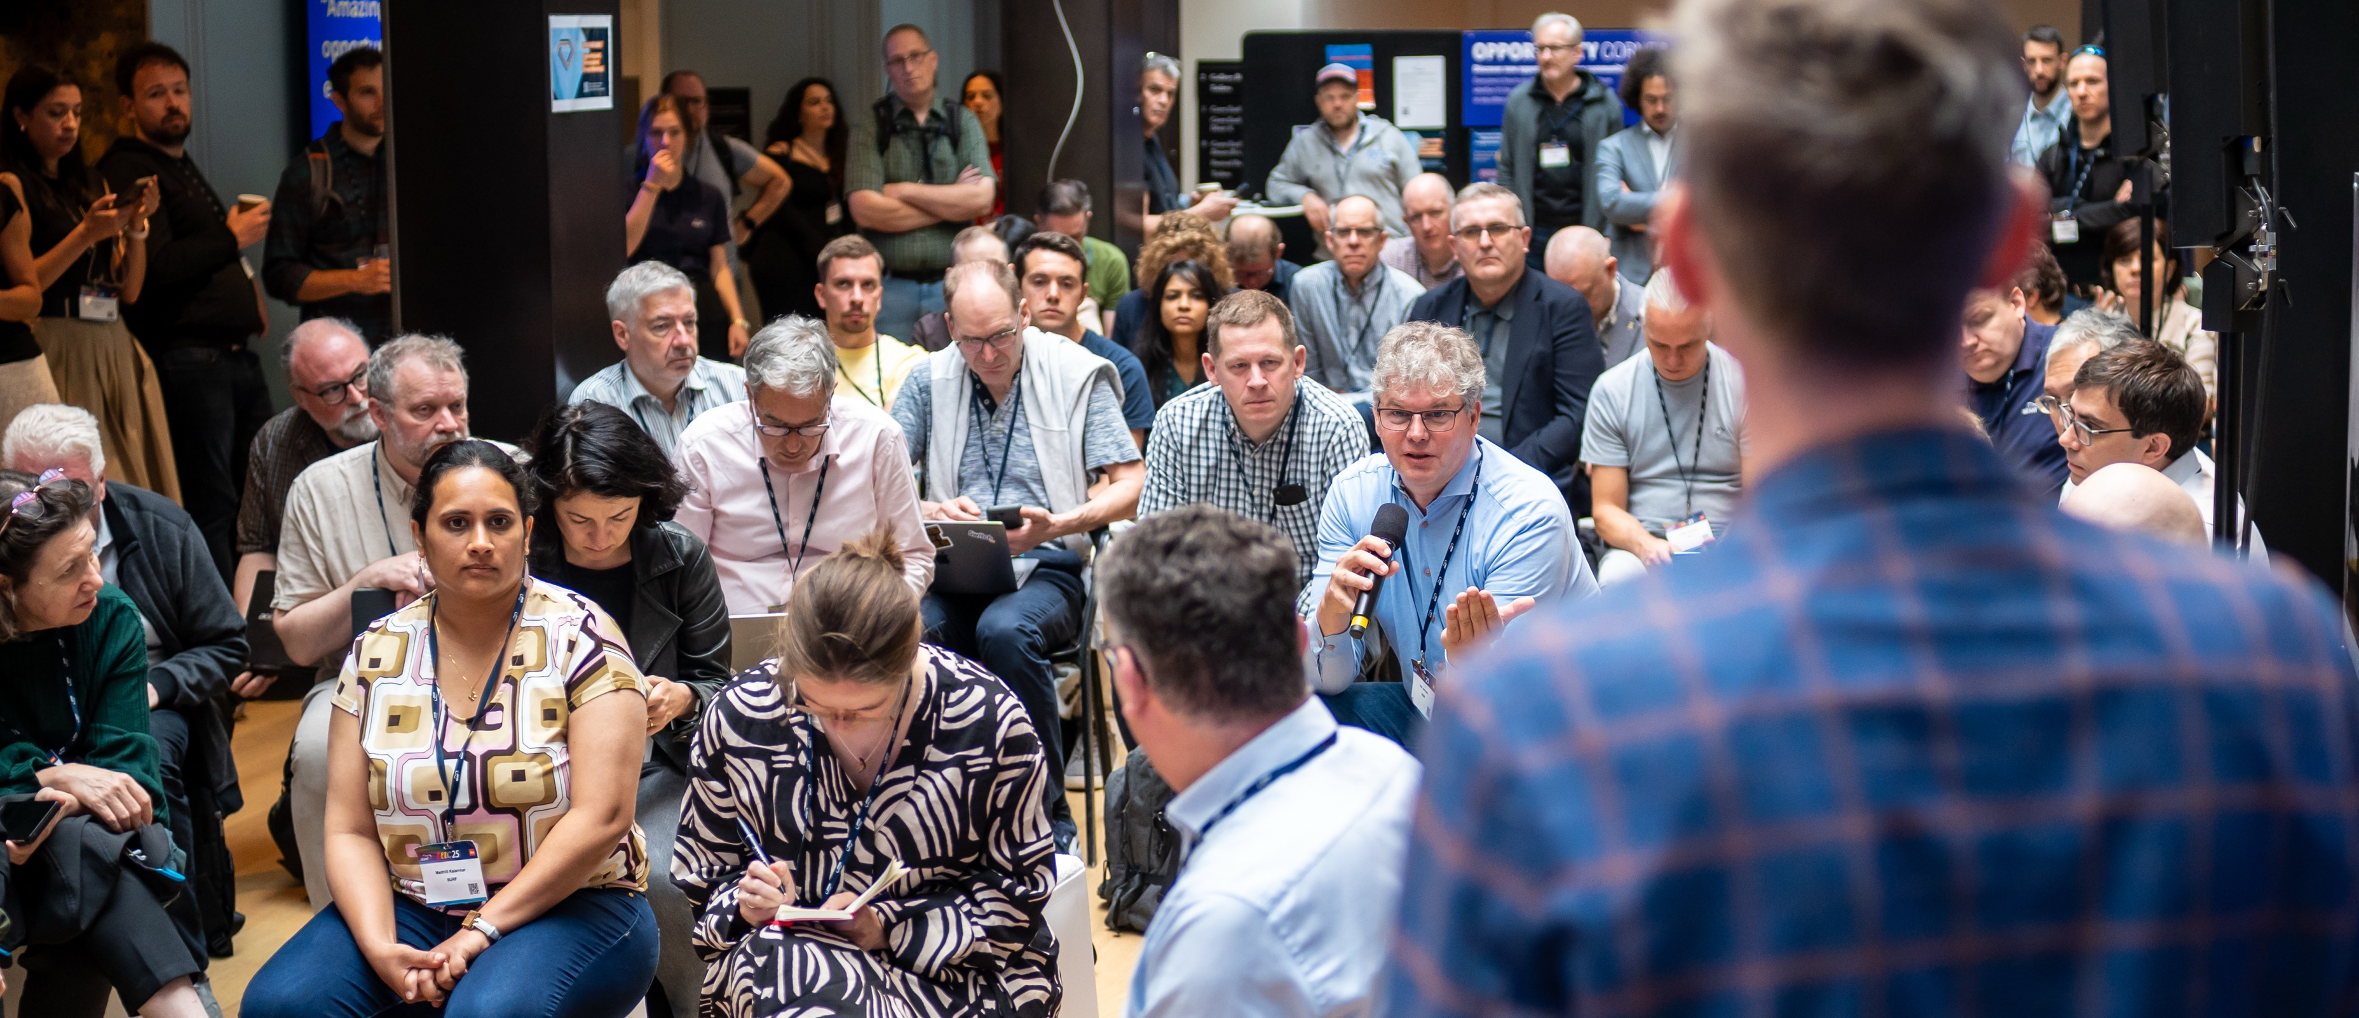
Collaboration is what we are.
TNC 25, GÉANT Photos via Flickr. © PKR Photos
Notes:
Just look around you.
We come together in order to…
Just look around you – a lot of effort, energy, and time
So interesting, because all of this is so unnecessary.
I hate to break it to you but…

Slide 4

This could have been a call.
But…
Notes:
This could have been a Zoom Call.
All of us coming here? The effort, the time, even the environmental impact?
So unnecessary.
I see some disagreement.
But why?
Talk even uploaded before.
Still, we choose to come here.

Slide 5
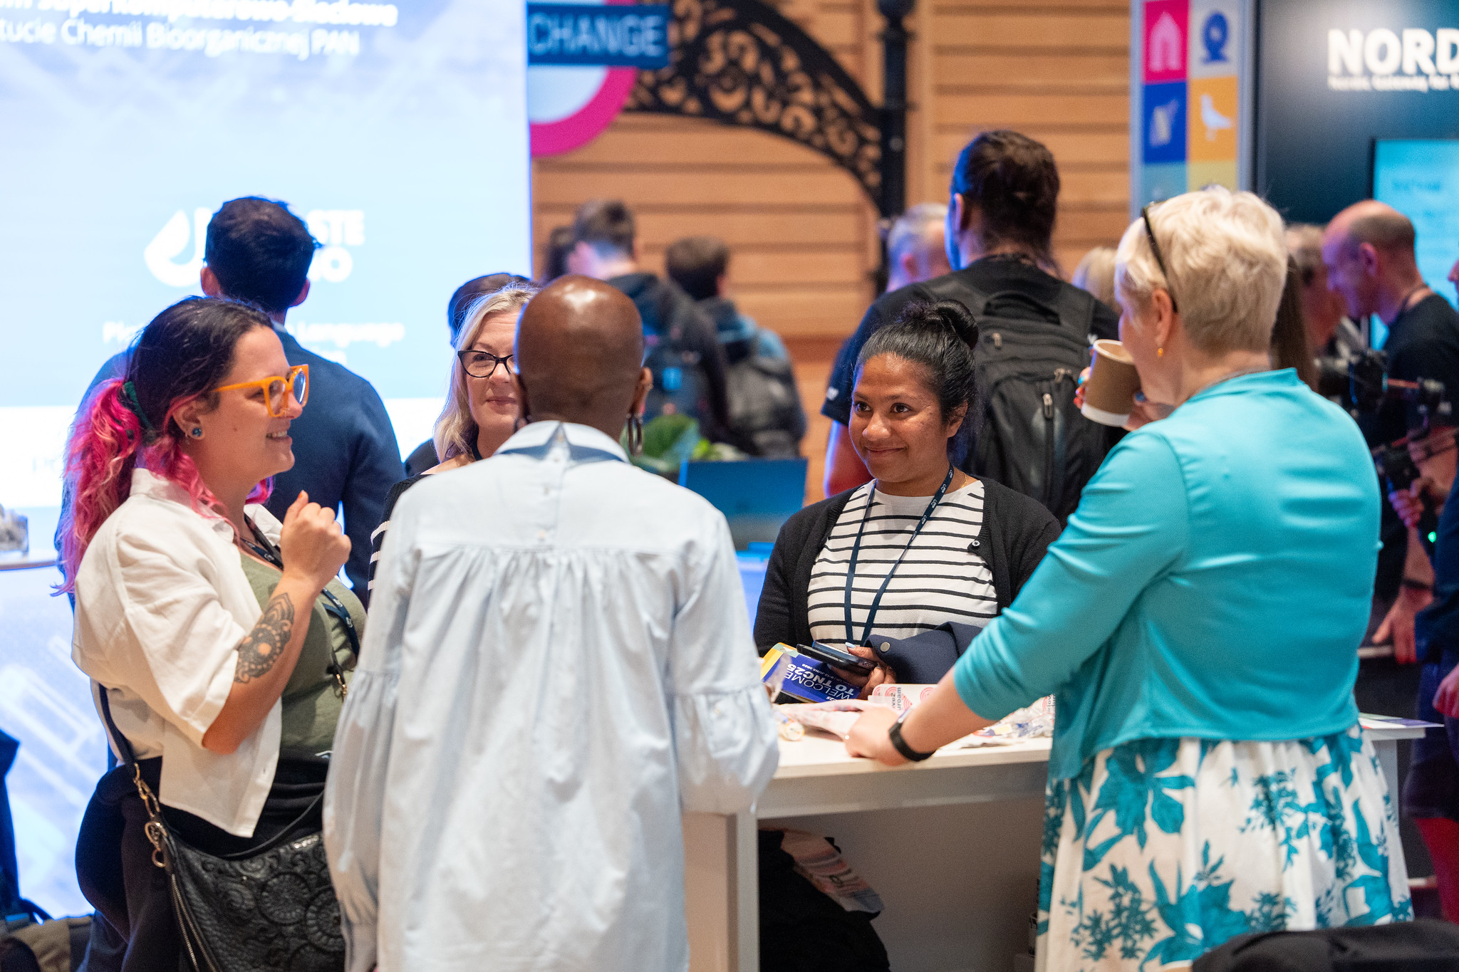
So why are we here?
Collaboration is
deeply social and about
Trust
Sharing
Disagreement
The unexpected
…
TNC 25, GÉANT Photos via Flickr. © PKR Photos
Notes:
And we should.
Collaboration is deeply social.
It is about…
Trust & Relationships
Sharing of skills, knowledge, experiences
Even disagreement
The Unexpected

Slide 6
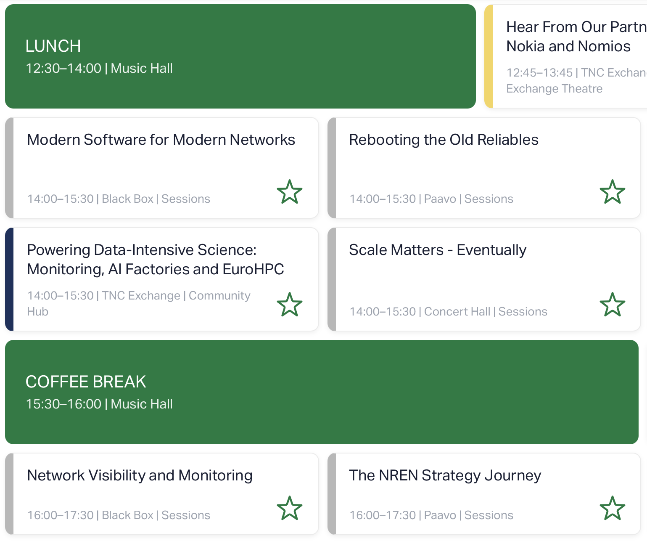
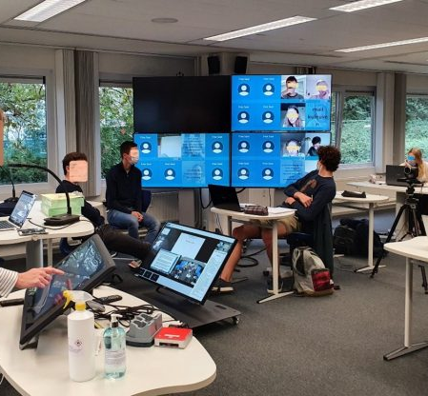
Yet, facilitating collaboration is often deeply technical.
GÉANT (May 14). TNC26 Programm (Screenshot). tnc26.geant.org
Hybrid Classroom @ KU Leuven © Annalies Raes
Notes:
And yet it is often deeply technological.
Both in the back end and front end, which is more my typical area of work
Often tech-driven or technology first approach when thinking about hybrid spaces or infrastructures

Slide 7
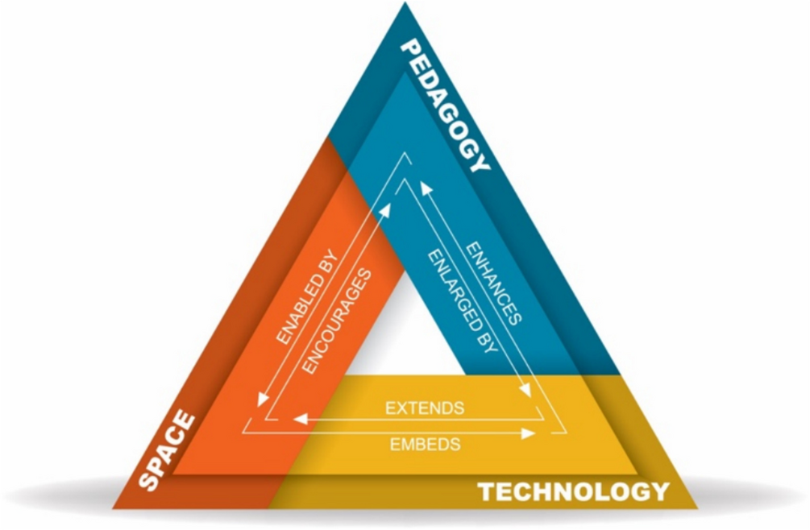
But technology never stands on its own.
It extends space.
It enhances pedagogy.
(as well as research, … )
D. Radcliffe (2009). PST Framework
Notes:
Technology never exist on their own.
It is always anchored to physical compontents
and are a means of interaction
Technology extend space and enhances pedagogy.
And here, pedagogy can be replaced by research, collaboration, and other forms of interaction
Because in the end, technology is interdependent with other aspects.

Slide 8
But technology never stands on its own.
It extends space.
It enhances pedagogy.
(as well as research, … )
Technology is one part of designing for
truly human and social interactions.
D. Radcliffe (2009). PST Framework
Notes:
Technology is not just a part of providing infrastructure,
but it is one part of designing for truly human and social interactions.
It is part of curated collaboration.
How we engage with each other, with data, with research, and so on.

Slide 9
Technology is one part of designing for
truly human and social interactions.
Notes:
And that is what I want to hold onto.
Technology is part of curated collaboration.

Slide 10
Technology is one part of designing for
truly human and social interactions.
I invite you take a moment and reflect on your work.
Let’s not just think about what "technology can" do,
but rather how "we want" to use it.
Notes:
I invite you to take a moment and reflect on your work, on the things you heard here today.
Why is this important? What purpose does it serve?
And when going back to your work after this week, I hope you don’t just think about what technology can do,
But rather how we want to use.

Slide 11

Thank you
Felix Jahn
Technical University of Munich (TUM)
felix.jahn@tum.de
linkedin.com/in/fjahn/

