Slide 1
Diversify or Die: The Financial Future of NRENs
Yuliia Meshcheryna
GÉANT
12/06/2026

Slide 2
Notes:
Close your eyes for a second.
You’re in a small, closed room. At first, everything feels completely normal.
You’re breathing without thinking. Effortless. Automatic. But after a while… something changes. Your breathing becomes just a little heavier. Not dramatic — just enough that you notice.

Slide 3
Notes:
So you pay attention. You take a deeper breath. Then another. And then a thought appears:
Is there enough air in here?
And that’s when everything shifts. Your heart speeds up. Every breath suddenly matters - not because the air is gone, but because you don’t know how much is left.

Slide 4
Contract delayed
Grant not approved
Invoices due next week
Payroll shortly after
Notes:
Now it’s Monday. 08:47.
You open your email.
Grant not approved. Contracts delayed. Invoices next week. Payroll right after.
And suddenly, the room feels familiar (maybe say smaller?).
What’s your plan? Do you have any cash reserves?
How many months can you survive? Three months? Six? A year?

Slide 5
Contract delayed
Grant not approved
Invoices due next week
Payroll shortly after
Notes:
Now it’s Monday. 08:47.
You open your email.
Grant not approved. Contracts delayed. Invoices next week. Payroll right after.
And suddenly, the room feels familiar (maybe say smaller?).
What’s your plan? Do you have any cash reserves?
How many months can you survive? Three months? Six? A year?

Slide 6
Contract delayed
Grant not approved
Invoices due next week
Payroll shortly after
Notes:
Now it’s Monday. 08:47.
You open your email.
Grant not approved. Contracts delayed. Invoices next week. Payroll right after.
And suddenly, the room feels familiar (maybe say smaller?).
What’s your plan? Do you have any cash reserves?
How many months can you survive? Three months? Six? A year?

Slide 7
Contract delayed
Oxygen
How many months can you survive?
Grant not approved
Invoices due next week
Payroll shortly after
Notes:
Now it’s Monday. 08:47.
You open your email.
Grant not approved. Contracts delayed. Invoices next week. Payroll right after.
And suddenly, the room feels familiar (maybe say smaller?).
What’s your plan? Do you have any cash reserves?
How many months can you survive? Three months? Six? A year?

Slide 8
Contract delayed
Oxygen
Grant not approved
It keeps it alive
Invoices due next week
It pays people
It absorb shocks
It buys time
Payroll shortly after
Notes:
Money is not the purpose of an organisation. But it is the oxygen. It keeps it alive. It pays people. It absorbs shocks. It buys time. We don’t think about oxygen when it’s flowing. But the moment it tightens, everything changes - decisions narrow, risks multiply, confidence drops.

Slide 9
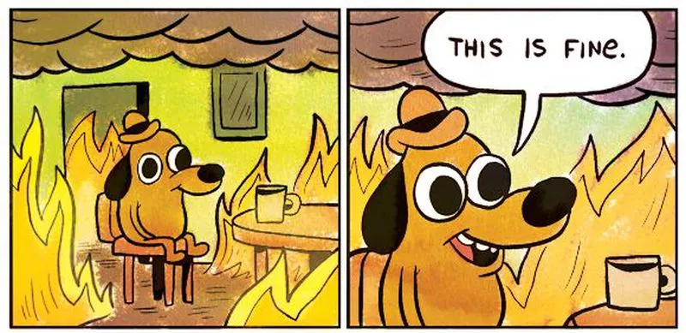
Knowing is not the same as acting
Notes:
Every organisation knows that financial resilience is critical. But knowing is not the same as acting.

Slide 10
How much oxygen
do we have?
Notes:
So the real question is:
So how much oxygen do we actually have?
In the non‑profit world, we like to believe that mission will carry us through.

Slide 11
Hope is not a financial strategy
30% of non‑profits formally close within 10 years
Notes:
But hope is not a financial strategy.
Around a third (30%) of non‑profits formally close within 10 years - and many more survive only by constantly fighting the next funding round. Why? Because we’ve built a culture where talking about money/profit still feels awkward. In the for-profit world, the equation is simple: the more value you create, the more money you can make. But when it comes to non-profits, we seem to reject that same logic. We’re uncomfortable with the idea that non-profits need money. People get upset when someone makes a lot of money by helping others. But nobody minds big money when it’s helps no one.

Slide 12
Hope is not a financial strategy
14 out of 44 NRENs commercialise their services
Notes:
I say this from my perspective in the finance team at GÉANT. According to the latest Compendium, only 14 out of 44 NRENs commercialise their services. We all understand the risks - so why not other income sources? Some may say government-structured organisations can’t commercialise. Perhaps.

Slide 13
Diversification ≠ Commercialisation
It means surplus. Cash in the bank.
Government Constraints
Some can't commercialise.
New Income Sources
Have we explored alternatives?
Surplus = Safety
Cash protects you.
Notes:
But diversification does not automatically mean commercialisation. It means surplus. And surplus here means cash in the bank- cash that can save you when times get tough.

Slide 14
A funding model under pressure
It means surplus. Cash in the bank.
Rising Costs & Tariffs
Defence Crowding Out
Dependency = Vulnerability
Political & Global Instability
More Competition for Grants
Notes:
The pressures to change go even further. The funding model we knew is evolving, becoming more competitive and less predictable. Global instability, rising tariffs, rising costs, political chaos, and defence taking a larger share of public budgets. There’s no doubt: our work is shaped by external factors. But being dependent on them is not a strategy - it’s a vulnerability.
These challenges aren’t abstract - I’ve seen them firsthand at GÉANT.

Slide 15
At GÉANT
We Chose to Act
Notes:
And when the world around you becomes unstable, you face a choice: wait and hope, or act before you’re forced to. We chose to act. We made difficult decisions and restructured to get stronger. It wasn’t comfortable - real change rarely is.
But it’s necessary if you want to succeed.

Slide 16
At GÉANT
We Chose to Act
Notes:
This change in mindset opened the door to new opportunities. One example is EuroHPC — a project that brings revenue, responsibility, and complexity. And that’s exactly the point: resilience isn’t about avoiding complexity. It’s about being strong enough to handle it.

Slide 17
At GÉANT
We Chose to Act
Resilience isn’t about avoiding complexity.
It’s being strong enough to handle it.
Revenue
Responsibility
Complexity
Notes:
This change in mindset opened the door to new opportunities. One example is EuroHPC — a project that brings revenue, responsibility, and complexity. And that’s exactly the point: resilience isn’t about avoiding complexity. It’s about being strong enough to handle it.

Slide 18
“When the winds of change blow, some build walls and others build windmills”.
Notes:
All of this shows one thing: the future is already here. It is not something that may happen - it is happening now. I’m not here to tell you exactly what to do. There is no single model, no universal solution. The decisions are always yours. You can find new sources of income. Or you can cut costs — hoping to survive the next five years.
But I am here to say this: You are not alone in facing these pressures. Financial resilience is not built during a crisis - it is built before a crisis.
There’ s a saying.

Slide 19
Which are we building?

Slide 20
Thank you!
yuliia.meshcheryna@geant.org

