Slide 1
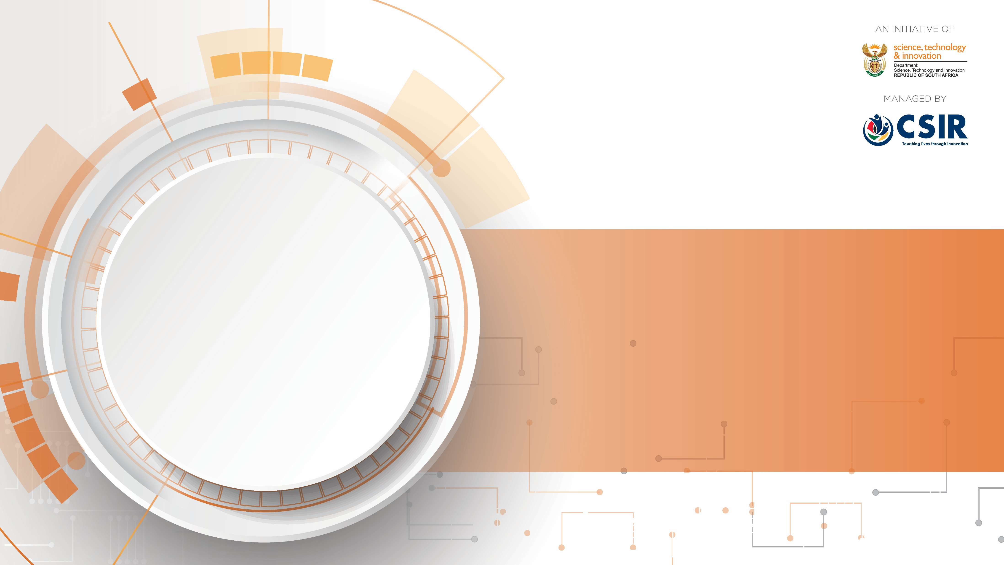
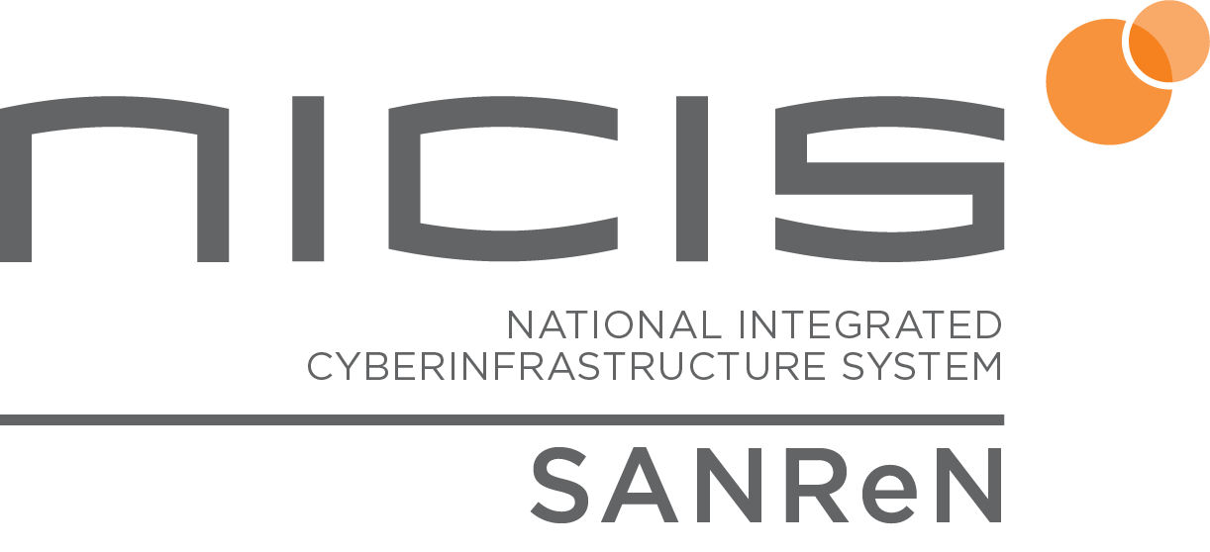
Community Data Transfer Nodes
An invitation to collaborate – Let’s move data faster!
Dr Kasandra Pillay
South African National Research Network (SANReN), CSIR

Slide 2

The Challenge
Researchers need fast, reliable global data sharing
Large research datasets are difficult to move efficiently
Many African institutions face:
  Financial constraints
  Limited technical resources
  Security and compliance challenges
Slow data movement delays research progress
Key Issue: Many institutions cannot deploy and manage specialized high-speed transfer infrastructure independently.

Slide 3
SANReN’s Solution
100Gbps Community Data Transfer Nodes (DTNs)
Funded by SANReN for the R&E community
Located on 100G NREN backbone (unrestricted connectivity)
Deployed nationally across South Africa
Optimized specifically for large-scale data movement
Built using the Science DMZ architecture (fasterdata.com)
Avoids campus bottlenecks (bandwidth limiters, FWs, 1G UTP campus network, shared/slow servers etc)
Managed endpoints with tuned performance and security
Used as intermittent storage for research transfers
Combined perfSONAR functionality for network testing

Slide 4
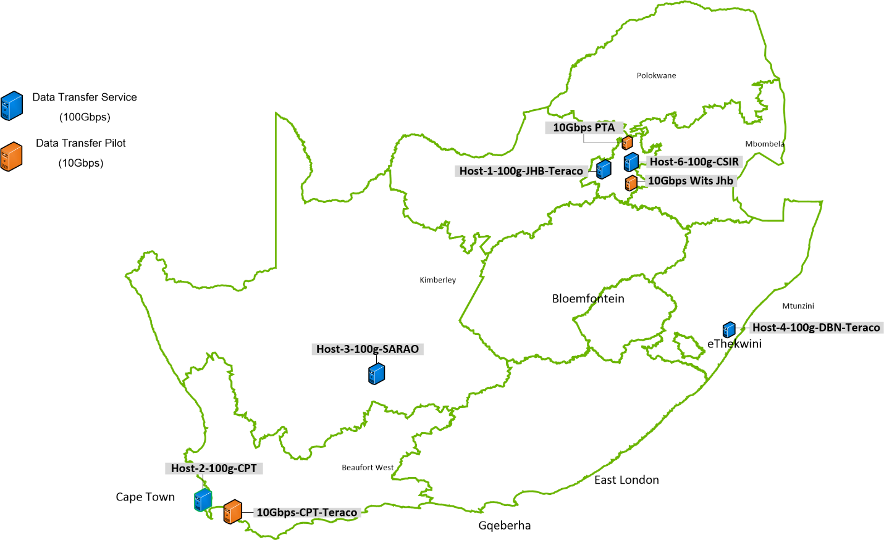
R&E community Data Transfer Nodes deployed on the SANReN network
Types of research communities assisted
Astronomy
Genomics
Physics
Goal: Enable South African researchers to collaborate globally without data bottlenecks using shared national infrastructure

Slide 5
Why Community DTNs Work
Shared Infrastructure Model benefits
Shared hardware and software costs
Better utilization of high-performance infrastructure
Reduced setup and optimization effort
Benchmarking capabilities for researchers
Flexible storage expansion for projects
Operational Advantages
Centrally managed and secured
Faster deployment for researchers
Optimized for local and international transfers

Slide 6
Impact Beyond South Africa
A Model for Other NRENs and RRENs
Many institutions globally face similar barriers
Community DTNs can support:
  Universities
  Research institutions
  Regional research networks
  International collaborations
Outcome: Faster and more reliable research data movement worldwide.

Slide 7
Call to Action for NRENs or teams
Implement community DTNs in your country or region
Share infrastructure and expertise
Enable faster and more secure research collaboration
Build a stronger global research ecosystem together
“If researchers know their community’s optimized DTN, research can move faster globally.”

Slide 8

THANK YOU
Reference
ESnet Fasterdata Knowledge Base https://fasterdata.es.net/

