Slide 1
Towards a Quantum GÉANT Network
A Lightning Talk at Strike One
Sergejs Kozlovičs
Helsinki Music Hall
June 10, 2026
Notes:
Good afternoon everyone.
Today I’d like to talk about a possible path towards a Quantum GÉANT Network, we have all the tools to build one.

Slide 2
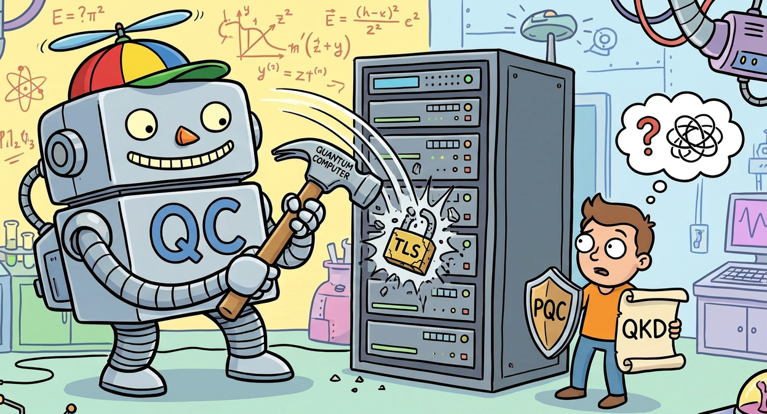
Quantum Computers and the Need to Protect our Data Transmission
PQC
Post-Quantum Crypto
Good but based on computational assumptions
QKD
Quantum Key Distribution
Information-theoretical security (ITS)
No assumptions except for Quantum Mechanics
Security proofs exist
New infrastructure needed!
Notes:
Quantum computers create a serious challenge for how we protect data transmission. In response, we often hear about post-quantum cryptography (new encryption algorithms), or PQC. PQC is important and useful, but it is still based on computational assumptions — in other words, on the belief that some mathematical problems remain hard to solve event by QC. However, I’m not staking my neck on that “PQC will never be broken”
Quantum key distribution, or QKD, offers something different. It offers information-theoretic security, with no assumptions beyond quantum mechanics, and it comes with strong security proofs. That makes it very attractive if we are thinking long-term about highly sensitive communications. We focus on it.
But there is a catch: QKD requires new infrastructure
The National Institute of Standards and Technology (NIST) and the European Union recommend transitioning to quantum-secure cryptography between 2030 and 2035. While Post-Quantum Cryptography (PQC) does not require specialized quantum hardware, it has to withstand the test of time, and it provides only security against quantum computational attacks. Quantum Key Distribution (QKD) offers an alternative approach. Although it requires new network infrastructure, QKD can provide perfect forward secrecy and even information-theoretic security (ITS)

Slide 3
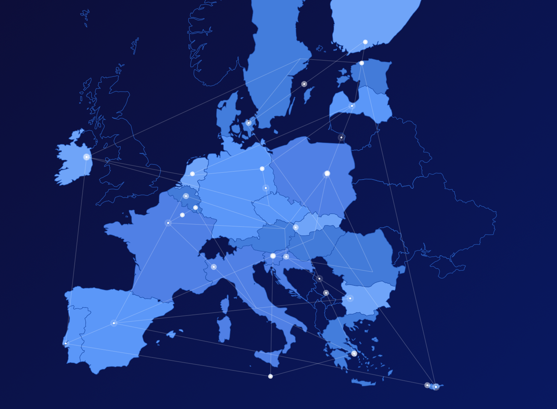
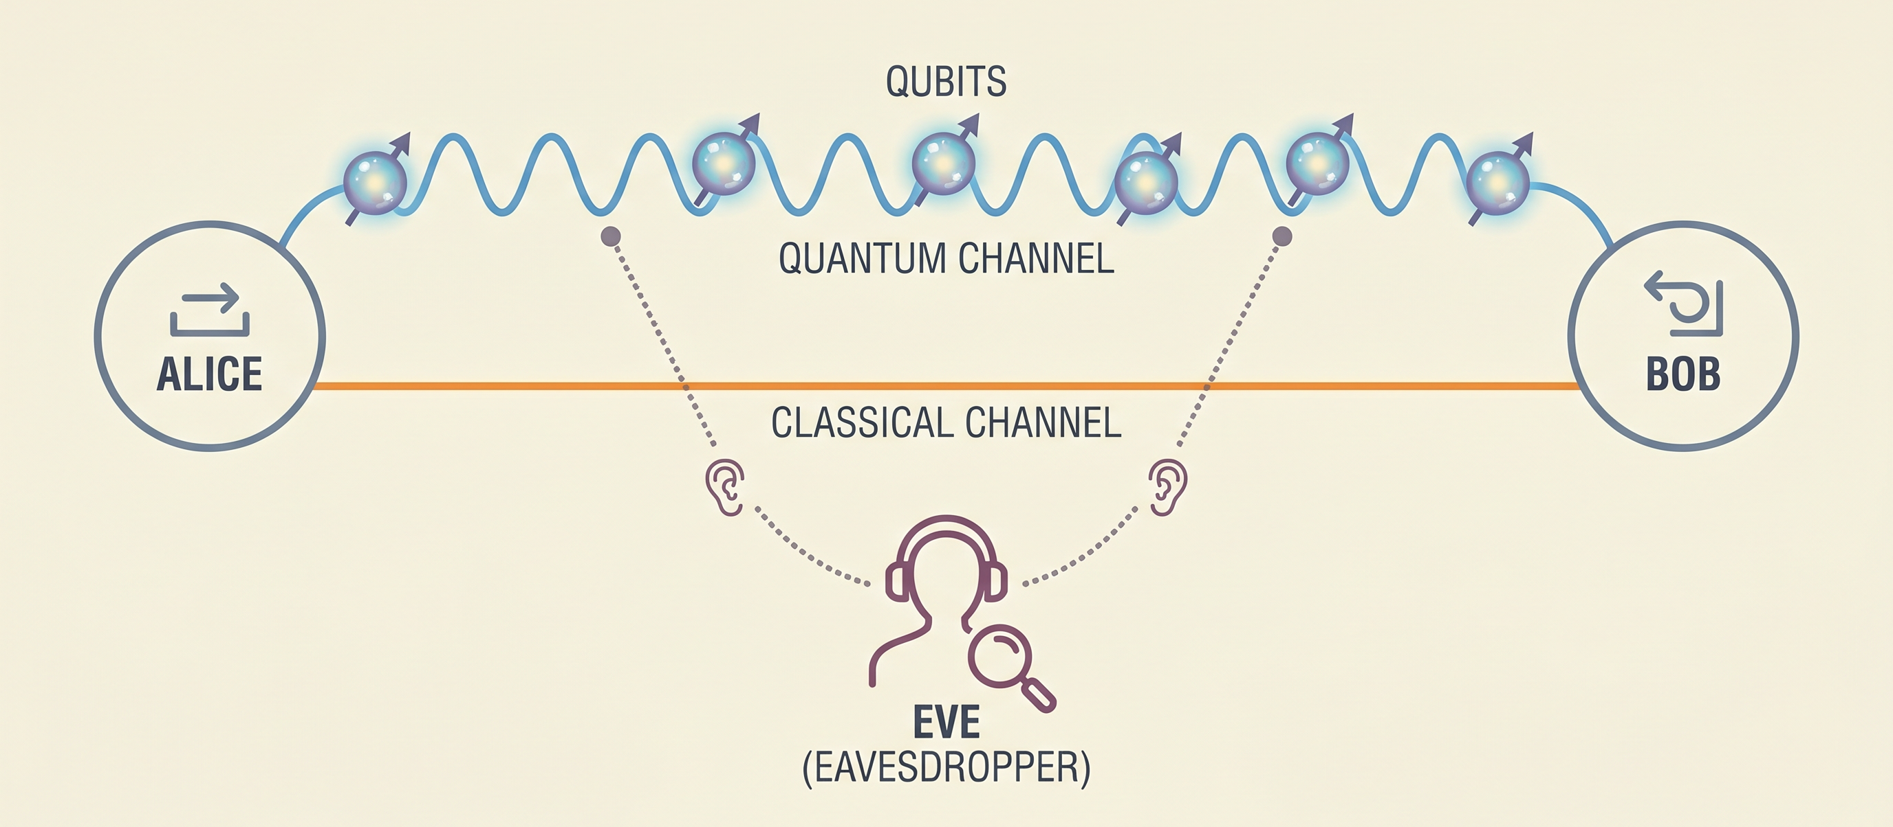
Quantum Key Distribution (QKD) Networks
QKD is a point-to-point technology!
(with distance and bitrate limitations)
QKD networks are needed!
EuroQCI, CEF, IPCEI… calls
Private companies also invest a lot
Notes:
And this leads to the next key point: QKD is fundamentally a point-to-point technology. It has distance limitations and bitrate limitations, so isolated links are not enough. If we want to use QKD in practice at scale, we need QKD networks.
This is already recognized across Europe. There are major initiatives and funding calls — for example EuroQCI, CEF, and IPCEI — and private companies are also investing heavily. So the momentum is real.

Slide 4
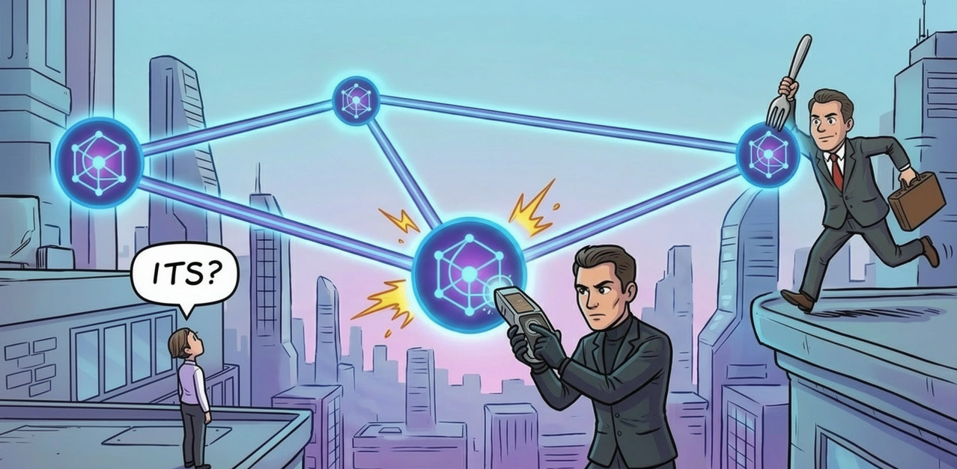
QKD is not going the right direction
Notes:
However, one of the messages of this talk is that QKD may not be going in quite the right direction.
Difficult to inter-connect HW from different vendors. Different authorities controlling nodes. New standards do not address ITS security. New ETSI standard draft assumes that keys are distributed to all “trusted nodes”. “Trusted nodes” may not be so trusted, e.g., because of dishonest administration or exposing QKD equipment to side-channel attacks.

Slide 5
GÉANT QKD
Many NRENs already have QKD experience!
Some optical fibers are already good for QKD.
We want ITS security even if some nodes are malicious.
Notes:
GÉANT is a natural place to do a secure academic QKD network.
Many NRENs already have QKD experience, and some optical fibres are already suitable for QKD. So there is a foundation we can build on.
This is partial (scappred) GEANT topology. Just an example how the QKD topology may look
like in the future.
But what kind of security do we actually want from a GÉANT QKD network?
The goal is end-to-end information-theoretic security — even in the presence of malicious nodes TNC26-lightning.pptx. That is an important shift in thinking. We are not just asking whether two neighboring sites can exchange a quantum-generated key. We are asking whether users across the network can obtain end-to-end secure keys, even if not every intermediate node is fully trusted.

Slide 6
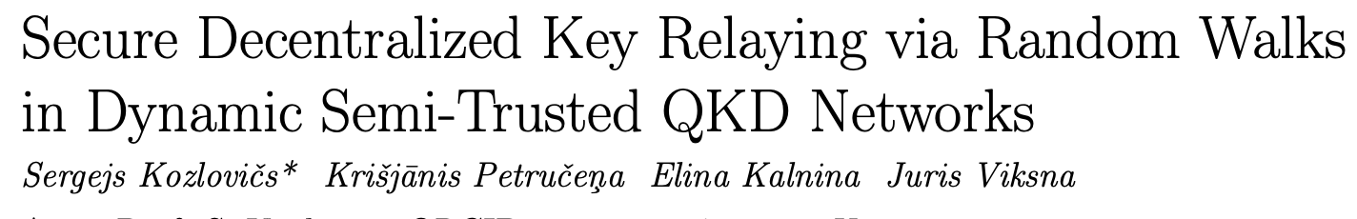
End-to-end ITS security
Theorem. For an (m+1)-connected network where each adversary controls no more than m nodes, it is possible to establish ITS secure end-to-end keys by using direct QKD links.
We add additional computational security layer to deal with articulation points.
Notes:
Here the slide gives a very interesting theoretical result: for an $\left(m+1\right)$-connected network, where an adversary controls no more than $m$ nodes, it is possible to establish information-theoretically secure end-to-end keys using direct QKD links TNC26-lightning.pptx. In practical terms, this means network topology matters. If we design the network with enough independent connectivity, we can tolerate some compromised nodes and still preserve strong end-to-end security. We also address

Slide 7
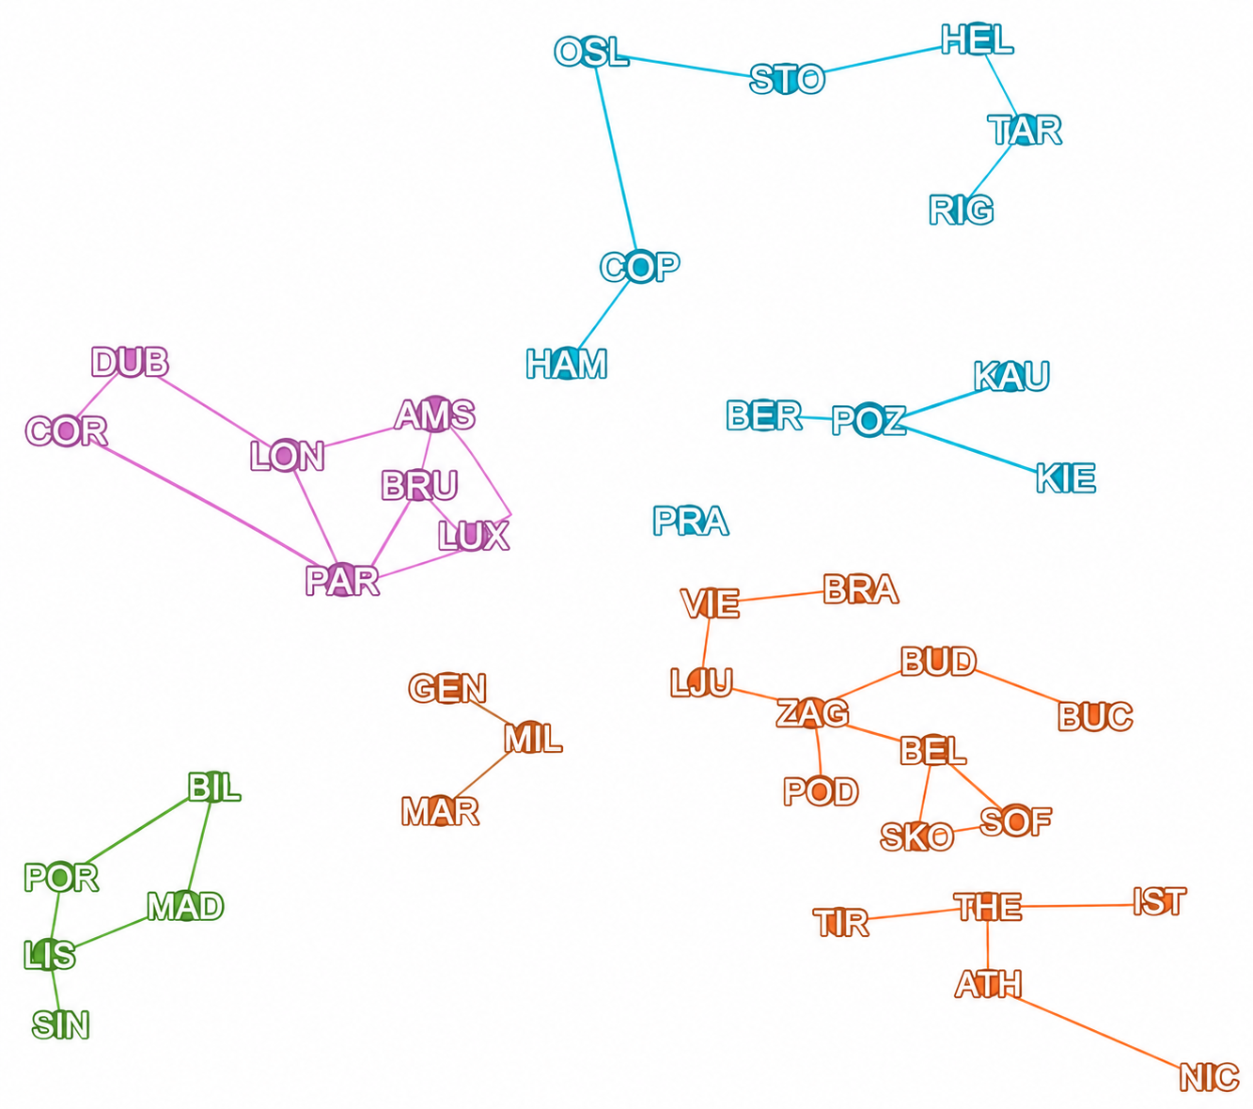
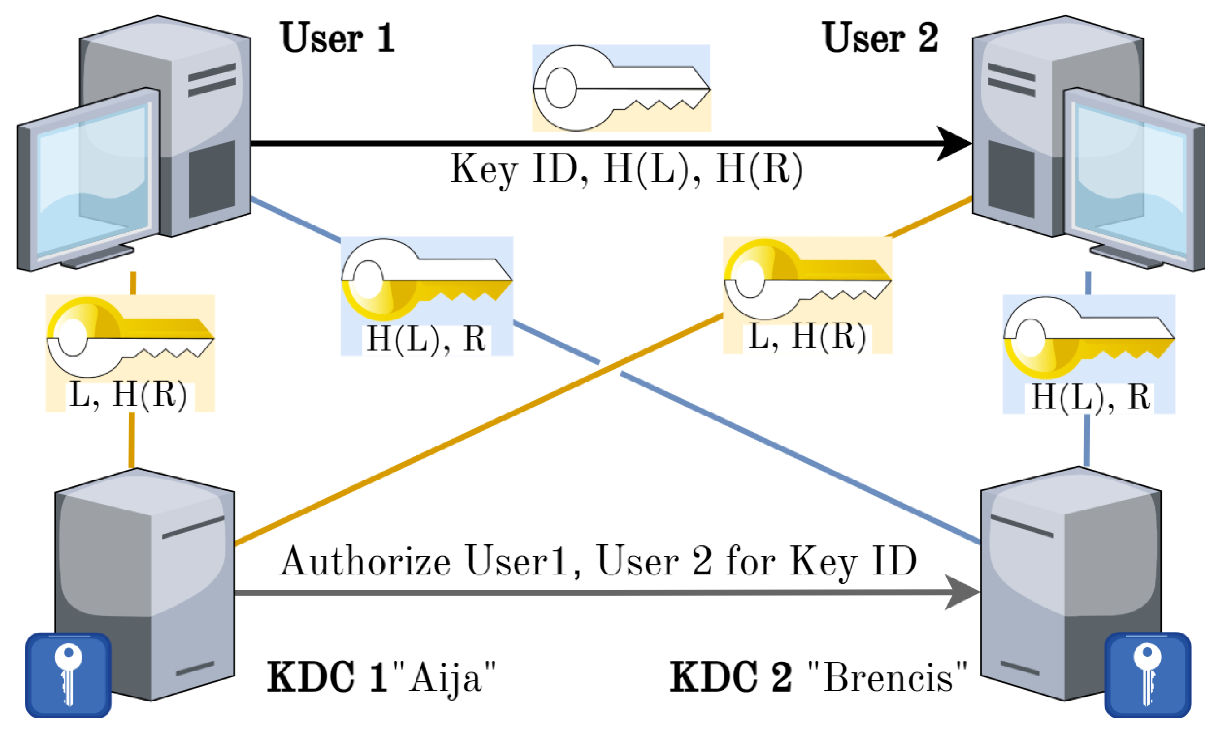
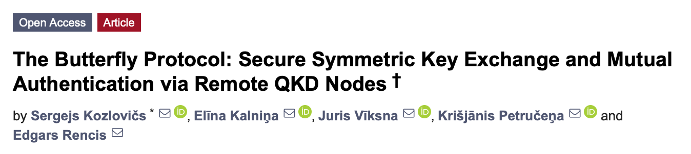
Building gradually
Missing links can be temporarily replaced by our Butterfly Protocol
Notes:
The vision is not “pure or nothing.” We do not need to wait for a perfect final network. We can build it gradually. It combines information-theoretic methods where possible with computational protections in other places. Then improve security as the network matures.

Slide 8
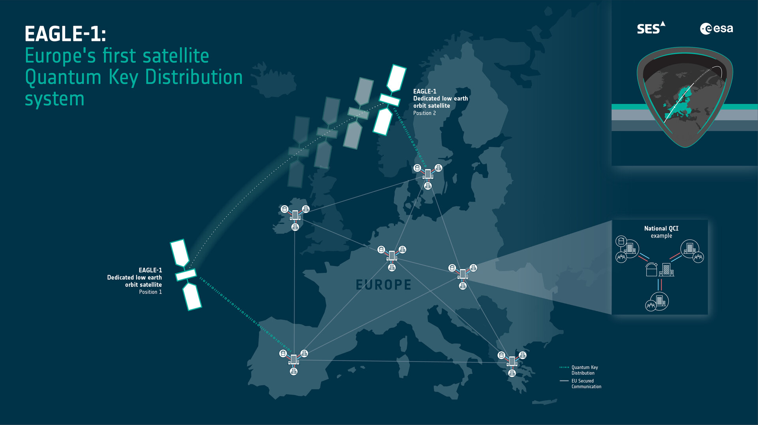

Ground stations needed!
Very expensive
Hight operational costs
Where to place?
Notes:
When building gradually, we should look also to satellite communication because there are terrestrial QKD limitations (e.g., the states separated by the Baltic sea). Ground stations – very expensive + operational costs + where to place them.
Eagle-1 satellite will be launched this year. Thus, GEANT NRENs may consider to buy ground stations. But they are very expensive, have high operational costs, and raise practical questions such as where they should be placed. So if we think about integrating terrestrial and satellite quantum networking, infrastructure planning becomes a major strategic question.

Slide 9
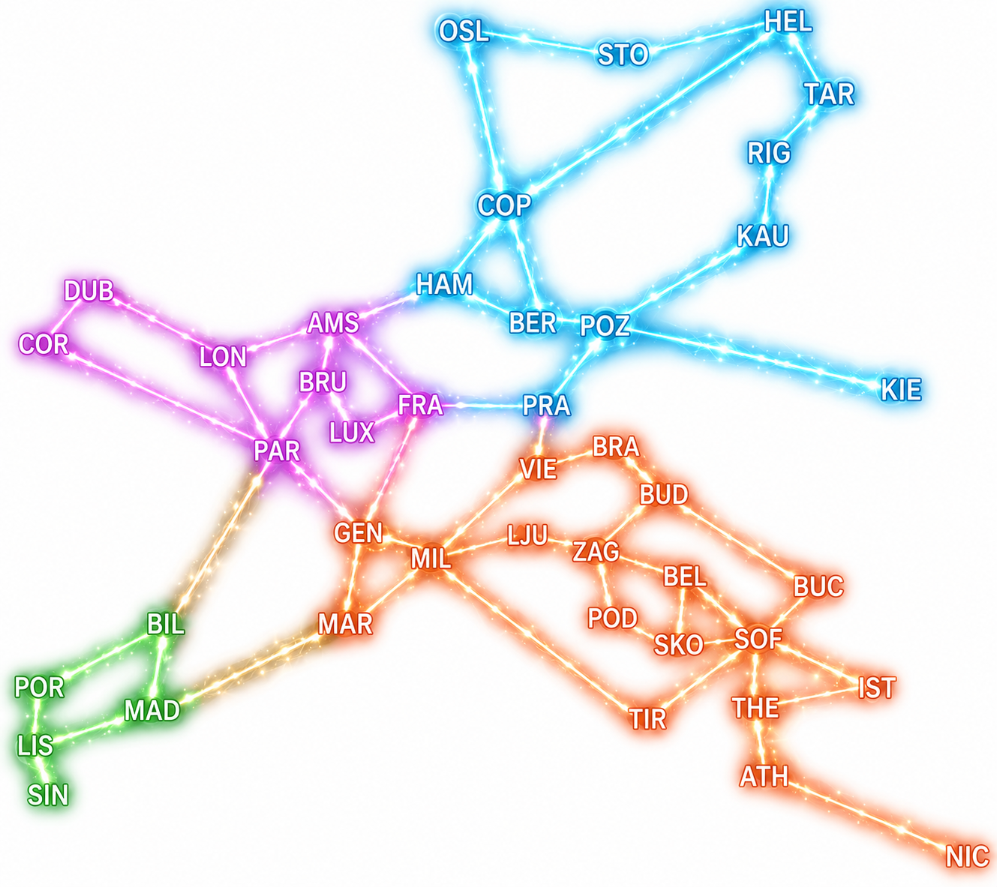
GÉANT QKD → GÉANT True Quantum Internet (“travelling qubits”)
Notes:
We have all the knowledge and tools to build QKD internet (only money and time needed), There is an even bigger vision beyond QKD. A future with travelling qubits – the real quantum internet. We cannot copy qubits but we can teleport.

Slide 10
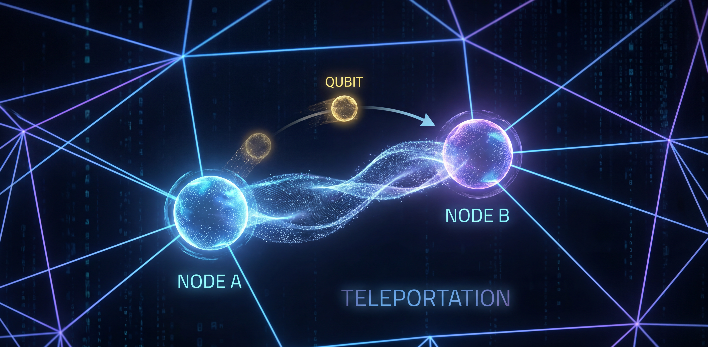

Quantum teleportation
Research by
Notes:
And that is what QIA does.
The idea is to be able to generate entangled qubit pairs between 2 distant nodes.
Entanglement is a very precious resource. If we have multiple pairs of entangled qubits, then it doesn’t matter whether the underlying network was secure – we can obtain ITS security in any case. Besides, entanglement allows us to teleport qubits and even create a hyper quantum computer connecting multiple distant quantum computers.
But that is a bright future. And my point is that we should start now!

Slide 11
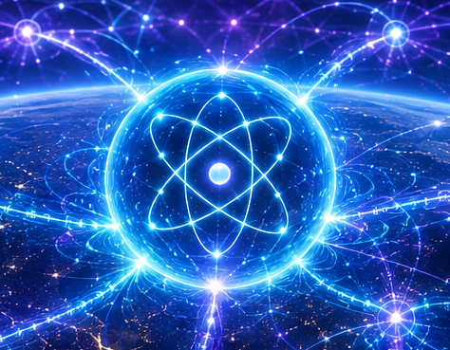
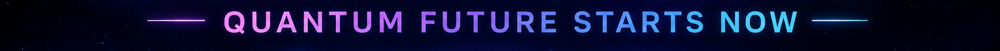
Thank you!
Kiitos!
sergejs.kozlovics@lumii.lv
Towards a Quantum GÉANT Network

