Slide 1
On borrowed second
GÉANT and Europe’s path to resilient Position Navigation and Time (PNT)
Domenico Vicinanza
Lightning Talk
10 June 2026

Slide 2
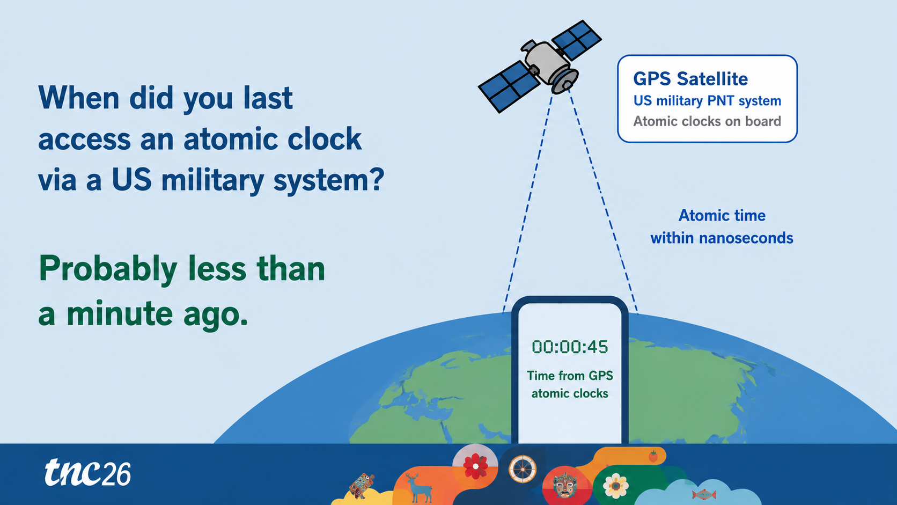

Slide 3
Why GNSS alone is not enough
GPS/GNSS
single external dependency
Four vulnerabilities make satellite navigation and timing a resilience issue.
1
Jamming
2
Spoofing
3
Physical limits
4
Geopolitical risk
!
GNSS outages have disrupted aviation, shipping and financial settlement in recent years across Europe.
For critical infrastructure, this creates a single point of failure.
This is why we need alternative PNT
Notes:
Low-cost devices can black out GNSS across a wide area.
Fake signals can manipulate position or time invisibly.
Tunnels, mines, urban canyons and subsea environments can mean no signal.

Slide 4
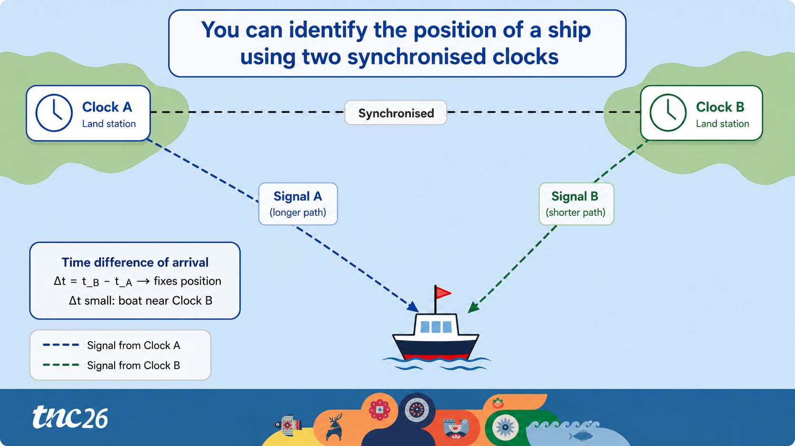

Slide 5
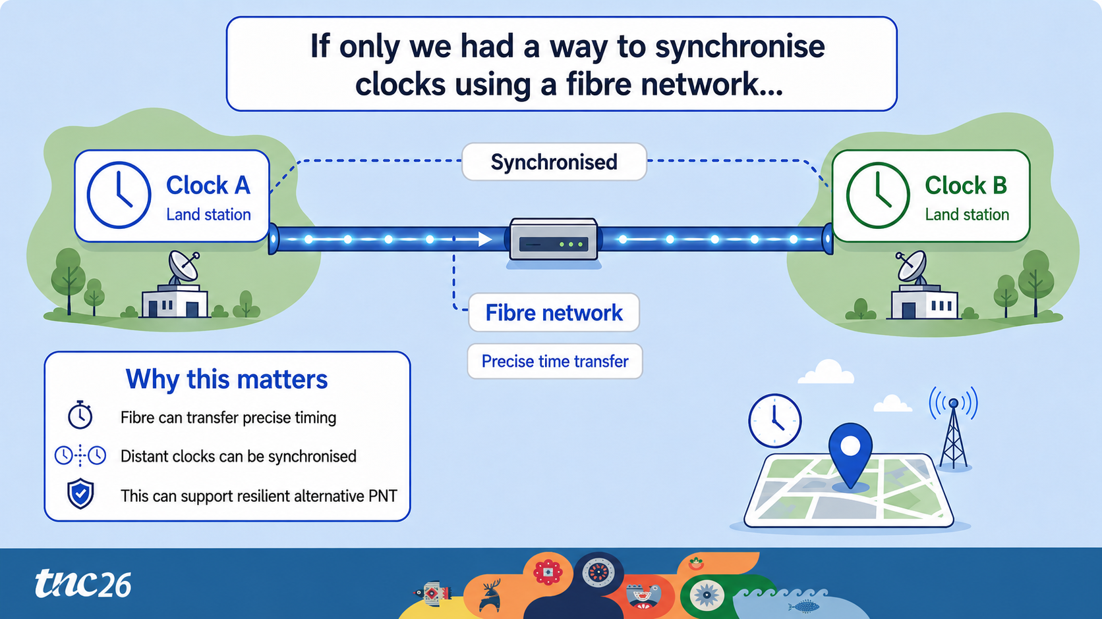


Slide 6
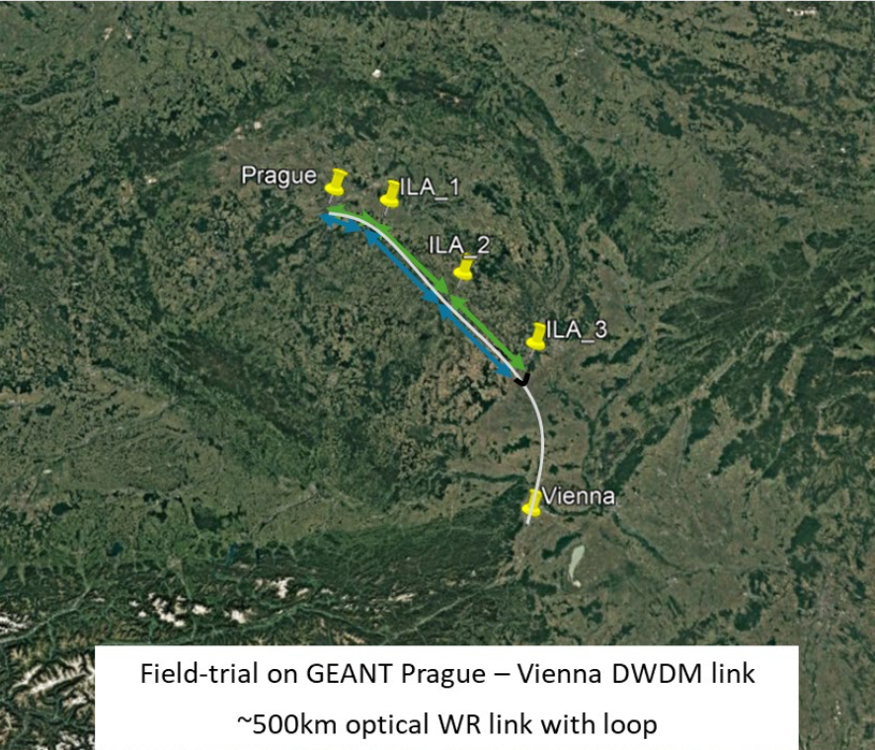
White Rabbit
Sub-nanosecond timing over fibre
White Rabbit over fibre: timing without satellites
1
Developed at CERN
2
Open standard
3
<1 ns accuracy
4
EC recognised
A fibre-based complement to GNSS for resilient timing and positioning services
Notes:
Created for the Large Hadron Collider to synchronise thousands of devices across a 27 km ring.
IEEE 1588 Precision Time Protocol extension, with open hardware and software.
Sub-nanosecond synchronisation over hundreds of kilometres of optical fibre.
Identified by the European Commission as a key Alternative PNT enabler.

Slide 7






Everything depends on time
Modern society relies on nanosecond-level synchronisation delivered by atomic clocks in orbit
Mobile &
Optical Networks
Power
Grids
Financial
Markets
Requires sub-microsecond accuracy
Requires sub-microsecond accuracy
Requires sub-microsecond accuracy
Scientific
Facilities
Transport &
Emergency Svcs
Telecom
Synchronisation
Requires sub-microsecond accuracy
Requires sub-microsecond accuracy
Requires sub-microsecond accuracy
All of this is delivered by
atomic clocks aboard GPS & Galileo satellites

Slide 8
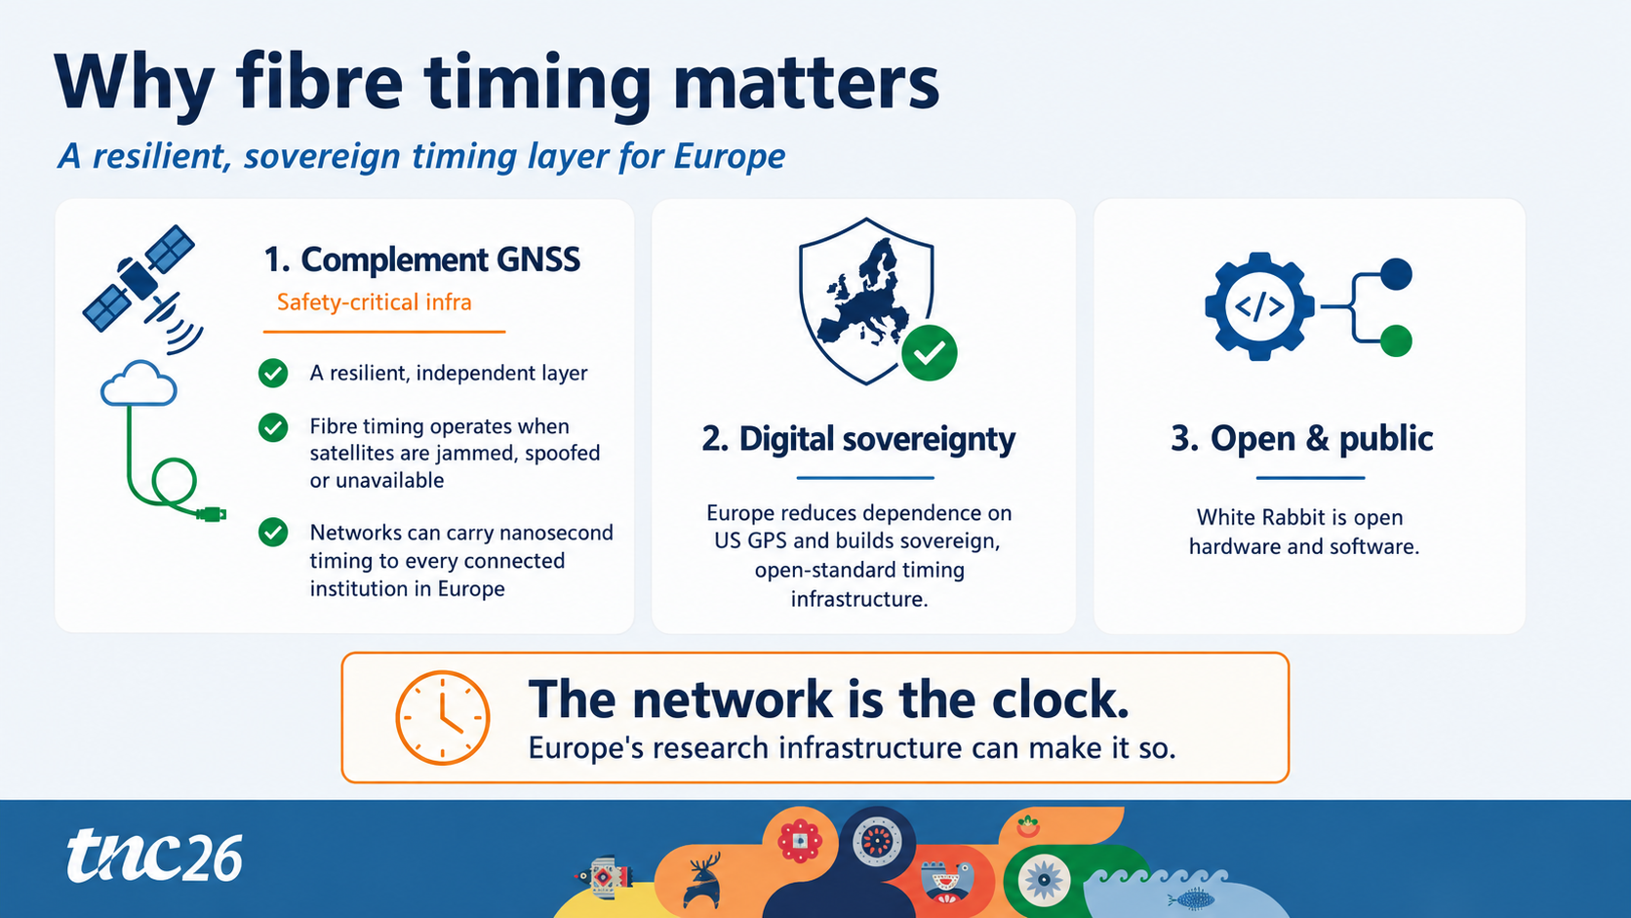

Slide 9
Thank you
Any questions?
domenico.vicinanza@geant.org

