Slide 1
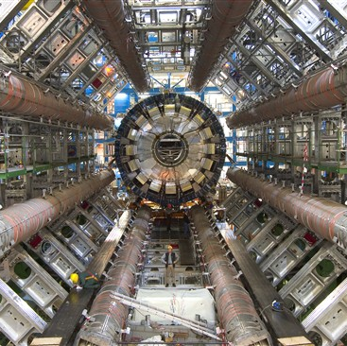
The CERN experiments’ journey towards
IPv6-only
Tim Chown (Jisc)
tim.chown@jisc.ac.uk
TNC 2026, Helsinki, 10 Jun 2026
With credit to everyone in the HEPiX
IPv6 WG and those at all the WLCG
sites who made IPv6 happen
The ATLAS calorimeter © 2005-2024 CERN (License: CC-BY-4.0)

Slide 2


Milestones on the journey to IPv6
Are we there yet?
1995 – IETF RFC1883 – the first core IPv6 standardisation
2004 – Many NRENs deployed IPv6 on their backbones during the 6NET project
2011 – Top-level RIRs declare unused IPv4 address space exhausted
2012 – World IPv6 Launch on June 6
2017 – IETF RFC8200 published as a full Internet Standard
  Good news!
  IPv6 has run on NREN backbones for over 20 years!

Slide 3
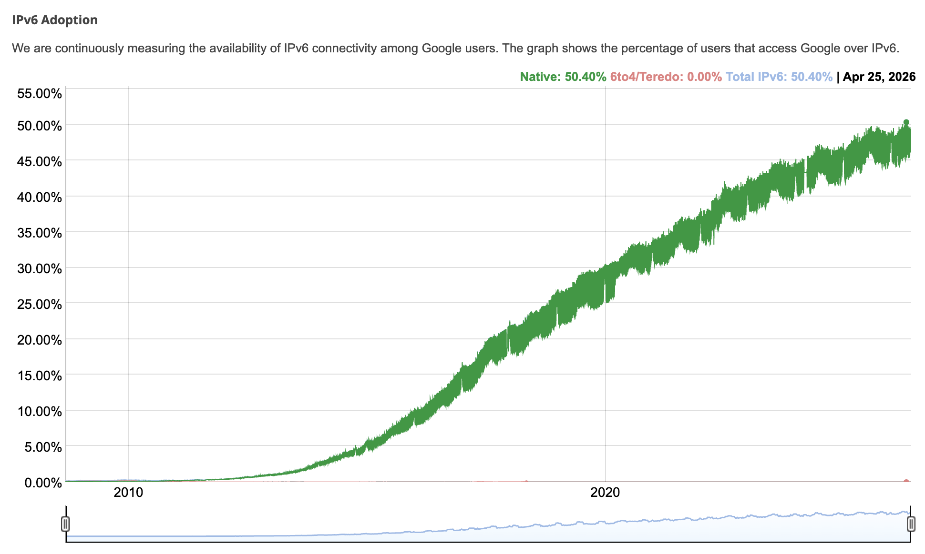

And IPv6 has just become the dominant user IP protocol
That’s 50.4%
worldwide as
of April 2026
https://www.google.com/intl/en/ipv6/statistics.html

Slide 4
IPv6 is present and enabled in all modern operating systems, devices, routers, etc
So, what’s the problem?

Slide 5
R&E deployment is slow
- less than 10%

Slide 6
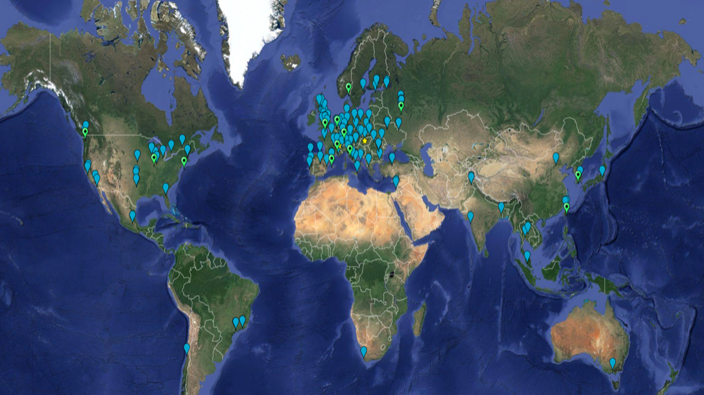
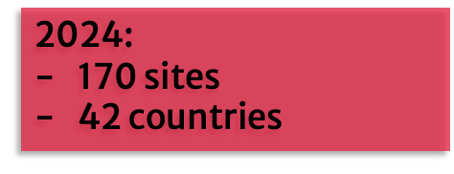
But there is one excellent exception to the R&E IPv6 trend!

Slide 7
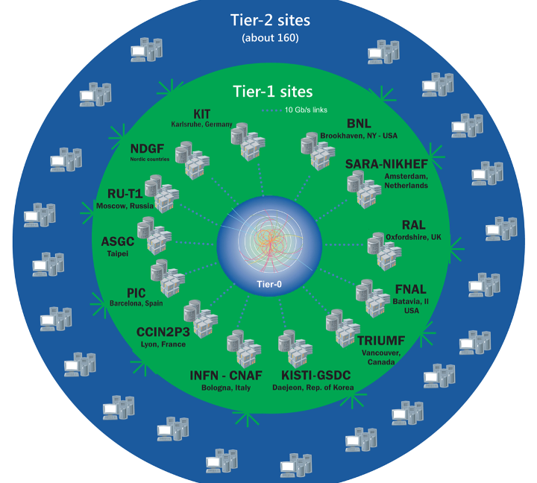
WLCG infrastructure
Many experiments: ATLAS, Alice, LHCb, CMS, …
Mission to store, distribute and analyse data
Sites in three tiers:
  Tier-0: CERN, home of the LHC
  Tier-1s: 17 national laboratories
  Tier-2s: 160 university physics departments
Networking:
  LHCOPN (private optical, Tier-0 to Tier-1s)
  LHCONE (L3VPN/VRF, between any Tiers)
  General NREN R&E networks (catchall)

Slide 8
IPv6 deployment – driven by the HEPiX IPv6 WG
Phase 1: to consider whether and how IPv6 should be deployed in HEP, especially for WLCG
Readiness and gap analysis of software and systems – started in 2011, completed
Phase 2: dual-stack deployment – enabling and preferring IPv6
Dual-stack at data servers – started 2018, now complete
Dual-stack worker nodes – ticket campaign started Dec 2023 – 75% complete, 15% in progress
Phase 3: move towards a single protocol – simpler operation, simpler security, no NAT, Scitags, …
Decommission IPv4 on WANs and migrate to IPv6 only – ongoing

Slide 9
So where are we now with use of IPv6 for WLCG data transfers?
We can see from a variety of sources…

Slide 10
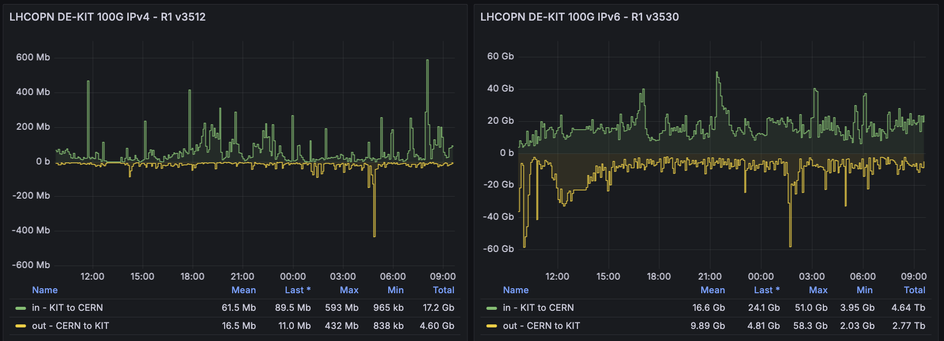
Traffic on a given OPN link – KIT (DE) – over 99.5% IPv6
Total IPv4 in 24 hours = 17.2Gb in, 4.6Gb out
Total IPv6 in 24 hours = 4.64Tb in, 2.77Tb out

Slide 11
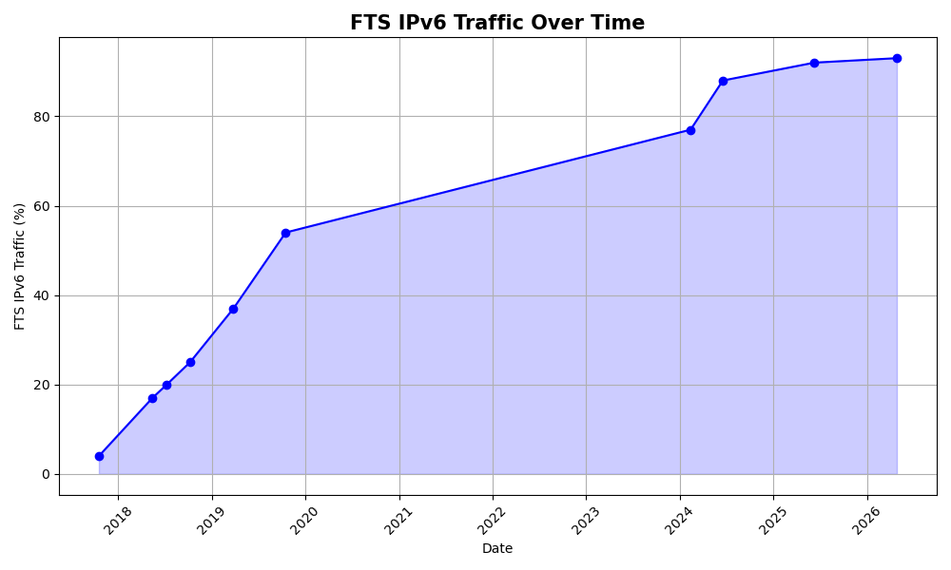
FTS logs – includes non-WLCG transfers – over 93% IPv6
FTS is the CERN
File Transfer Service
These plots are for
ALL FTS transfers
Most transfers
use a “stack” of
Rucio, FTS and
an underlying tool
such as XRootD

Slide 12
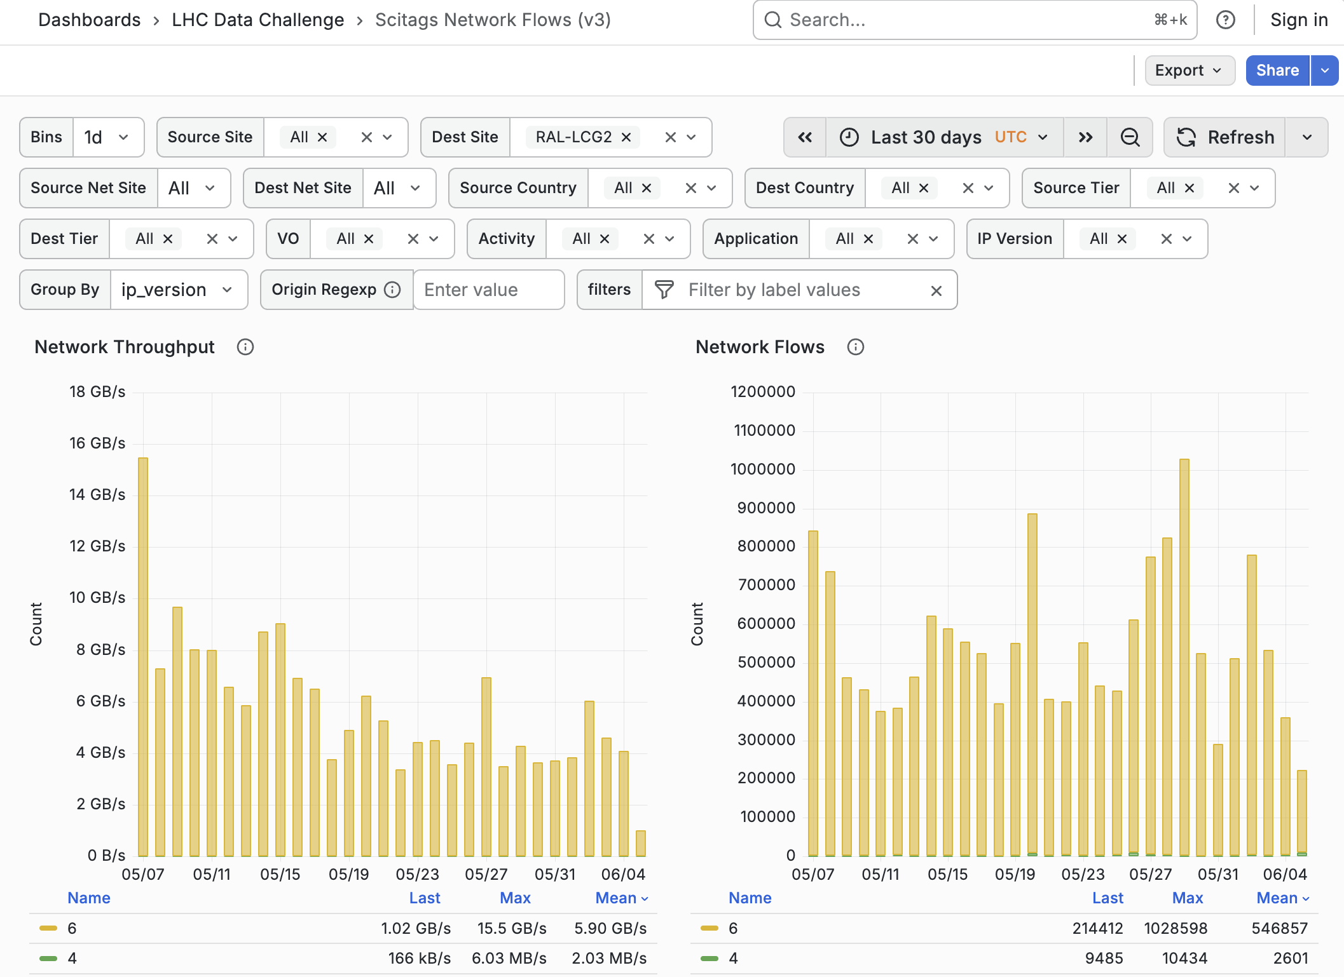
Scitags plots – flows into RAL(UK) – over 99.9% IPv6
Scitags supports the
identification of traffic by
science domain and activity
https://scitags.org/
It includes per-packet
marking for IPv6 traffic
= INNOVATION!
Mean volumes:
IPv6: 5.90GB/s in
IPv4: 2.03MB/s in

Slide 13
So, everything’s looking good?
Yes, but if we don’t need IPv4 we should now be turning it off wherever we can

Slide 14
Phase 1: Removing IPv4 on CERN–Tier-1 LHCOPN links
CN-IHEP
AS3460
█
KR-KISTI
AS 17579
█
RRC-JINR
AS 2875
█
PL-NCBJ
AS 198743
█
RS-SCC-T1
AS
█
RO-UPB
AS2614
█
ES-PIC
AS 43115
█ █ █
CA-TRIUMF
AS 36391
█
ES-PIC
AS43115
█ █ █
CH-CERN
AS 513
█ █ █ █
US-BNL
AS 43
█
CH-CERN
AS 513
█ █ █ █
DE-KIT
AS 58069
█ █ █ █
DE-KIT
AS58069
█ █ █ █
FR-CCIN2P3
AS 789
█ █ █ █
US-FNAL
AS 3152
█
FR-CCIN2P3
AS789
█ █ █ █
US-FNAL-CMS
AS3152
█
NL-T1
SARA AS 1103-1162
NIKHEF AS 1103-1104
█ █ █
NDGF
Scandinavia AS 39590
█ █
NDGF
CH-LHEP AS 216467
█
UK-RAL
AS 43475
█ █ █ █
IT-INFN-CNAF
AS 137-2038
█ █ █ █
Line speeds:
10Gbps
Experiments:
█ = Alice █ = Atlas
█ = CMS █ = LHCb
Last update:
- 20260528
- edoardo.martelli@cern.ch
20Gbps
5 of 17 Tier-1 links now IPv6-only: FNAL, BNL, NCBJ, UPB, PIC
10Gbps
40Gbps
100Gbps
200Gbps
400Gbps
800Gbps
IPv4

Slide 15
The IPv6-only schedule
All Tier-1 OPN links due to be IPv6-only by the end of 2026,
making them IPv6-only for the next Data Challenge in Feb 2026
- preparing for the High Luminosity LHC Phase in 2030
All LHCONE links due to be IPv6-only by the end of 2028,
making them ready for the bigger Data Challenge in 2029

Slide 16
In closing - our key messages to you…
IPv6 is mature in R&E networks
Nearly 100% of the WLCG’s WAN transfers are IPv6
Some WAN links already IPv6-only
Dual-stack is not the end game
If you’re enabling IPv6, also plan where and when you can turn off IPv4
NRENs should encourage and support existing and especially new projects to use IPv6 from day 1

Slide 17
Thank you!
With credit to the HEPiX IPv6 WG including but not limited to:
G Attebury (UNL), M Babik (CERN), M Bly (RAL), N Buraglio (ESnet), T Chown (Jisc),
D Christidis (CERN), J Chudoba (FZU Prague), P Demar (FNAL), A Fernandez Casani (IFIC/LHCb),
J Flix (PIC), A Forti (GridPP/ATLAS), C Grigoras (CERN/ALICE), B Hoeft (KIT), H Ito (BNL),
D P Kelsey (RAL), E Martelli (CERN), S McKee (U Michigan), C Misa Moreira (CERN),
R Nandakumar (RAL), K Ohrenberg (DESY), F Prelz (INFN), D Rand (Imperial),
A Sciabà (CERN/CMS), Z Shan (IHEP), T Skirvin (FNAL), M Wadenstein (NDGF), C Walker (Jisc) and many others!

