Slide 1
Reframing GÉANT
- a European Commons?
Tanja Maier (GÉANT)
Helsinki, Finland
11 June 2026

Slide 2
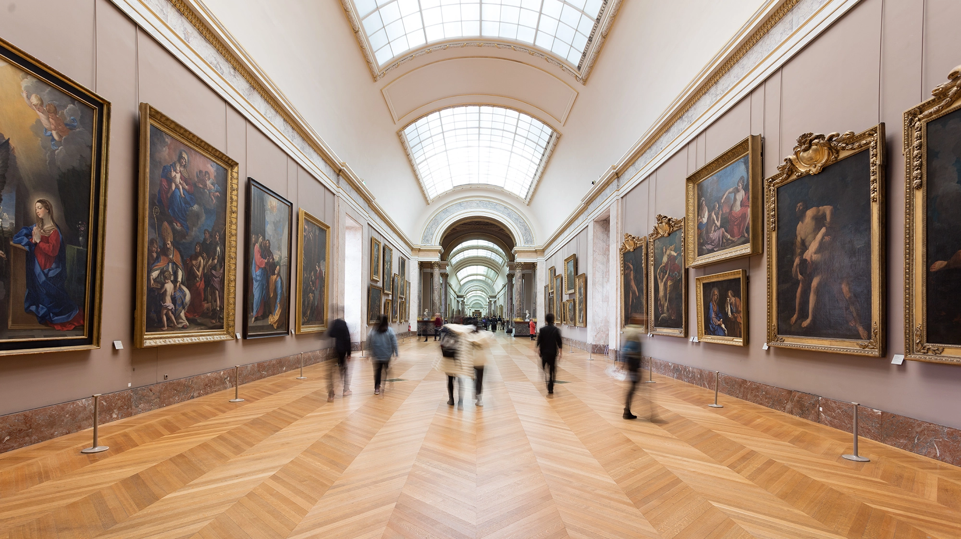
Grand Gallery Louvre, www.louvre.fr

Slide 3

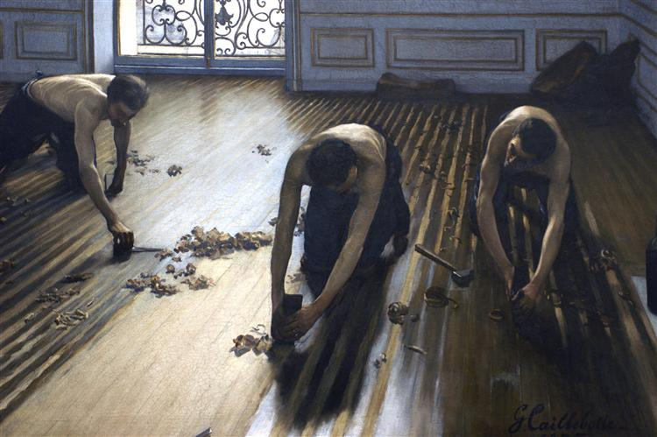

Slide 4


Slide 5
Security Services
International projects
We are a specialised Internet Service Provider.
Time & Frequency
Identity &
Access
Quantum Experiments
Fibre-sensing

Slide 6
International projects
Security Services
We are a specialised Internet Service Provider.
Time & Frequency
Identity &
Access
Quantum Experiments
Fibre-sensing

Slide 7
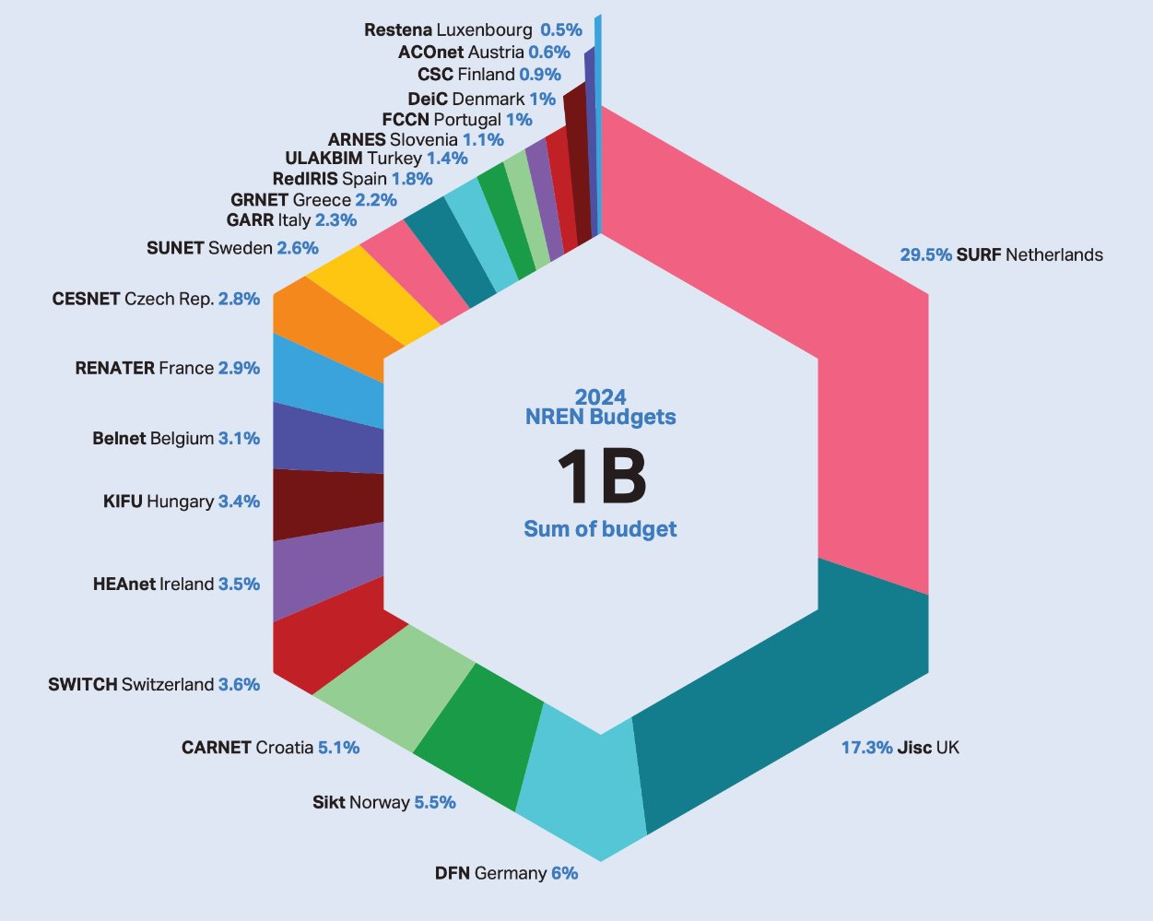
EU Project Funding
We are grant recipients of EU funding
Membership and Subscription

Slide 8
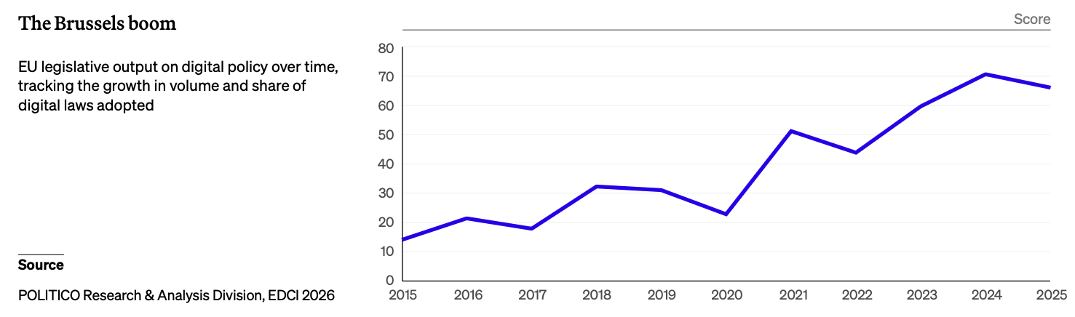
The Brussels boom
EU legislative output on digital policy over time, tackling the growth in volume and share of digital laws adopted
Source: POLITICO Research & Analysis Division, EDCI 2026

Slide 9

- a European Commons?
New logo

Slide 10





Slide 11





Slide 12
European Research and Education Commons
Pan-European
e-Infrastructure
Pan-European Network
Network
Now

Slide 13
Grand Gallery Louvre, www.louvre.fr

