Slide 1
NRENs
The Infrastructure You Use but Can’t Name
Grace Gausi
Helsinki, Finland
11th June 2026

Slide 2
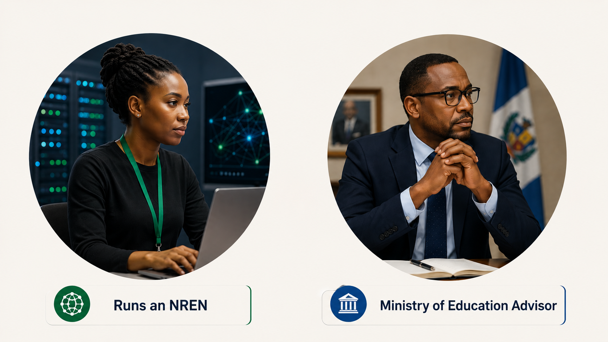
Two Sides of the Same Ecosystem
Notes:
I want to tell you about two people.
One runs an NREN. She has spent years building and maintaining infrastructure that connects universities, supports researchers, and enables collaboration. She knows the network inside out.
The other is a senior advisor in the Ministry of Education. He helps shape digital strategy and influences investment decisions in higher education and research.

Slide 3
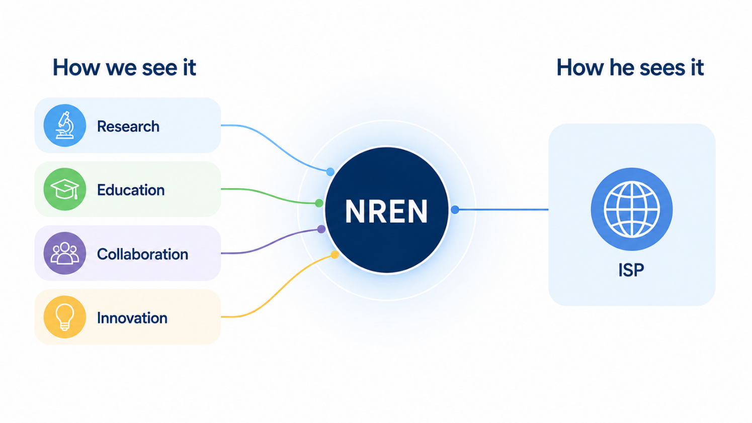
The Wrong Mental Model
Notes:
He's heard of the NREN.
In fact, he can tell you what the acronym stands for.
But if you asked him what makes an NREN different from a commercial ISP, his answer might be surprisingly simple:
"Isn't it just an internet provider for universities?“
An NREN enables research, education, collaboration, and innovation.
Yet outside rooms like this one, that distinction is often poorly understood.

Slide 4
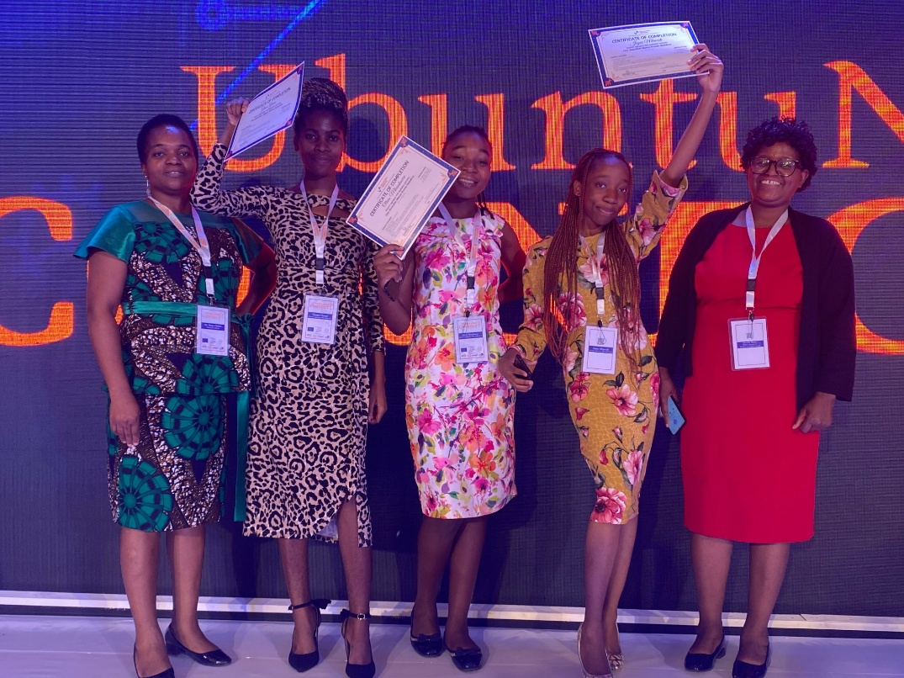
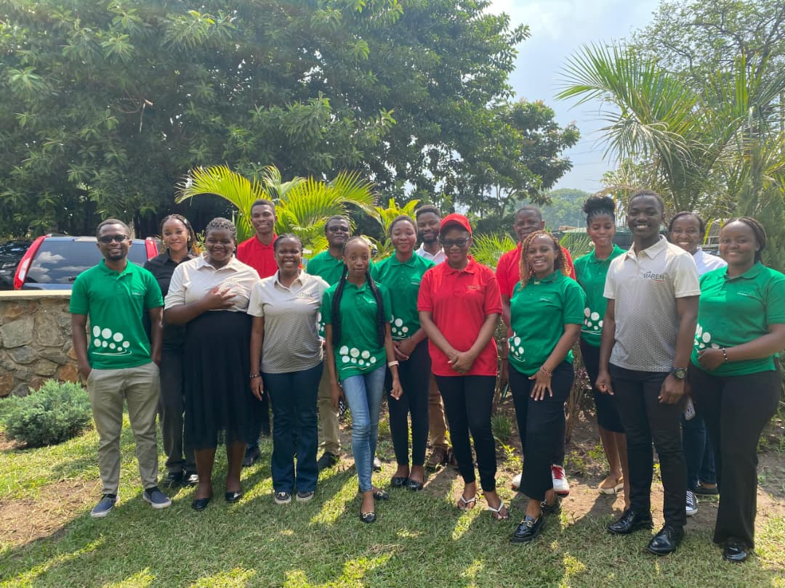
My First Introduction to NRENs – UbuntuConnect 23
Notes:
My introduction to the word "NREN" was at UbuntuConnect 23. I was a third-year student attending a hackathon.
I had already been using eduroam for three years, but I had no idea who provided it.
And when I first encountered the concept of an NREN, I understood it as little more than an ISP for universities.
It was only after an internship with the Malawi Research and Education Network that I began to understand what an NREN actually is.

Slide 5
Beyond Awareness
This is not really a marketing conversation.
It's about cultivating belonging.
Helping stakeholders understand us, see where they belong, and participate in our future
Notes:
It's about whether there is a shared understanding of who we are and the role we play in the research and education ecosystem.
And right now, that understanding lives mostly inside rooms like this one.
We've been having the identity conversation largely with ourselves.
But networks survive when their value is collectively recognized.

Slide 6
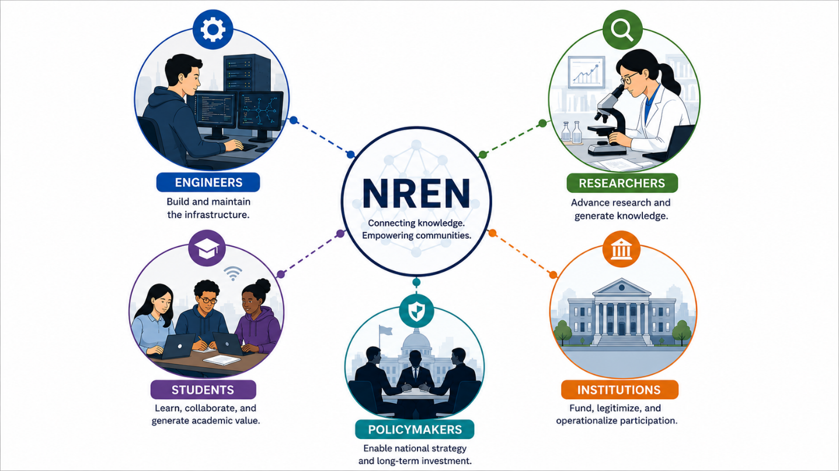
A Network Survives When Its Value Is Collectively Recognized
Notes:
Not just by the people who build them.
By the people whose decisions shape their future.
And that's why I keep coming back to this:
Sustainability is not only a technical challenge.
We're good at the technical challenges.
The harder challenge is understanding and belonging.

Slide 7
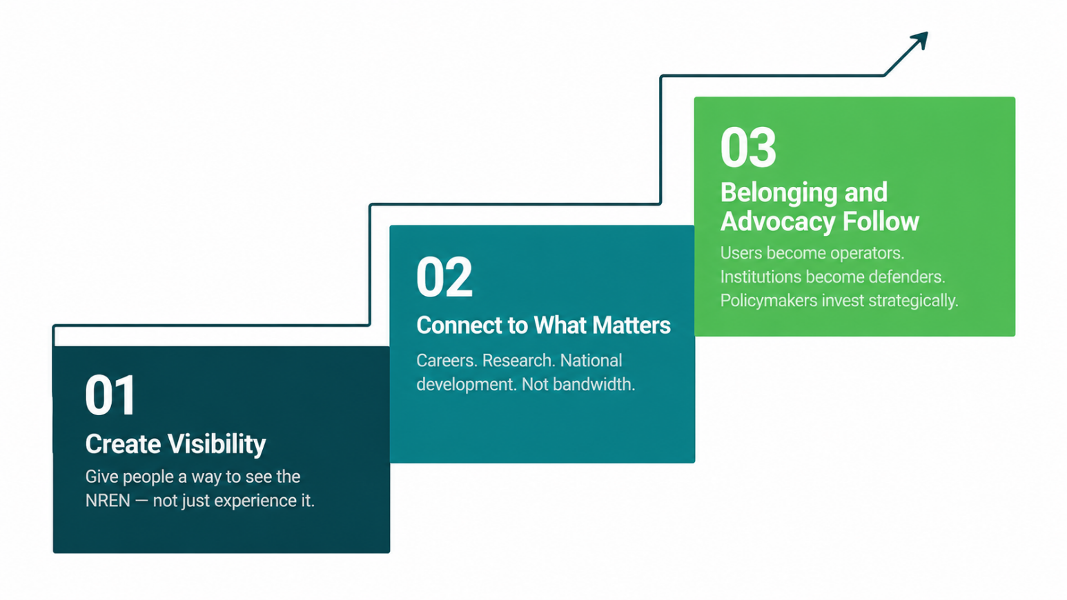
Belonging has to be engineered — just like the network.
Notes:
Because people rarely advocate for something they don't understand.
And they rarely feel connected to something they cannot see themselves in.
That's especially important for NRENs because most of us operate on a not-for-profit basis.
We need stakeholders to see themselves as part of the ecosystem, not simply consumers of its services.

Slide 8
The Next Challenge
If understanding can be built for a student, it can be built for a university leader, a policymaker, a funding agency, a researcher.
Let's keep building the networks.
But let's be just as intentional about building the understanding and belonging that sustains them
Notes:
My own understanding was built through a hackathon and an internship—intentional opportunities that connected me to an ecosystem I had already been benefiting from for years.
And I don't think my story is unique.
If understanding can be built for a student, it can be built for a university leader, a policymaker, a funding agency, or a researcher.
We have built infrastructure worth protecting.
The next challenge is making sure the people who depend on it, govern it, fund it, and benefit from it understand why it matters.
Because sustainable networks are not sustained by technology alone.
They are sustained by people who recognize their value, feel connected to their mission, and choose to support them.
So let's keep building the networks.
But let's be just as intentional about building the understanding and belonging that keep them alive.

Slide 9
Thank you
Any questions?
g.gausi@maren.ac.mw

