Slide 1
Top security risk? Framing people as the weakest link
Cornelia Puhze, Human Centred Security Expert
tnc26, June 2026

Slide 2
Verizon Data Breach Investigations Reports
74%
60%
62%
82%
85%
68%
Notes:
for as long as the DBIR has measured it, the human element has been involved in the majority of breaches between roughly 60 and 85 percent
The default read: users are the problem, must know more, behave better, be punished

Slide 3

Beispielfolie «Titel und Bild»
Notes:
Weakest-link framing is problematic and harmful
Shifts responsibility, undermines trust
Worst of all: turns victims into perpetrators

Slide 4



Notes:
Individualism: blames individual weakness, not the system, chain concept is wrong (safety science) Blamed not supported, people go quiet, stop reporting, hide mistakes
Othering: people as the enemy, "insider threat" level with criminals
Individualism, fatalism, othering: frames that block change.

Slide 5

Notes:
"We don't blame the bolt, we examine the design”
It shouldn't be possible for someone to click on a mouse to bring a system down. We need to build infrastructure that is more robust.
So stop saying "someone failed". Say: "the system was set up to make failure likely".

Slide 6
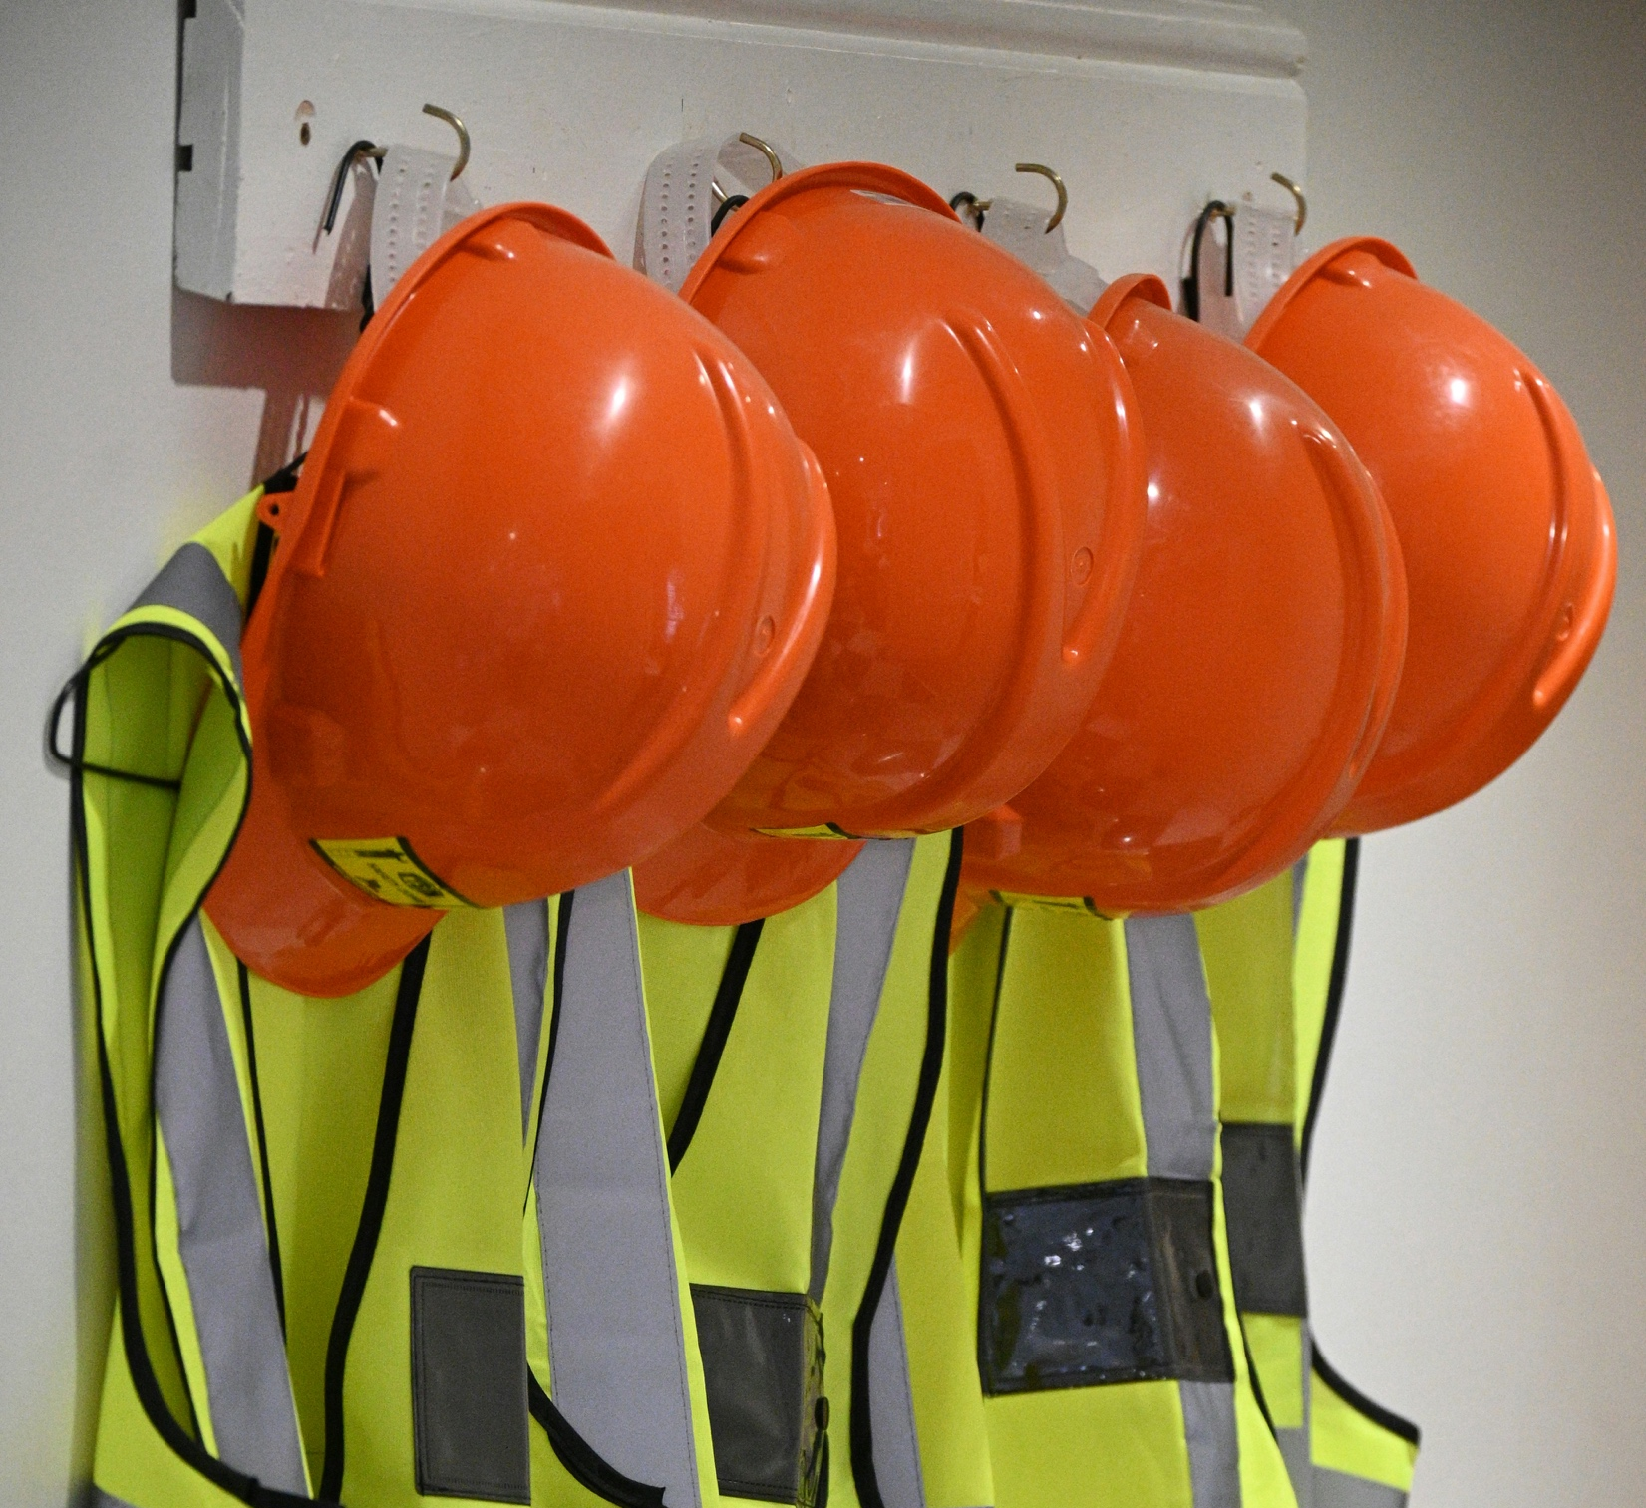
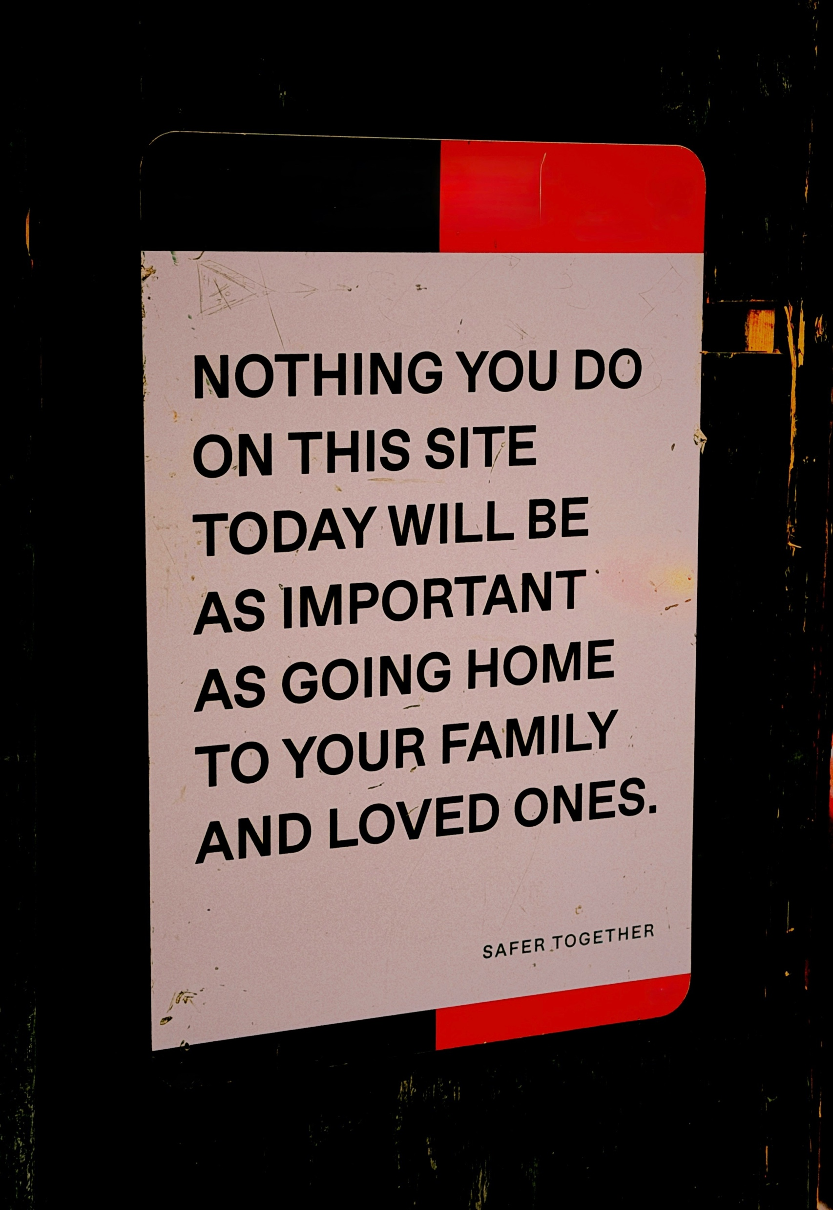
Notes:
Change is possible
Precedent: factory injuries, road deaths once blamed on individuals, then we redesigned (guards, seatbelts, junctions) and harm fell
Change conditions, not humans

Slide 7

Notes:
secure path = easy path, controls around targets
Organisation's job, not the individual's burden
Drop the phrase weakest link and"how do we stop people failing" but "how do we build security people can succeed in"

Slide 8

Switch
Human Centred Security
Competence Center
hucs@switch.ch
GÉANT Security Awareness Community
security.geant.org/awareness/
awareness@geant.org
GÉANT Digital Safety Fresco Workshop
Cornelia Puhze
Expert Human-Centred Security
Notes:
Be in touch!

