Slide 1

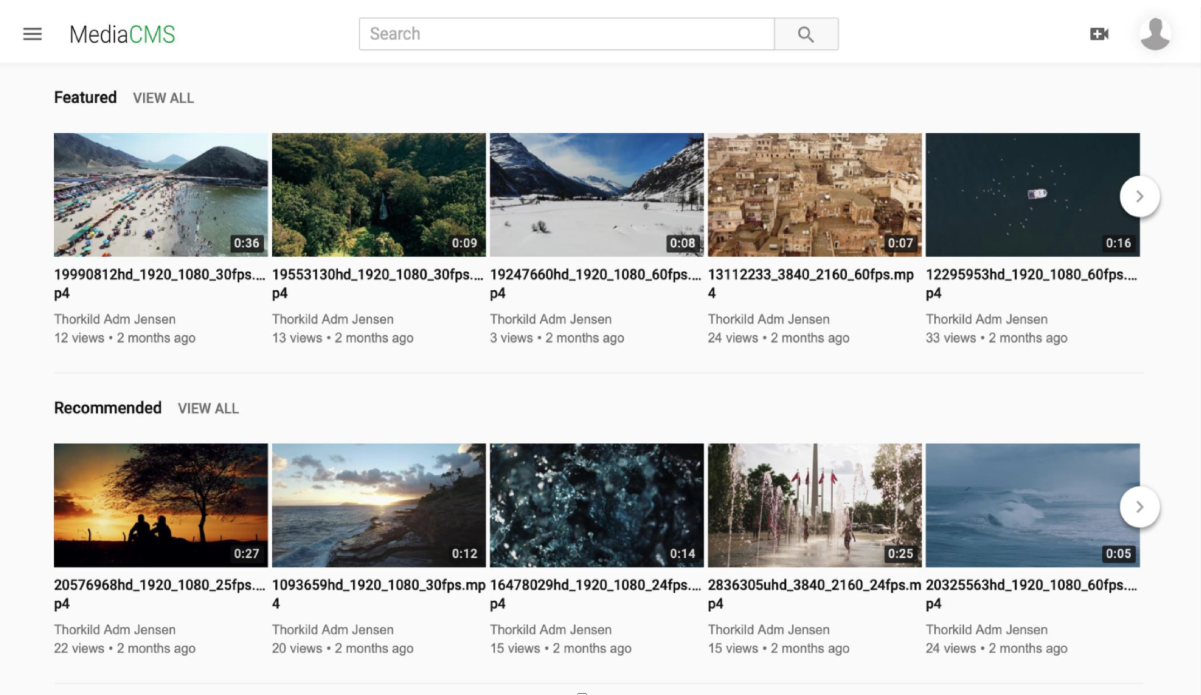
MediaCMS
New open source media management system for the educational sector
Thorkild Jensen, DeiC

Slide 2
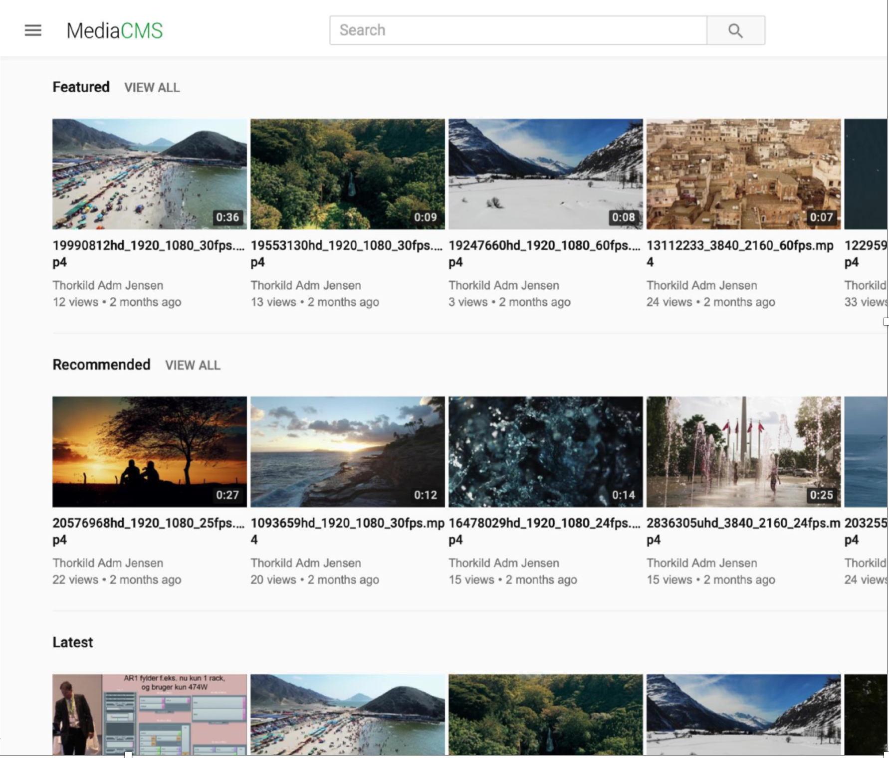
MediaCMS - Stand out…
After surveying open source systems, showcasing to institutions
MediaCMS has been approved at DeiC as a project in development
Present status:
  Features added to project
    Complete: SAML/SSO
    Complete: Media Editor
    Complete: Auto transcription/transl.
    Complete: Chapters
    Complete: Bulk actions & Sharing
    Complete: Moodle integration
    Pending: Generic LMS integrations
    Pending: Full migration service
So what can it offer?

Slide 3
MediaCMS - Offers…
Institutions:
  A modern media portal in clean and current design
  Gives access to media portal with strong ownership
  Reduced vendor dependency
  Supports a collaborative development approach
  Can easily be designed to own needs (open source)
  A feature can be ready the next month!

Slide 4
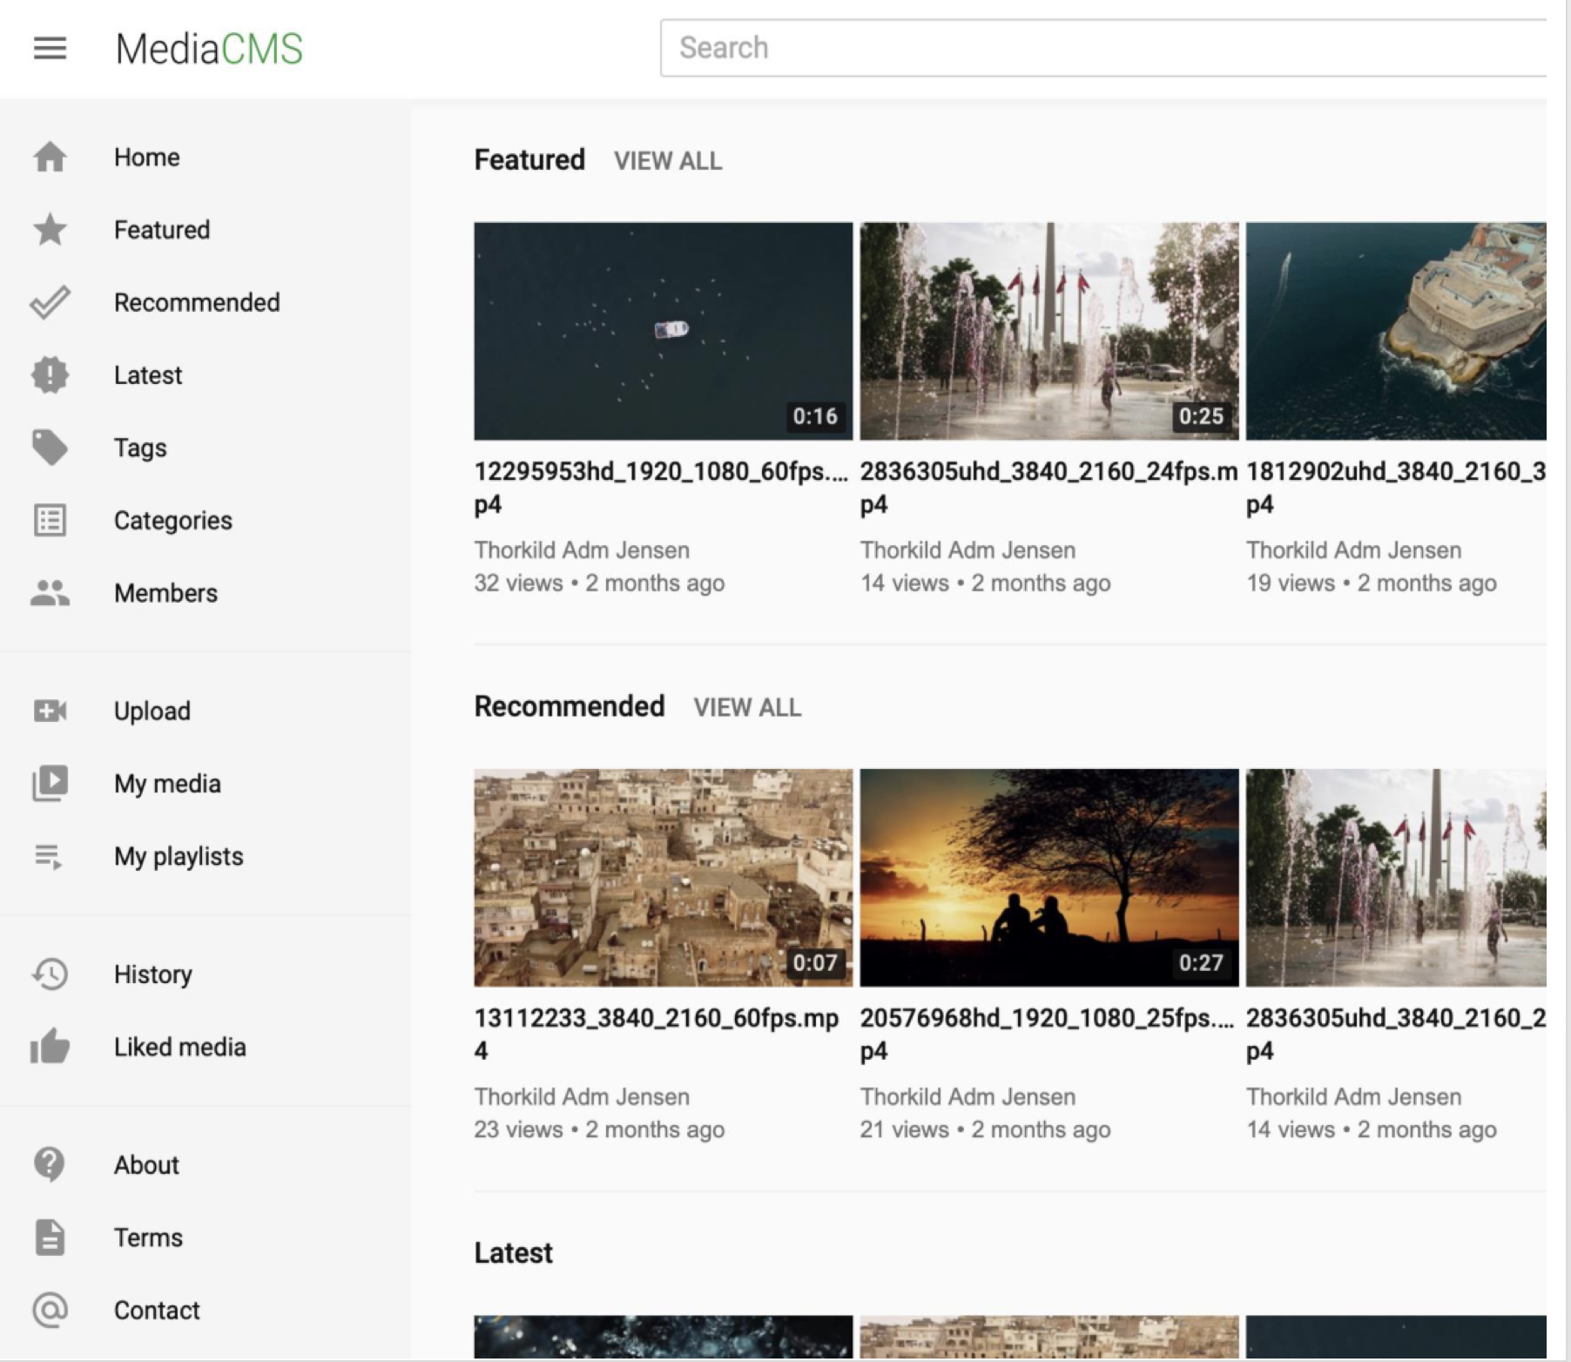
MediaCMS - Offers…
Users:
  Usability on a next level
    Have easy overview of navigation
    Feel at home from the first moment
    “Much better than other systems”
  Mobile: full support for all workflows
  Fast workflows
    Upload
      Single files or bulk
      Video, audio, pictures, pdf
    View without waiting time
    Edit media without waiting time
    Publish without waiting time
  Transcoding happening in the background

Slide 5
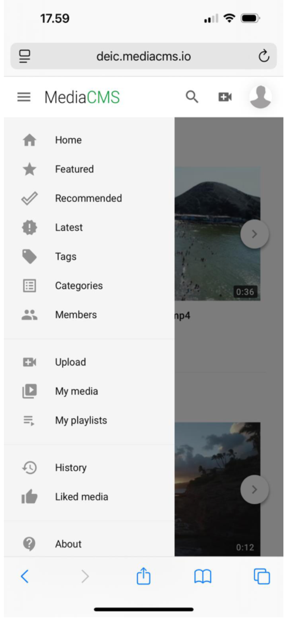
MediaCMS - Offers…
Users:
  Usability on a next level
    Have easy overview of navigation
    Feel at home at the first moment
    “Much better than other systems”
  Mobile: full support for all workflows
  Fast workflows
    Upload
      Single files or bulk
      Video, audio, pictures, pdf
    View without waiting time
    Edit media without waiting time
    Publish without waiting time
  Transcoding happening in the background

Slide 6
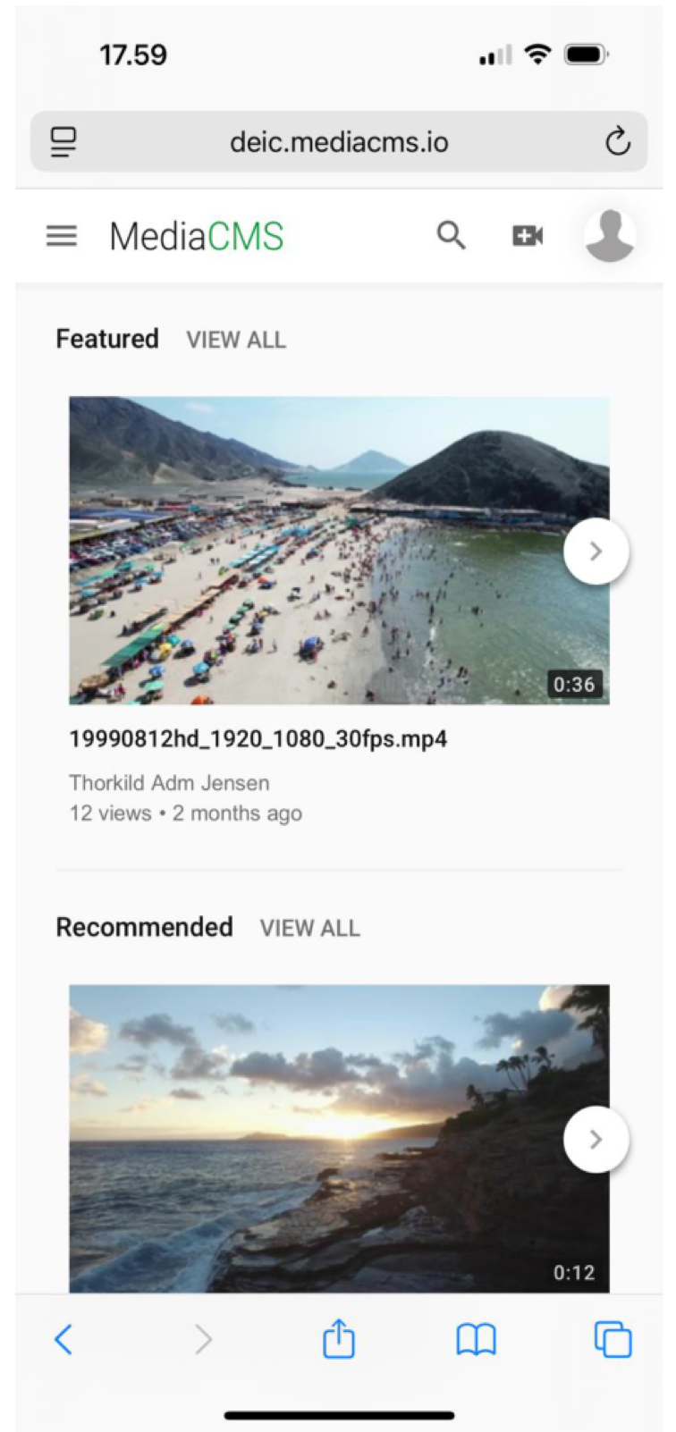
MediaCMS - Offers…
Users:
  Usability on a next level
    Have easy overview of navigation
    Feel at home at the first moment
    “Much better than other systems”
  Mobile: full support for all workflows
  Fast workflows
    Upload
      Single files or bulk
      Video, audio, pictures, pdf
    View without waiting time
    Edit media without waiting time
    Publish without waiting time
  Transcoding happening in the background

Slide 7
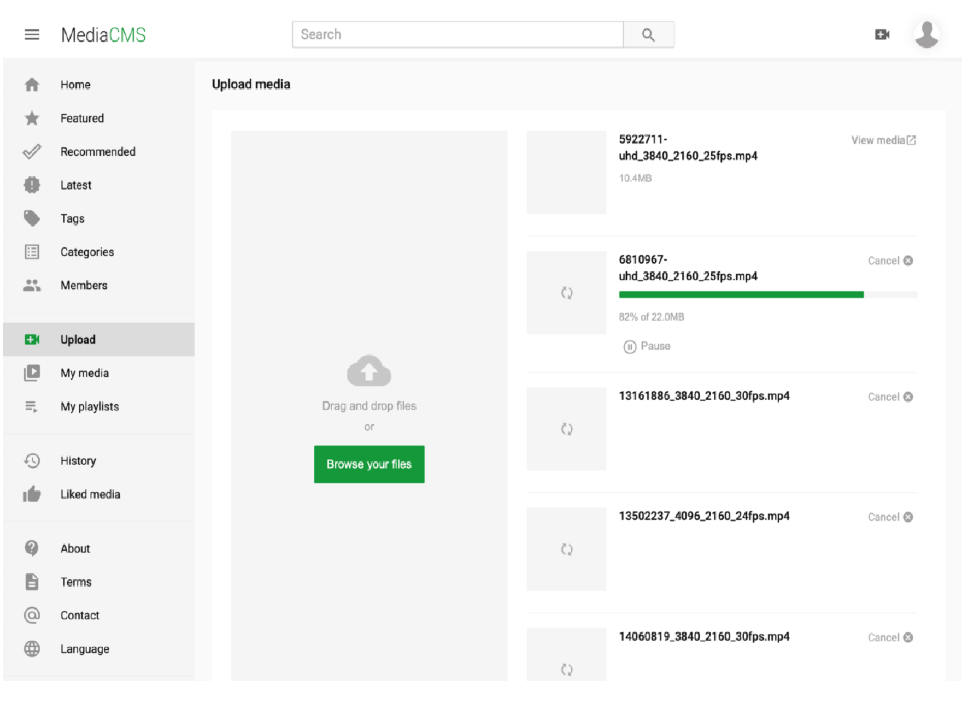
MediaCMS - Offers…
Users:
  Usability on a next level
    Have easy overview of navigation
    Feel at home at the first moment
    “Much better than other systems”
  Mobile: full support for all workflows
  Fast workflows
    Upload
      Single files or bulk
      Video, audio, pictures, pdf
    View without waiting time
    Edit media without waiting time
    Publish without waiting time
  Transcoding happening in the background

Slide 8
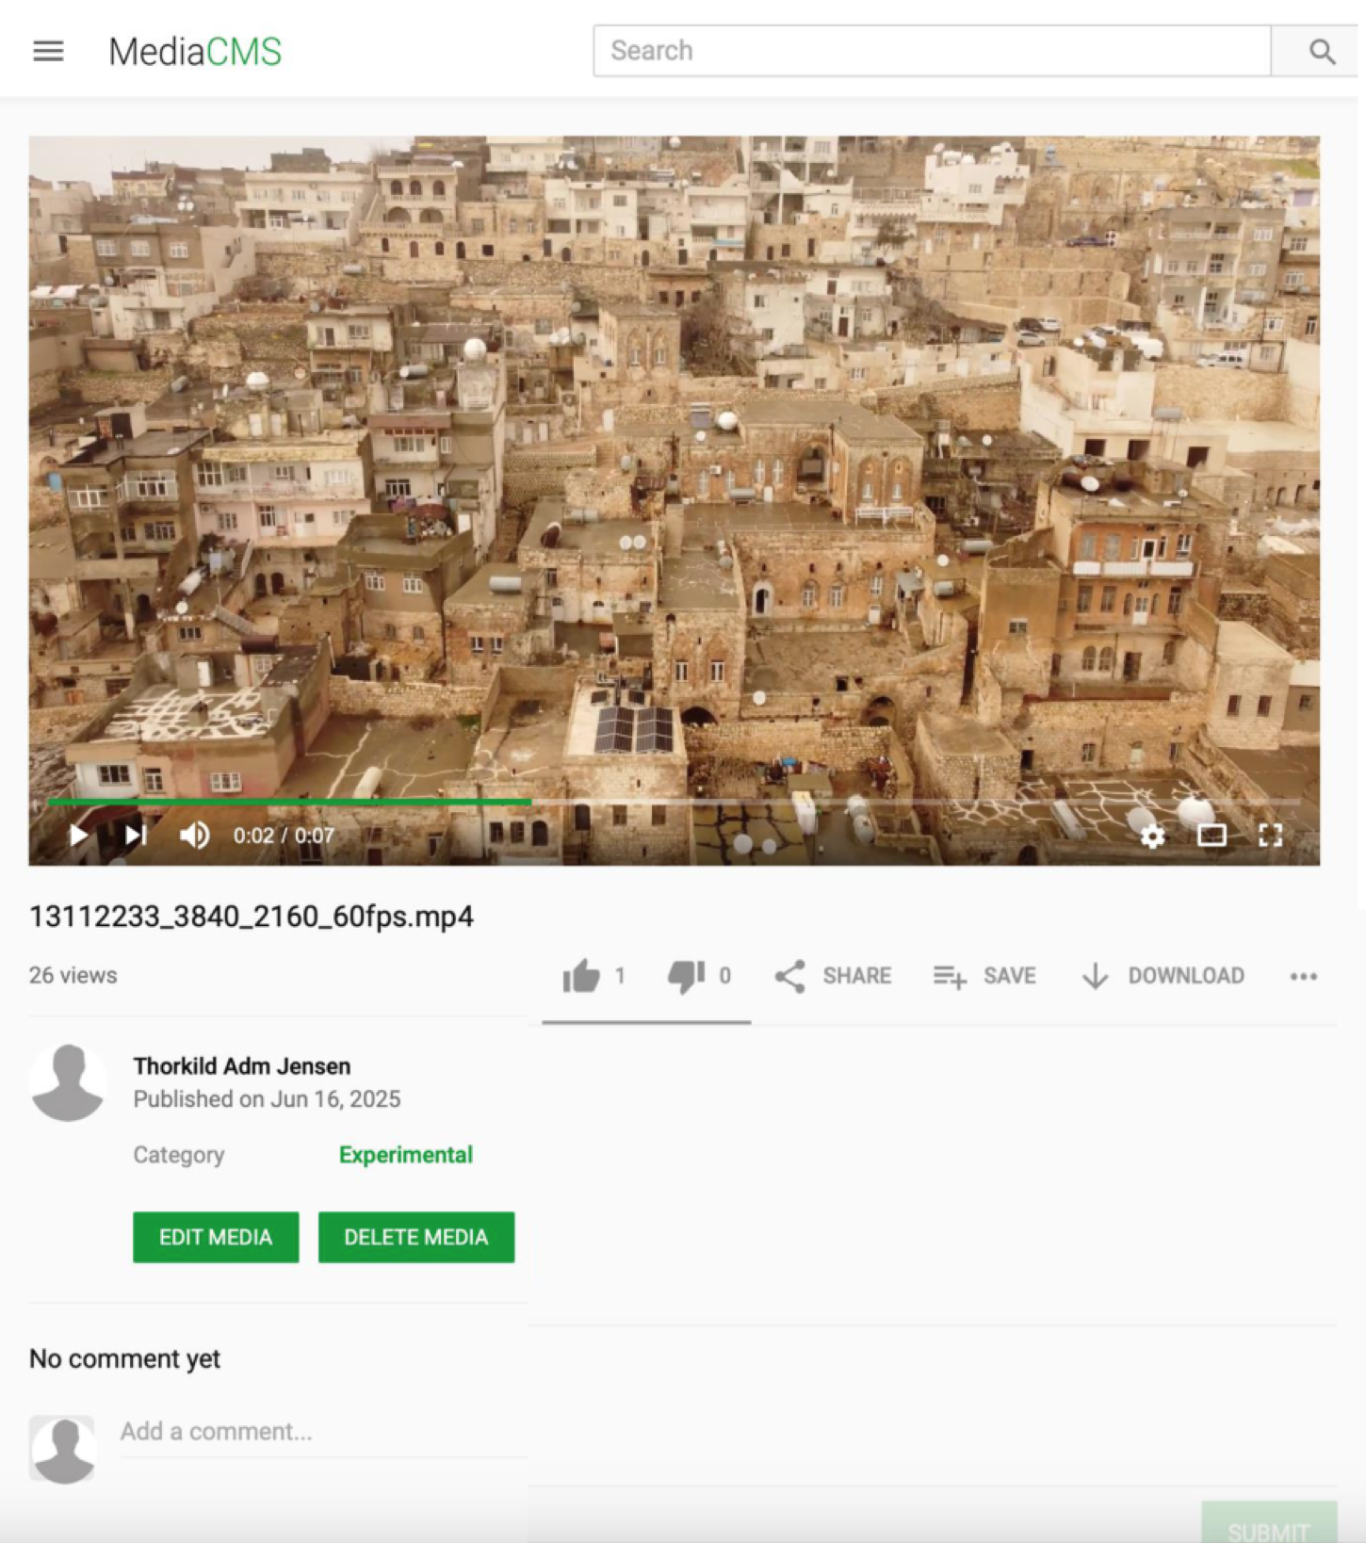
MediaCMS - Offers…
Users:
  Usability on a next level
    Have easy overview of navigation
    Feel at home at the first moment
    “Much better than other systems”
  Mobile: full support for all workflows
  Fast workflows
    Upload
      Single files or bulk
      Video, audio, pictures, pdf
    View without waiting time
    Edit media without waiting time
    Publish without waiting time
  Transcoding happening in the background

Slide 9
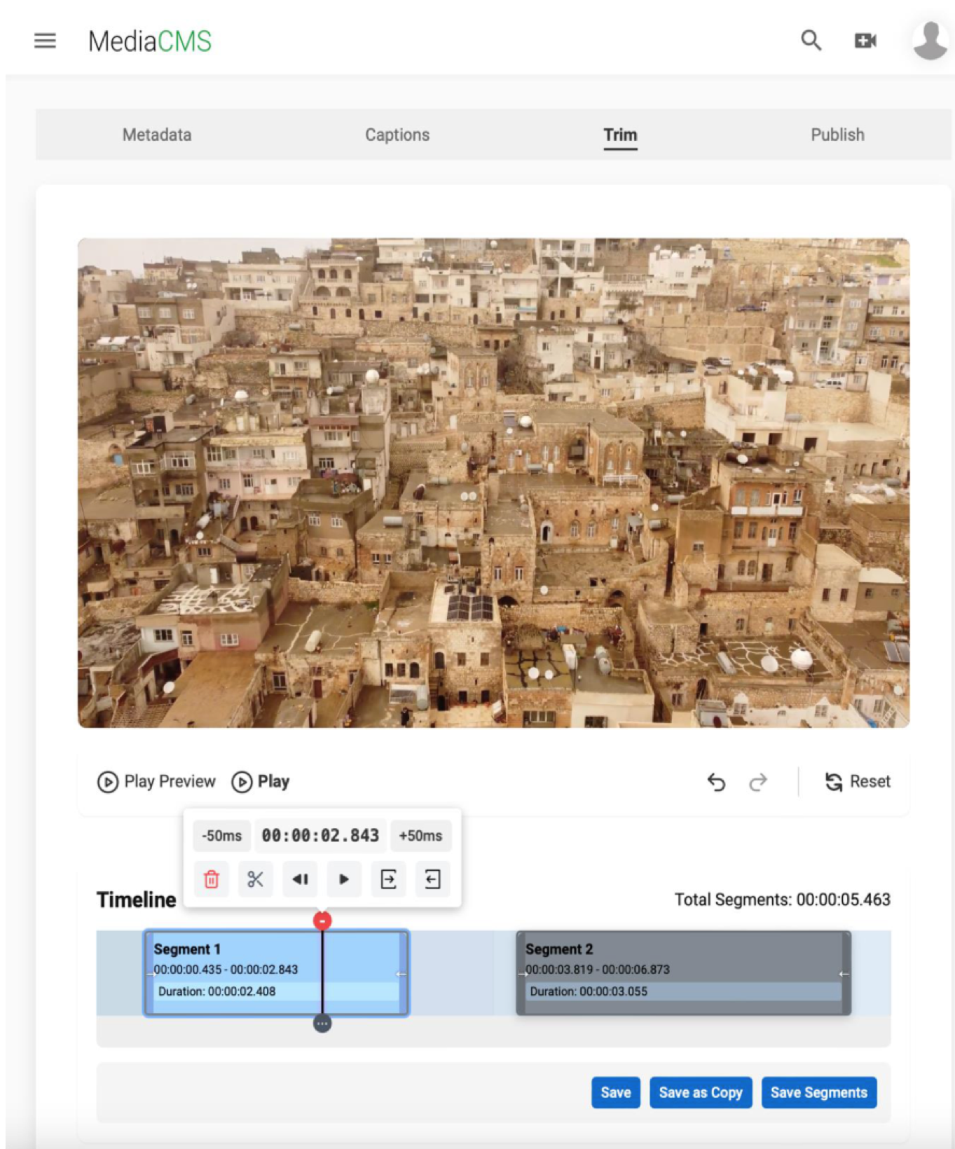
MediaCMS - Offers…
Users:
  Usability on a next level
    Have easy overview of navigation
    Feel at home at the first moment
    “Much better than other systems”
  Mobile: full support for all workflows
  Fast workflows
    Upload
      Single files or bulk
      Video, audio, pictures, pdf
    View without waiting time
    Edit media without waiting time
    Publish without waiting time
  Transcoding happening in the background

Slide 10
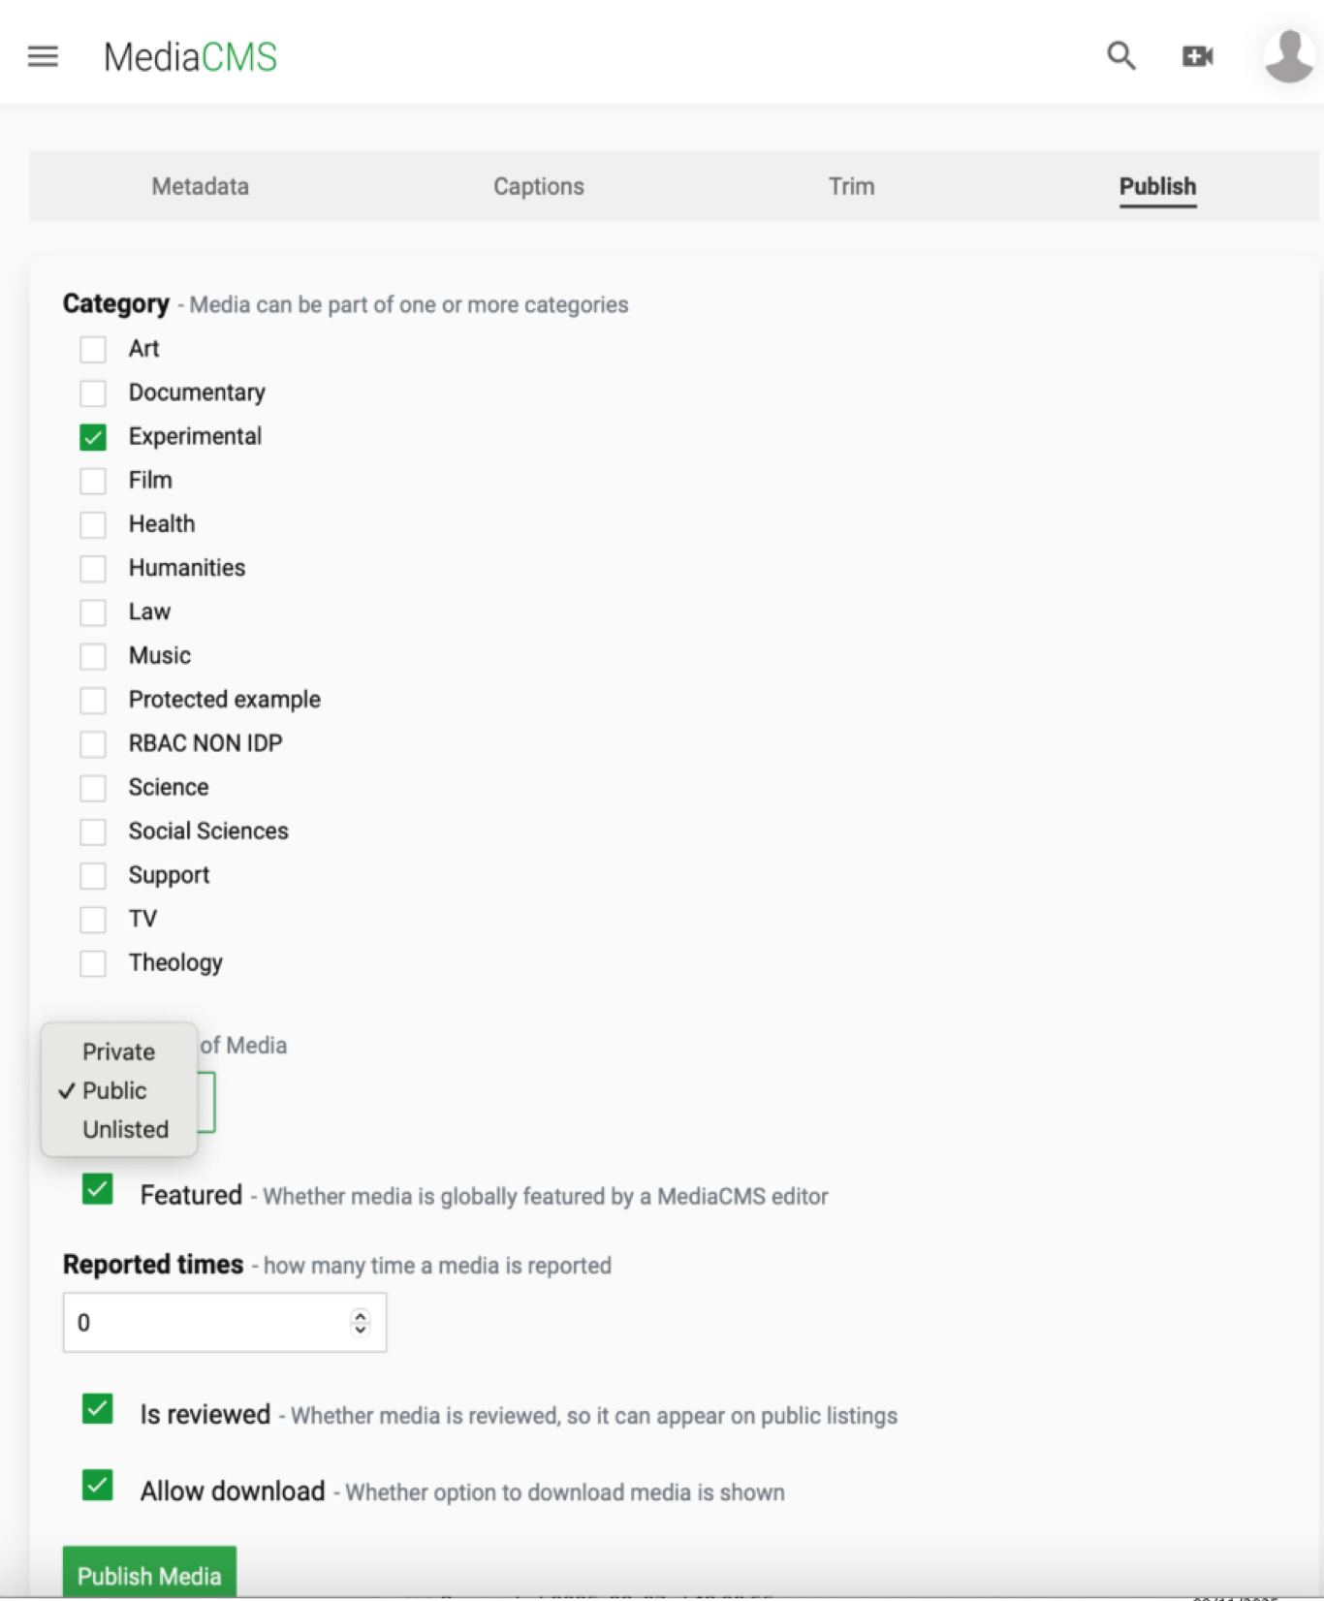
MediaCMS - Offers…
Users:
  Usability on a next level
    Have easy overview of navigation
    Feel at home at the first moment
    “Much better than other systems”
  Mobile: full support for all workflows
  Fast workflows
    Upload
      Single files or bulk
      Video, audio, pictures, pdf
    View without waiting time
    Edit media without waiting time
    Publish without waiting time
  Transcoding happening in the background

Slide 11
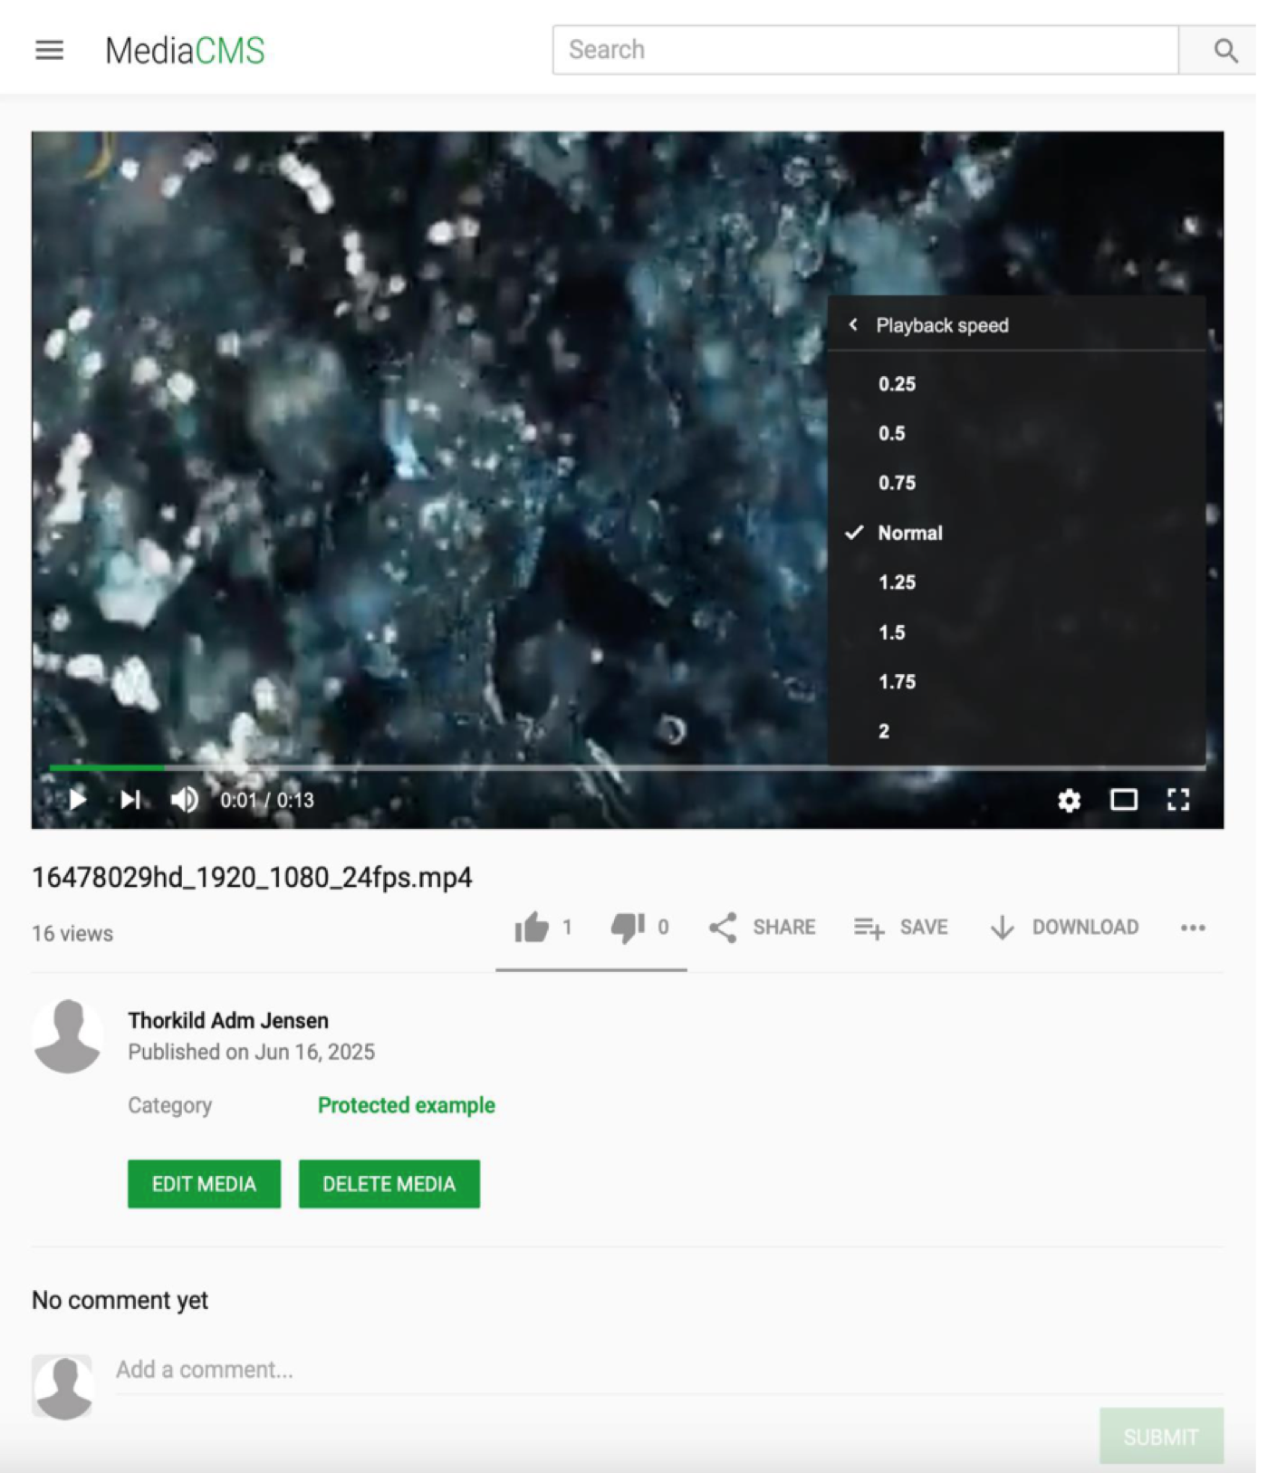
MediaCMS - Offers…
Users: (viewers)
  Playback speed
    Faster playback is often used
  Captions
    Transcriptions / translations
  Download
    Offline viewing on mobiles
  Commenting
    Link to specific moment in video

Slide 12
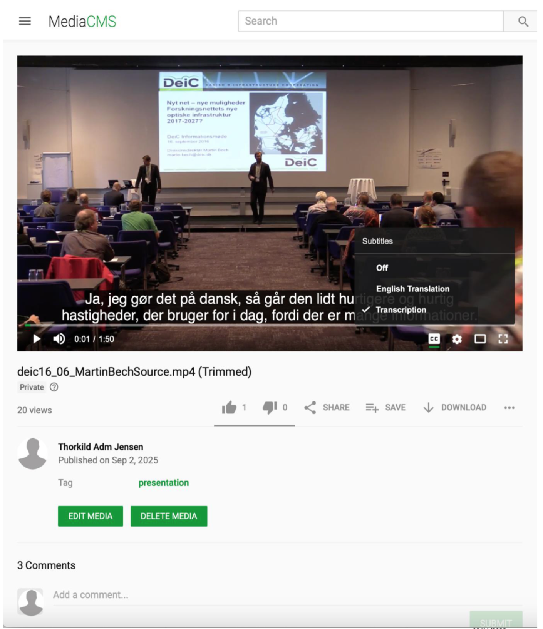
MediaCMS - Offers…
Users: (viewers)
  Playback speed
    Faster playback is often used
  Captions
    Transcriptions / translations
  Download
    Offline viewing on mobiles
  Commenting
    Link to specific moment in video

Slide 13
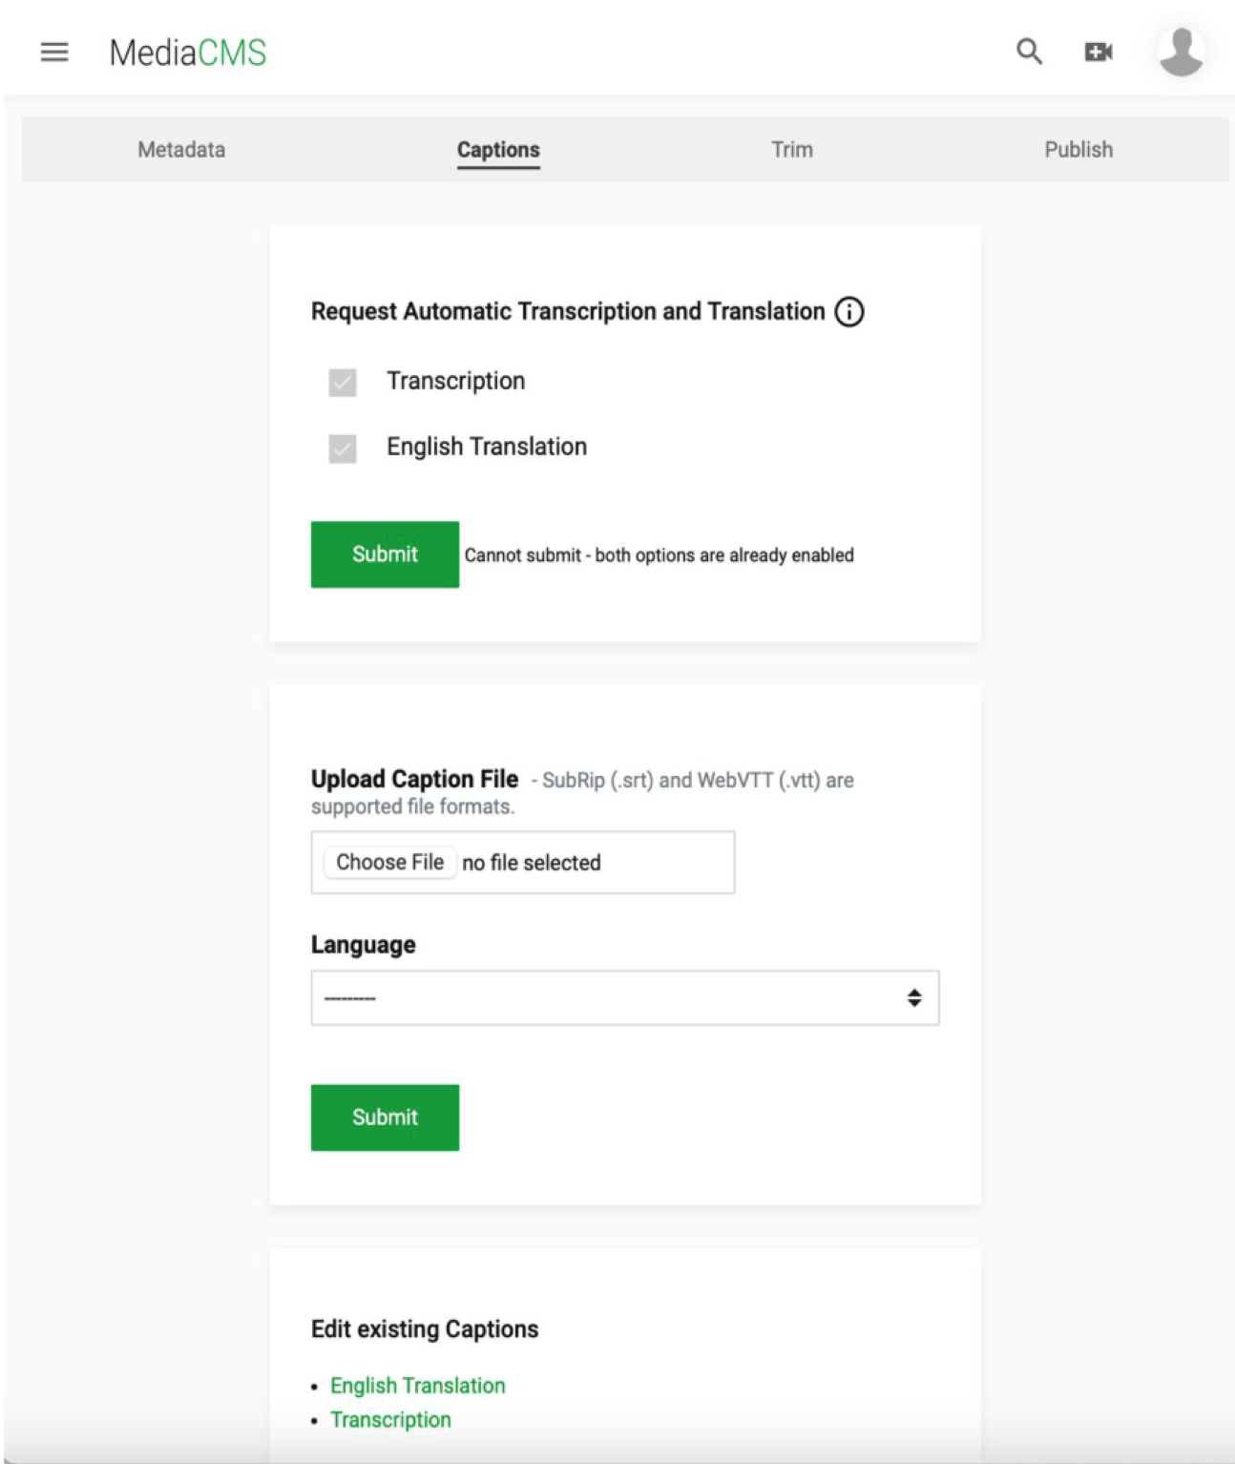
MediaCMS - Offers…
Users: (viewers)
  Playback speed
    Faster playback is often used
  Captions
    Transcriptions / translations
  Download
    Offline viewing on mobiles
  Commenting
    Link to specific moment in video

Slide 14
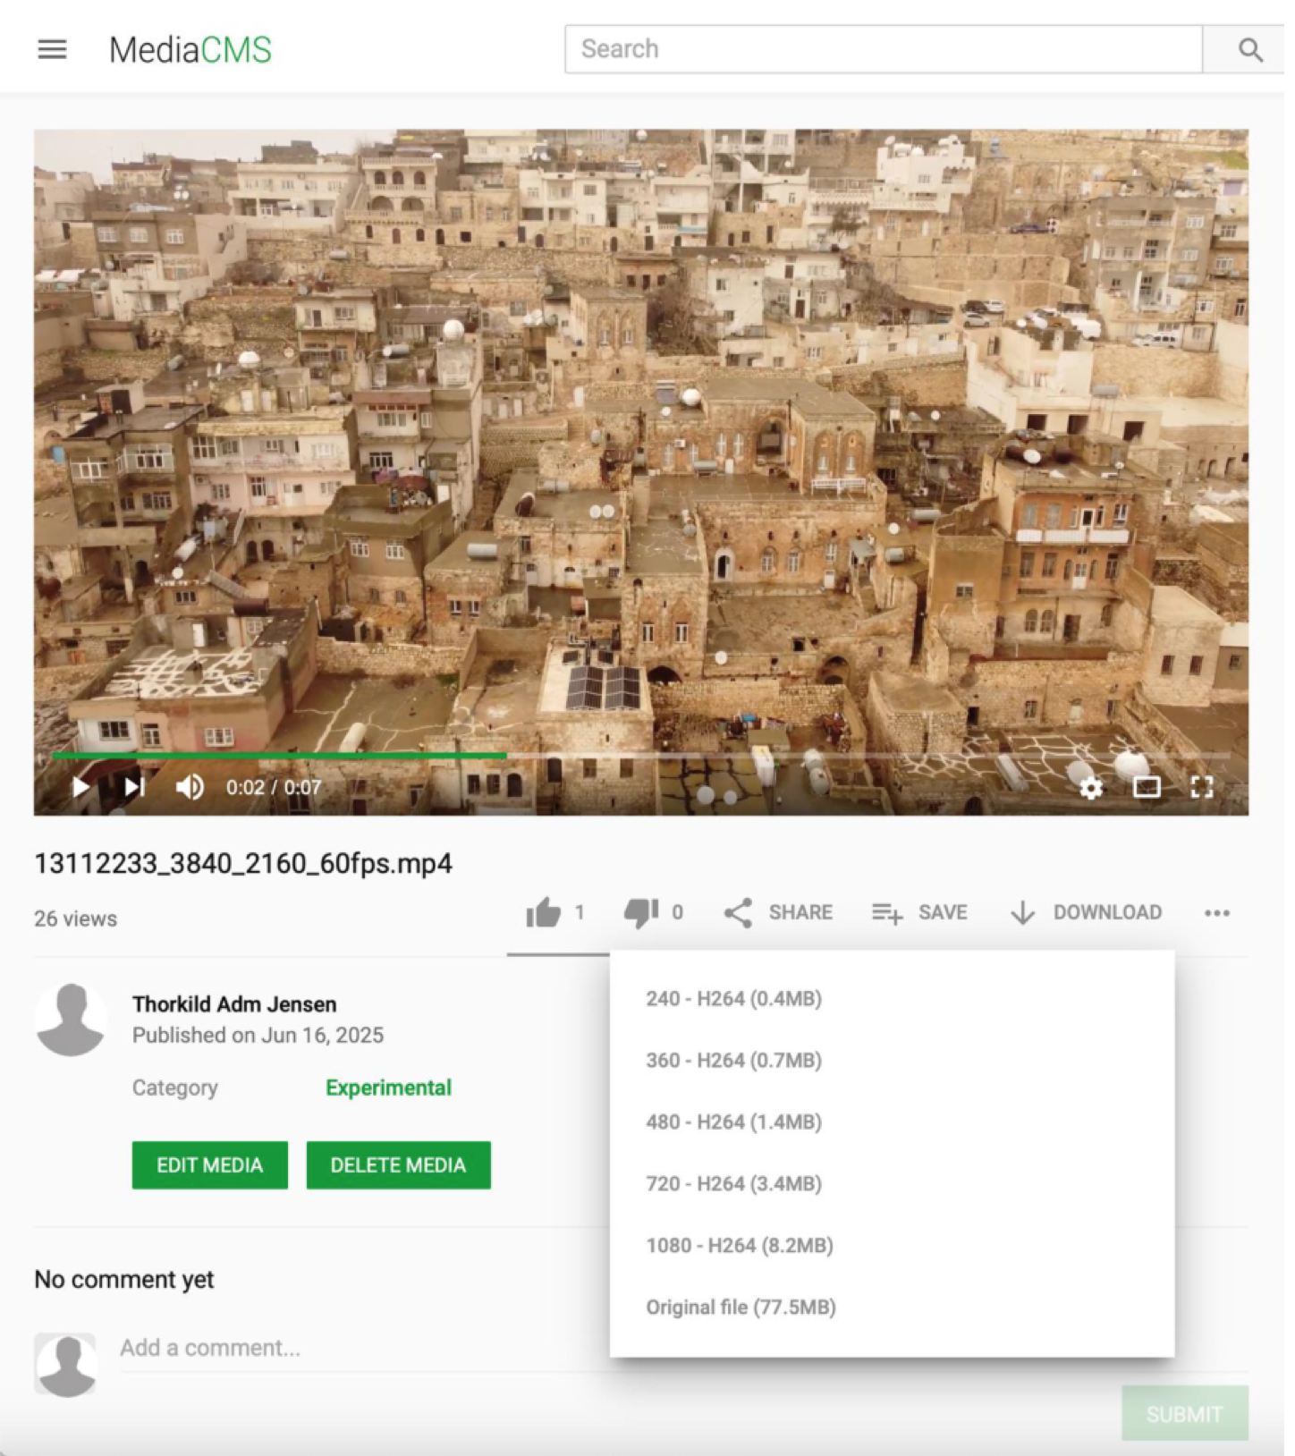
MediaCMS - Offers…
Users: (viewers)
  Playback speed
    Faster playback is often used
  Captions
    Transcriptions / translations
  Download
    Offline viewing on mobiles
  Commenting
    Link to specific moment in video

Slide 15
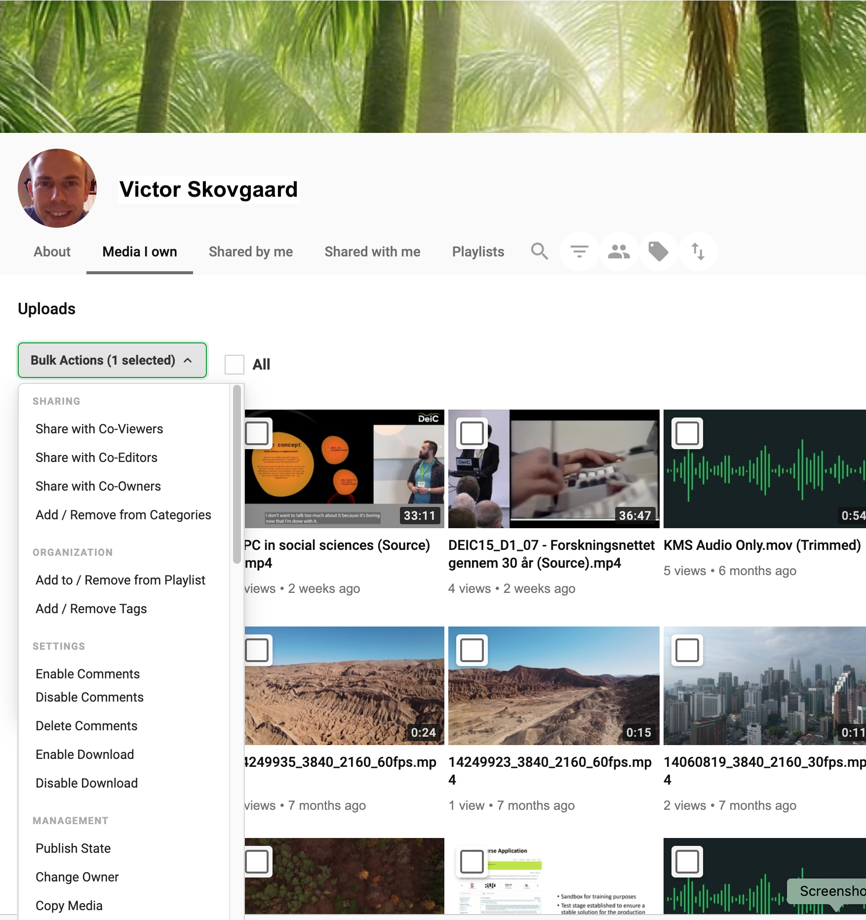
MediaCMS - Offers…
User: (Owners My Media)
  Transcription / Translation
  Bulk Actions
    Sharing with other users
      Co-viewers, -editors, -owners
    Add/Remove from playlists
    Add/Remove tags
    Enable Comments
    Disable Comments
    Delete Comments
    Enable Download
    Disable Download
    Publish State
    Change Owner
    Copy Media
    Delete Media

Slide 16
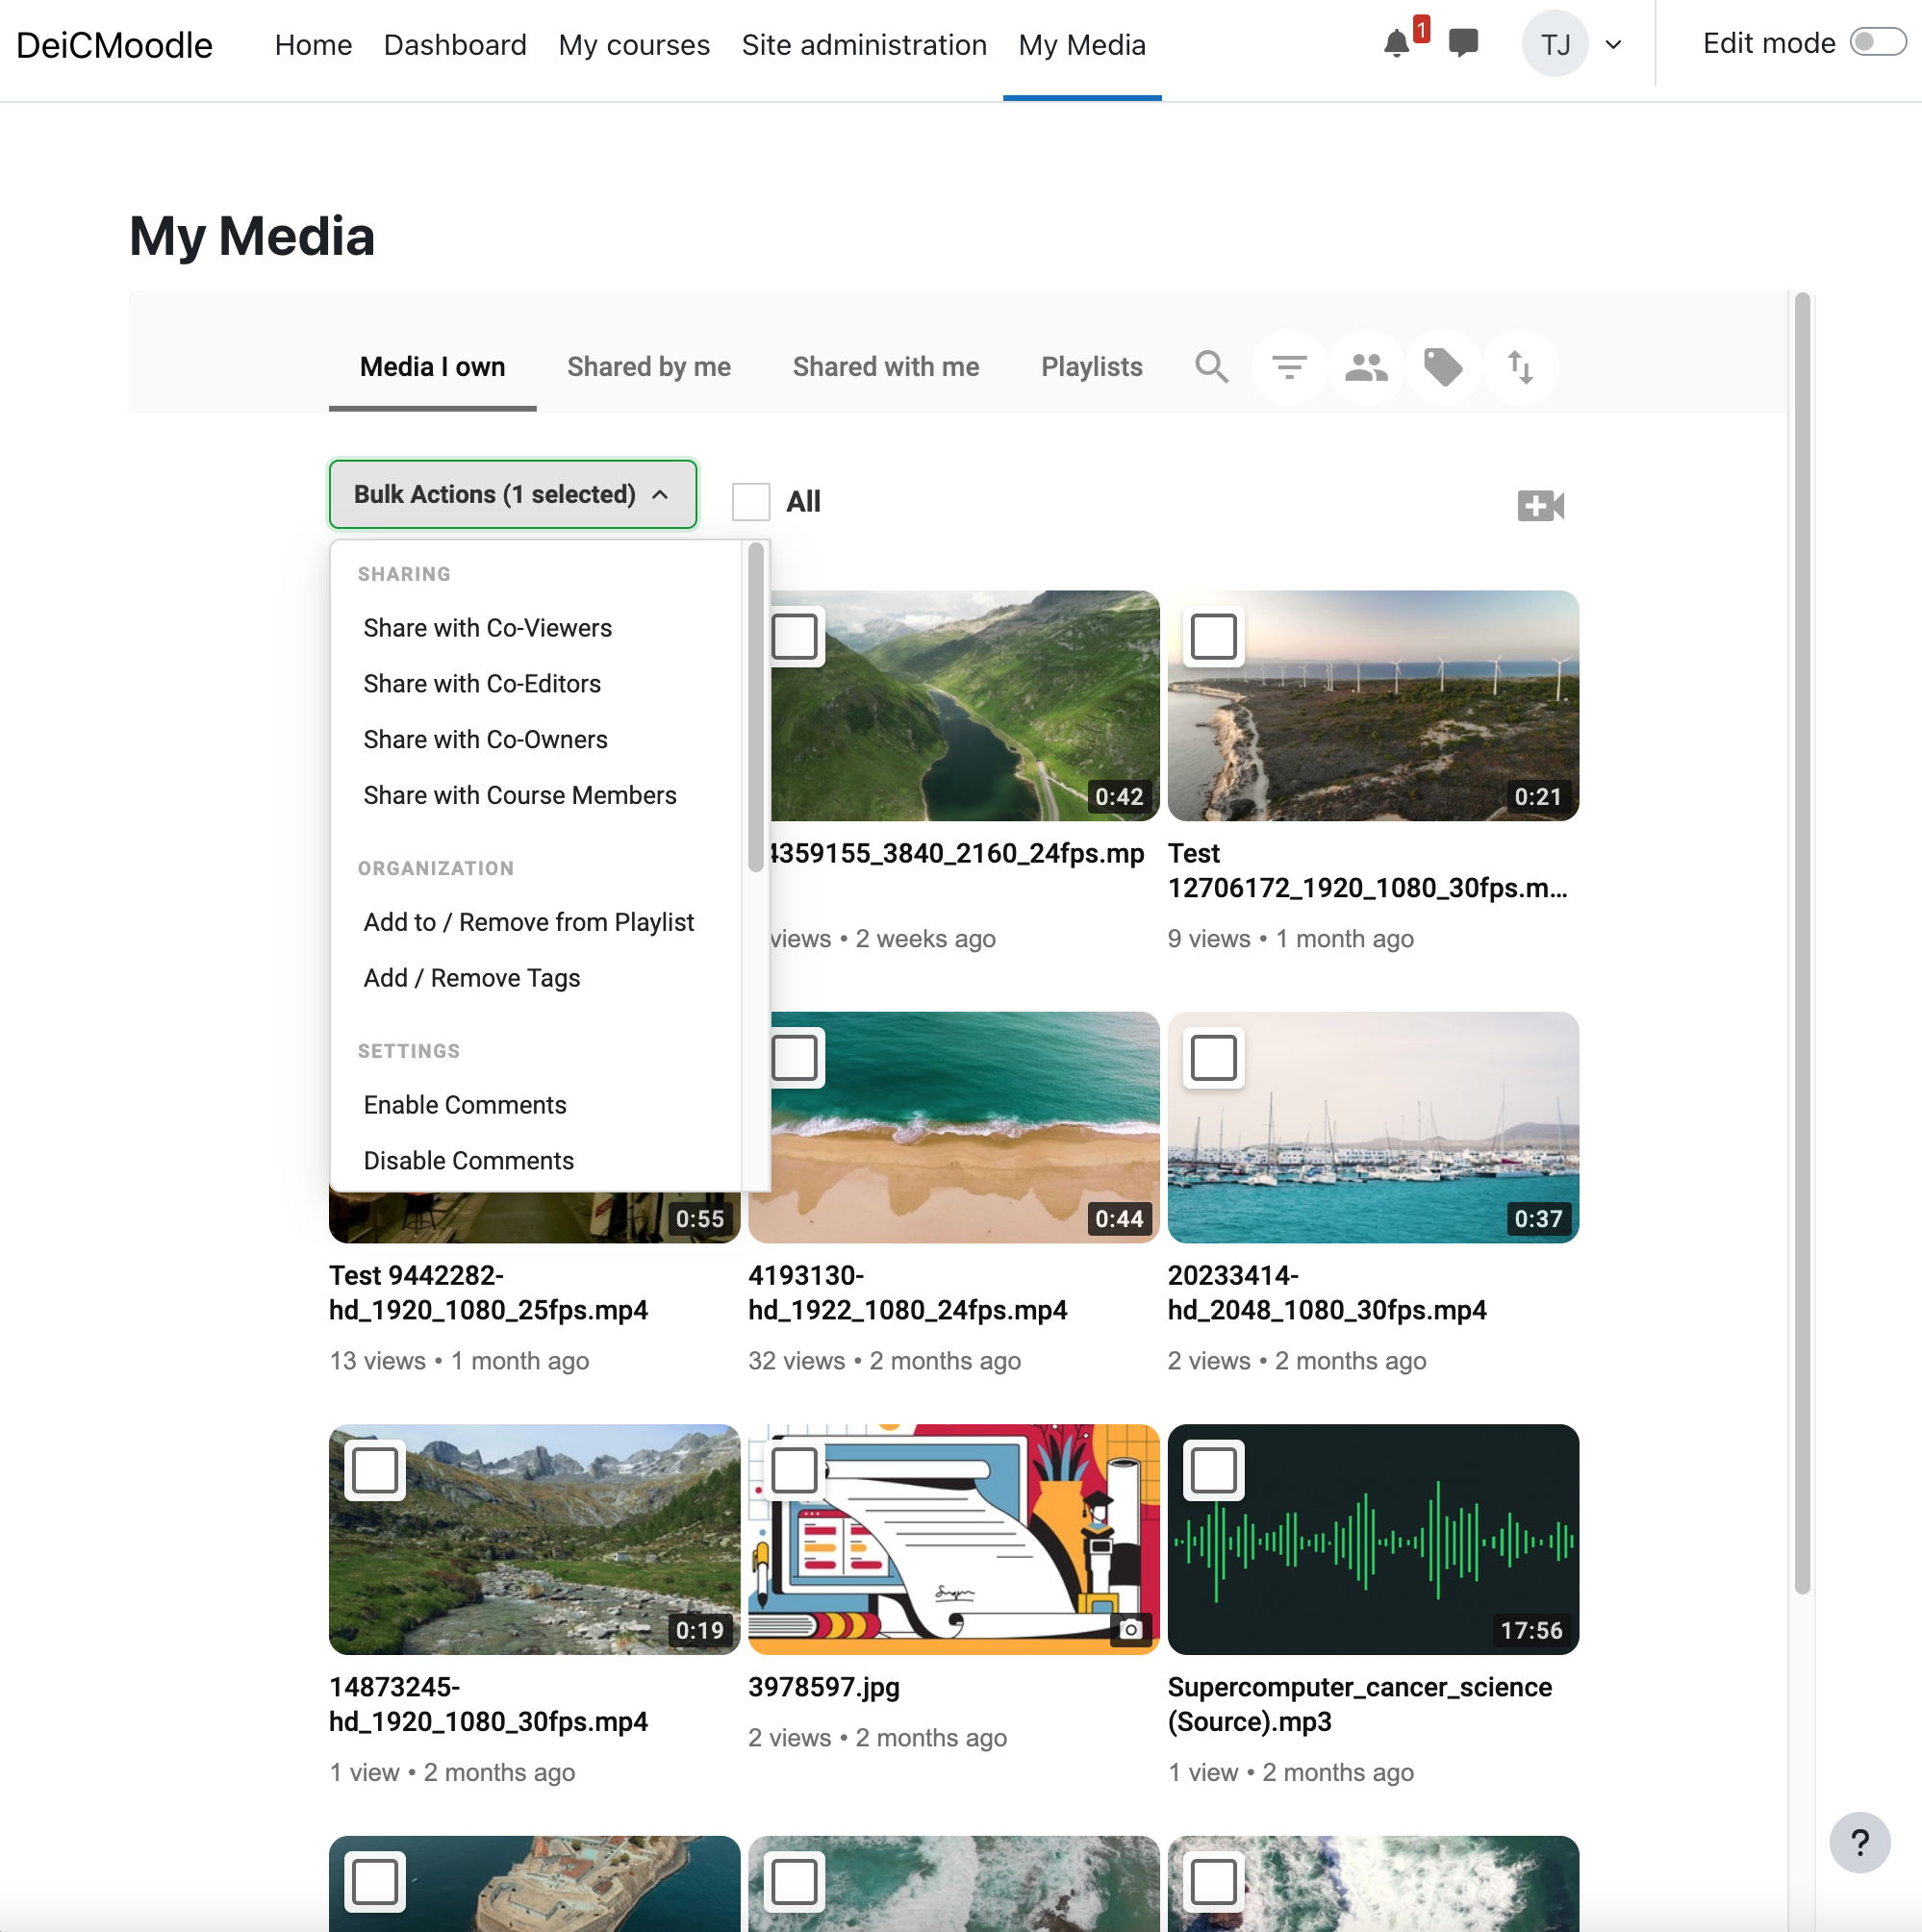
MediaCMS - Offers…
User: (LMS Integration – My Media)
  Moodle
  My Media
    Upload
    Editing
    Transcription / Translation
    Sharing
    Bulk Actions
    Etc.
  Embedding
    Insert media in LMS elements
      Pages
      Forum
      Assignments
  Course clean-up

Slide 17
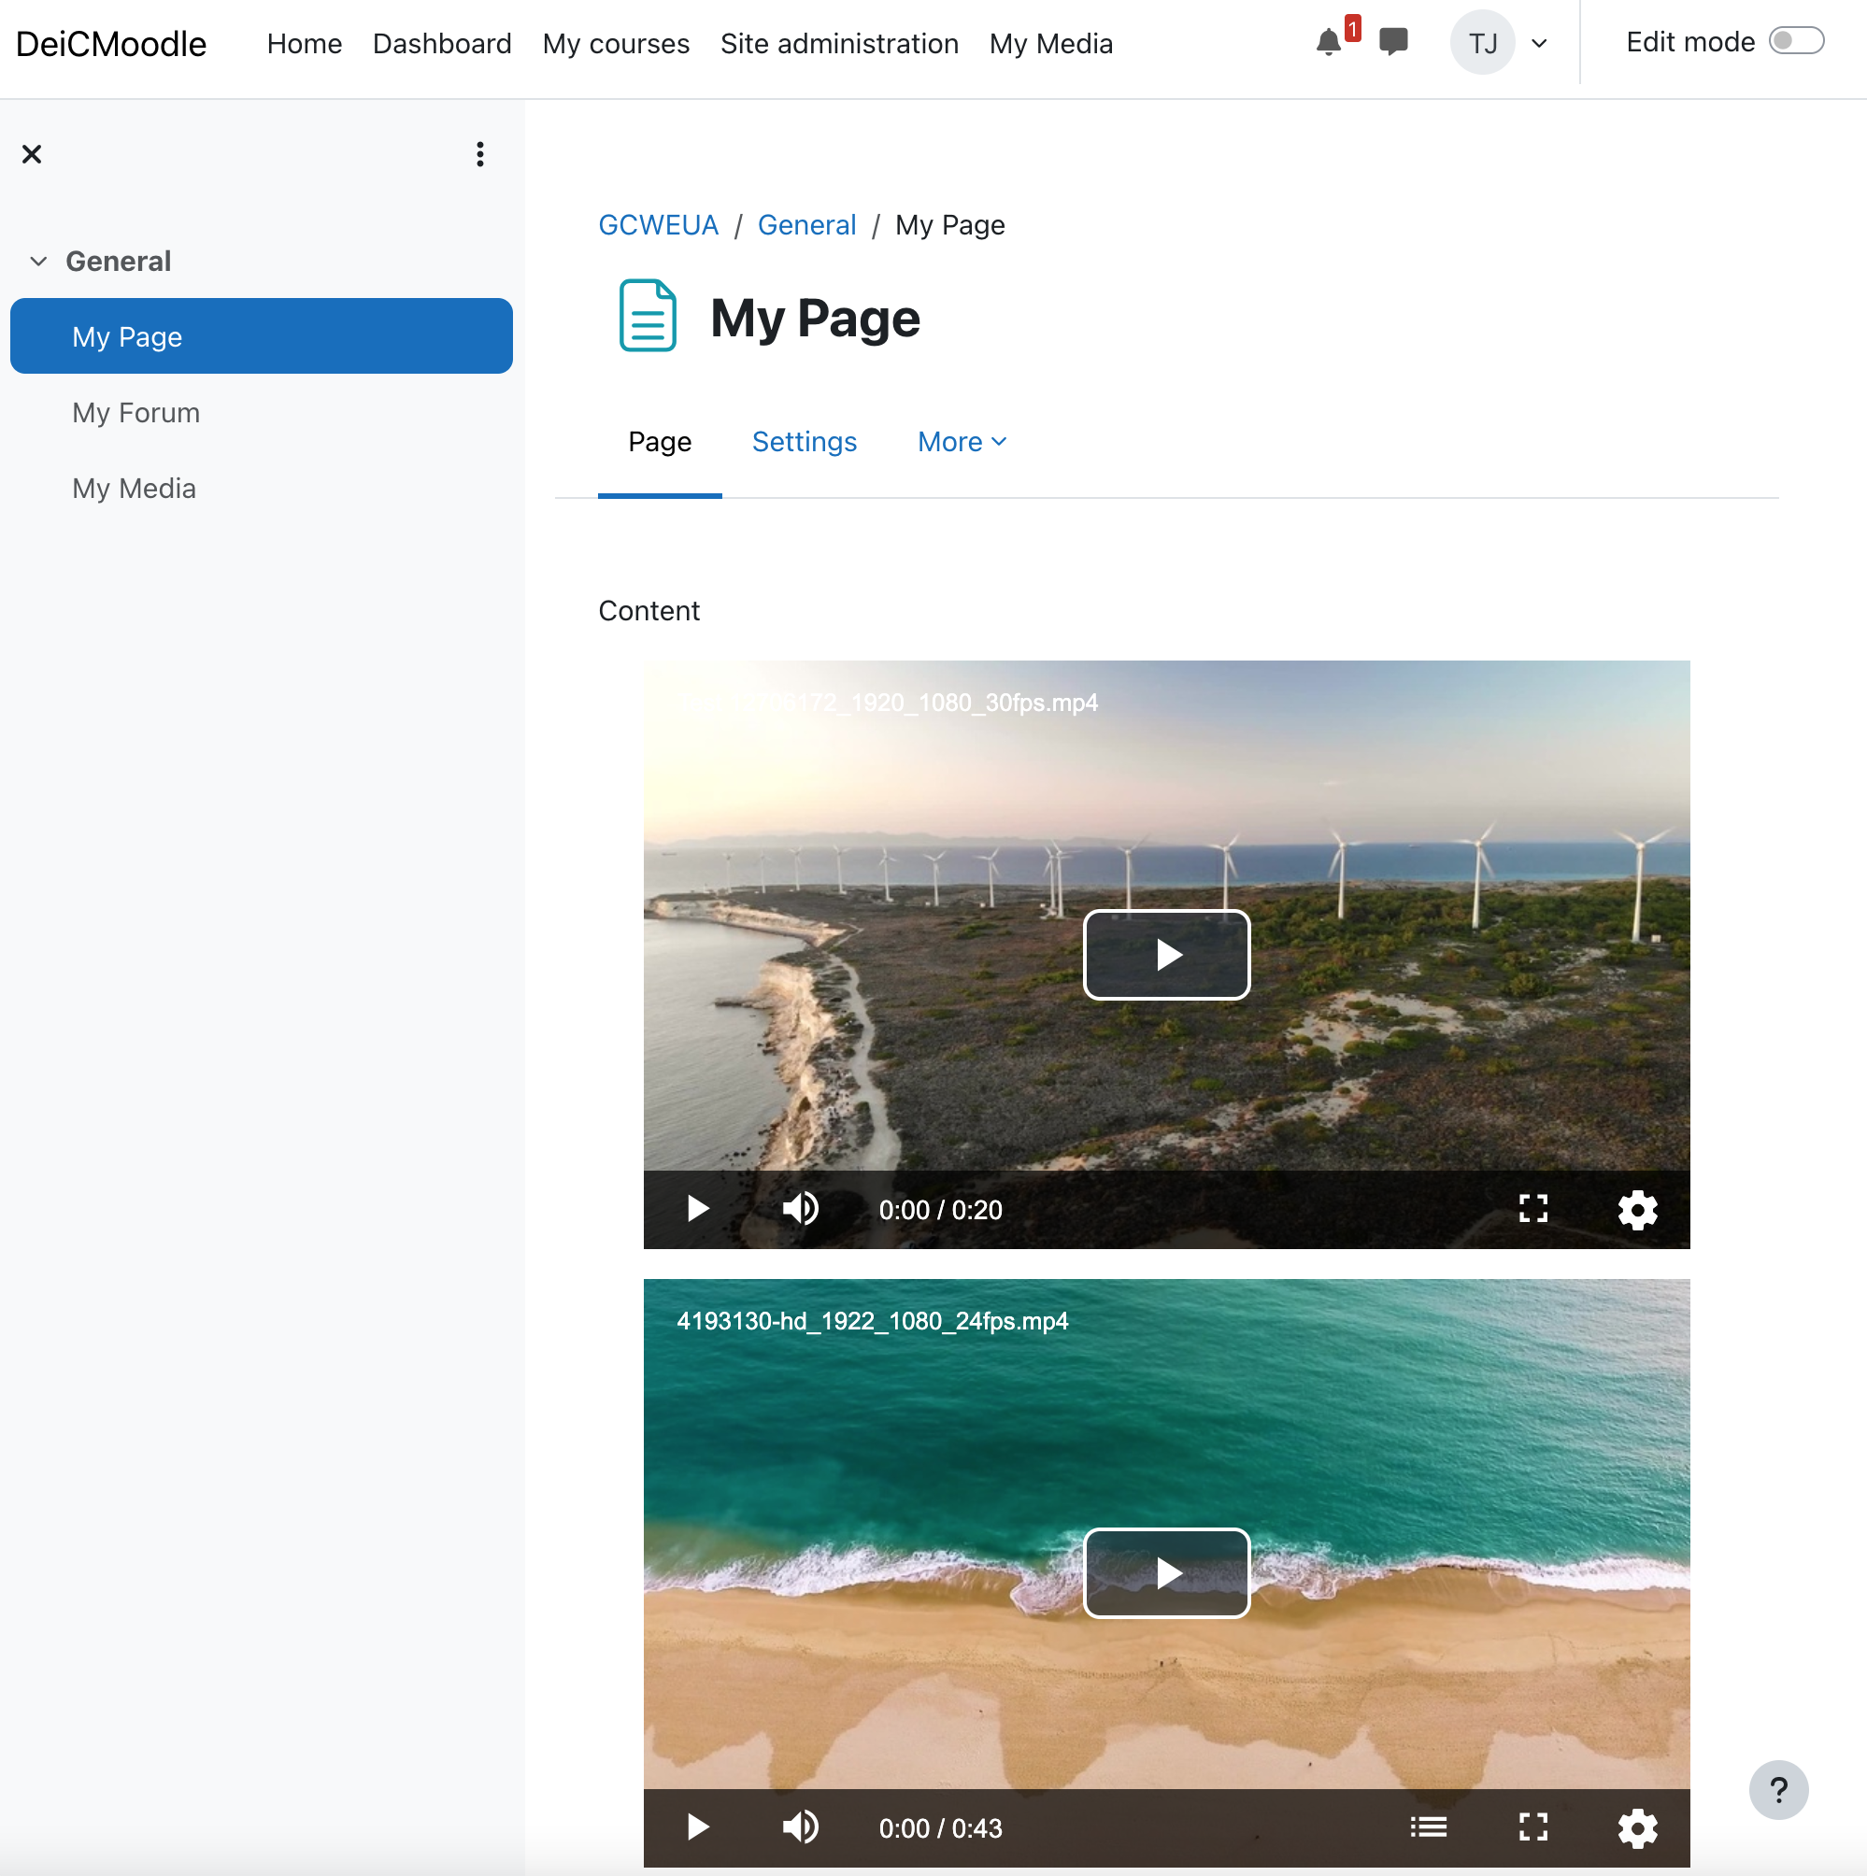
MediaCMS - Offers…
User: (LMS Integration)
  Moodle
  My Media
    Upload
    Editing
    Transcription / Translation
    Sharing
    Bulk Actions
    Etc.
  Embedding
    Insert media in LMS elements
      Pages
      Forum
      Assignments
    Adjusts to mobile devices
  Course clean-up

Slide 18
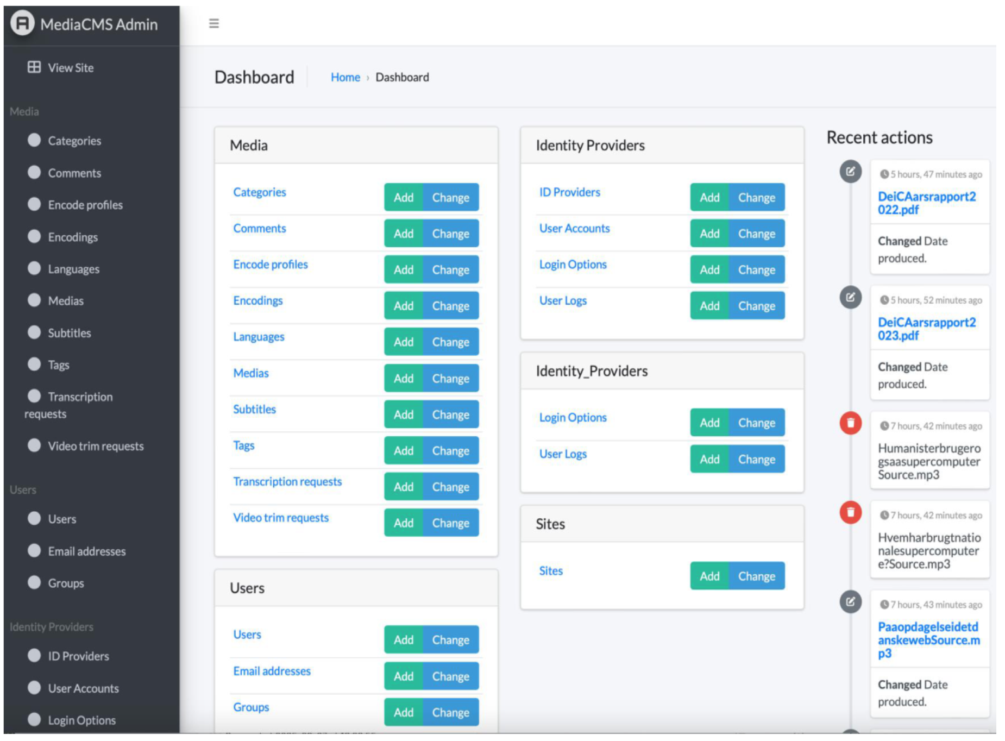
MediaCMS - Offers…
Administrators
  Handle a variety of elements
    Users
    Groups
    Media
    Categories
    Encoding Profiles
    Encodings
    Edits
    Captions
    Comments
    Tags
    Languages
    Logs
  Recent actions / changes

Slide 19
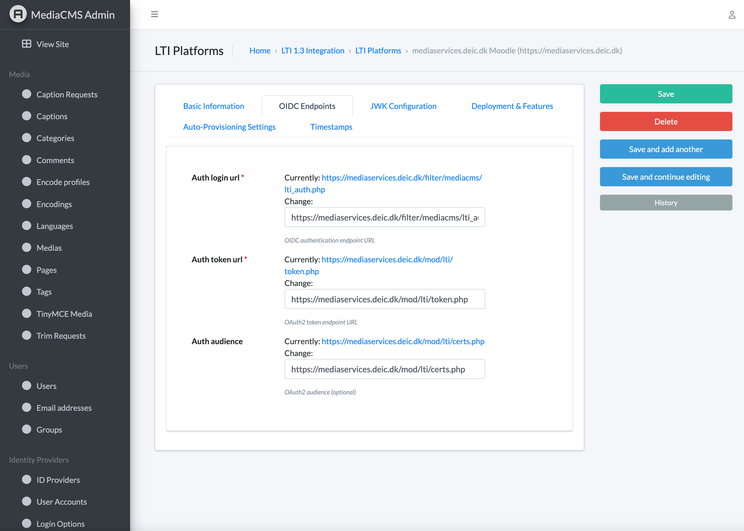
MediaCMS - Offers…
Administrators
  Configurations
    SAML
      Encoding
      Attributes
      Permissions
      Role mapping
      Group mapping
    LMS / LTI
      IDs
      Tokens
      URLs
      Synchronisation
      ….

Slide 20
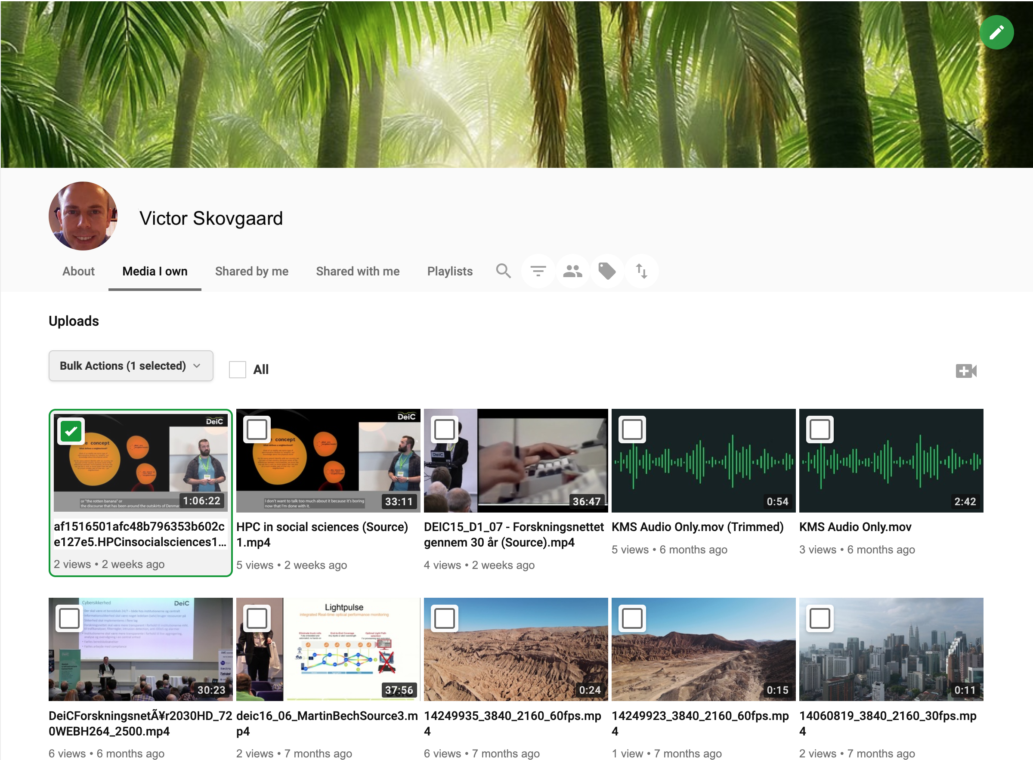
Coming soon…
LTI Generic: Other LMS systems
Migration service
  Others systems > MediaCMS
  Transferring
    Media
    Metadata
    Basic statistics
  API Extensions
Expected in Oct. 2026
Other features you need!

Slide 21
MediaCMS
Easy to become involved!
Contact us if this is interesting!
thorkild.Jensen@deic.dk
casper.tollund@deic.dk
Or taps us on our shoulders after this session…
Thanks!

