Slide 1

Streamlining Multi-Vendor Automation
RESTCONF Clients from YANG Modules
Matteo Colantonio

Slide 2


DO NOT PARSE CLI
unless it’s your only option
fragile_automation.py
# Brittle regex that breaks on any firmware update
import re
cli_output = "Interface Ethernet1/1 is Up, MTU 1500"
match = re.search(r"(\S+) is (\S+), MTU (\d+)", cli_output)
if match:
state = match.group(2)
2

Slide 3

Raw RESTCONF/NETCONF is fragile too
Replacing parsers with raw XML or JSON is not progress.
brittle_restconf.py
payload = {
"example:interface": [
{
"name": "eth0",
"mtu": "1500"
}
]
}
uri="https://example.com/restconf/data/example:interface/intrface=eth0"
requests.patch(uri, json=payload)
string instead of integer!
missing ‘e’ char
3

Slide 4

YANG modules → Software Development Kit?
*
404
* Pyangbind & Pydantify: pure data models, no operations
So I built it.*
* it works for Nokia G30 and GX platforms
4

Slide 5
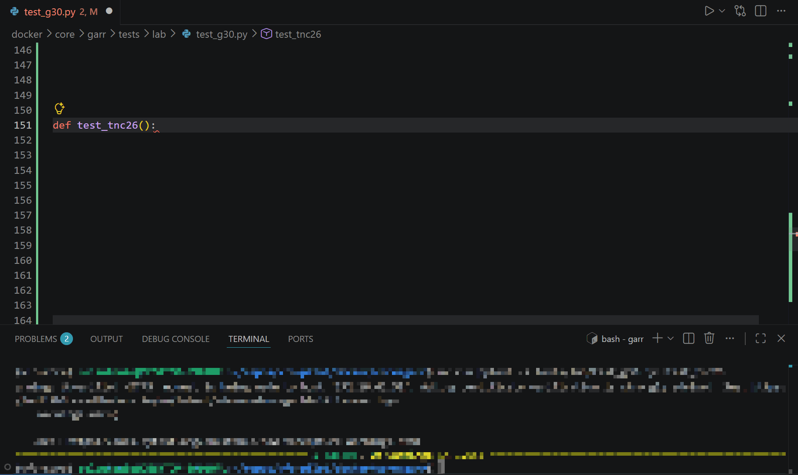
YANG modules → IDE-friendly type-safe RESTCONF SDK
cool_automation.py
Navigate paths/URIs with autocomplete.
Type-safe & runtime validation. Fail locally.
CRUD methods for running datastore + RPC operations.
Faster. Easier. Safer.
5

Slide 6
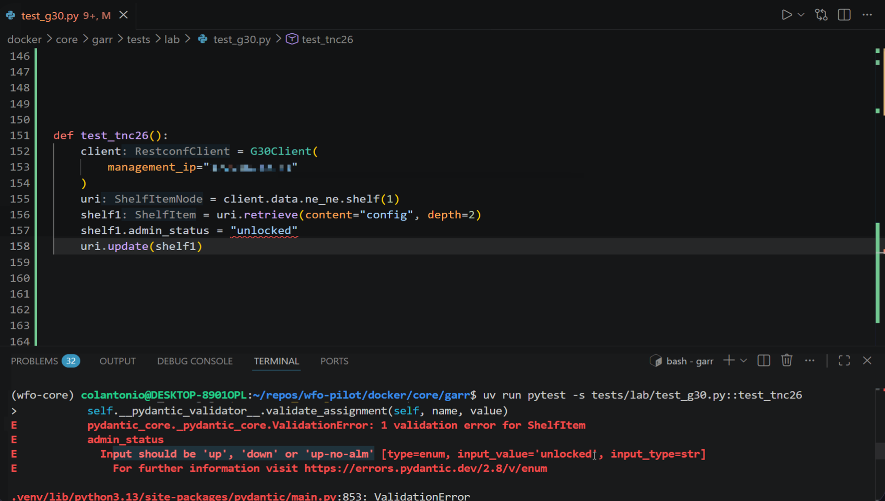
YANG modules → IDE-friendly type-safe RESTCONF SDK
cool_automation.py
Navigate paths/URIs with autocomplete.
Type-safe & runtime validation. Fail locally.
CRUD methods for running datastore + RPC operations.
Faster. Easier. Safer.
6

Slide 7


YANG2SDK
Give it a try!
$ git clone https://github.com/ConsortiumGARR/yang2sdk.git
matteo.colantonio@garr.it

