Slide 1

From Open Data to Usable Data: RI-SCALE Data Exploitation Platforms for Scalable Open Science
Lightning talk 10.6.2026
Ville Tenhunen, Magdalena Brus, Gergely Sipos
(EGI Foundation)

Slide 2
AI is (re)shaping scientific research.

Slide 3
Simplified workflow with tools, data, models
Scientific problem or idea
Discover the data or model
Data wrangling
Create/ retrain AI models
Run models
Scientific findings
Data
Data
Model
Data
Tools
Model
Model
Tools
Data
Tools
Tools
Model
Model
Data
Tools
Model

Slide 4
Computing power is
where the data isn't.

Slide 5
Data access and transfer can be cumbersome.

Slide 6
AI tool setup and integration
pose high technical barrier.

Slide 7

Data Exploitation Platform (DEP):
Compute extension to RI data holdings
Data holdings
Curated data, preserved for the long term
Data spaces
Research Infrastructures
Pre-configured AI tools
Computing & infrastructure
DEP
AAI, security, credit management, policies
Replicated data
(discovery, transfer, data management)
AI Models
(development, training, validation and deployment)
AI Model Developer
Data Lifecycle Management
AI Lifecycle management
DEP End User
DEP Operator

Slide 8

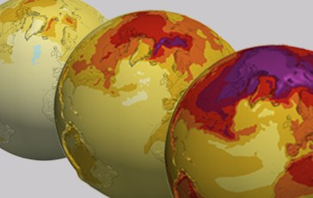


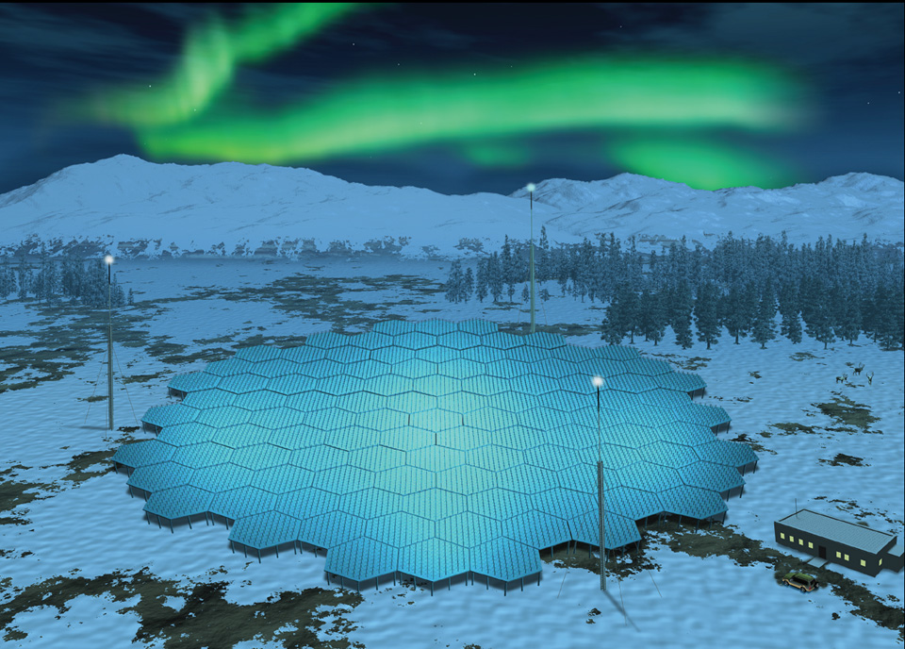


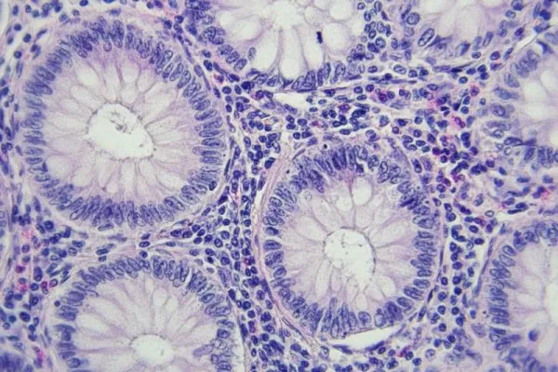


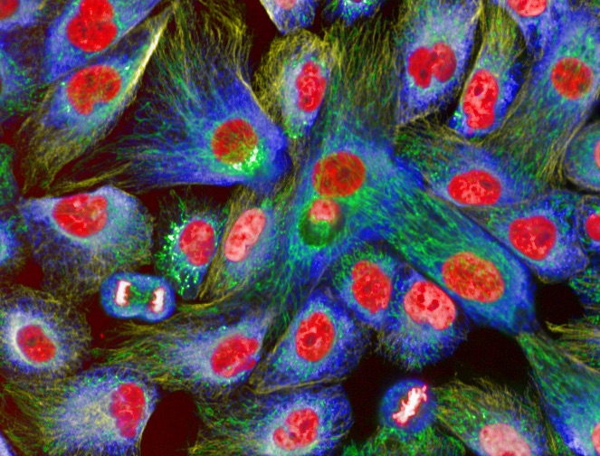

Scientific validation cases for DEP technology
Climate modelling 1. High-resolution downscaling of climate scenarios and risk trend analysis in agriculture 2. Smart detection of anomalies in climate data usage
Near-Earth geospace studies 3. Intelligent Scheduling of Radar Observations and Experiments 4. Space Debris and Anomaly Detection
Cancer treatment 5. Colorectal cancer prediction with explainable AI 6. Synthetic data for computational pathology
Imaging in life sciences 7. Foundational models for heterogeneous biological image data 8. Generative AI-Powered assistant for data discovery and analysis
20PB
3PB
3PB
5PB

Slide 9







Technological validation cases for the DEP
Scalability on EuroHPC Our models can run on Europe’s largest supercomputers for Destination Earth, the highly accurate ‘Digital Twin of the Earth’
Image compression Achieve DEP performance improvement by using JPEG2000 Part 2 compression in DICOM image-metadata format
Green computing Achieve energy saving and performance improvement with the use of GROQ cards for AI model training and inference
Credit management Be able to measure Data Exploitation Platform usage and environmental impact, and express them in form of ‘credits’

Slide 10



The DEP is similar to a Data Lab, but…
The DEP enables end-to-end data lifecycle management through orchestration services, integrated AI frameworks and reusable models
The DEP ensures secure and policy-based access through federated AAI, supports resource and usage monitoring
The DEP enables interoperability with European Data Spaces while promoting energy-efficient computing practices.

Slide 11

Get involved!
Research Infrastructures
Compute & HPC providers
AI Model Developers
Startups, SMEs & Industry
Innovation Partners
Ecosystem Partners
https://www.riscale.eu/get-involved

Slide 12

Thank you!
Let’ talk.
https://riscale.eu/

