Slide 1

Conference Presentation
1/8
Empowering Women in STEM in Palestine Under Occupation
15%
Women in STEM
Despite challenges, Palestinian women are breaking barriers in science, technology, engineering, and mathematics fields.
Building Digital Futures
Through AI and NREN
This presentation explores how artificial intelligence and National Research and Education Networks (NREN) can create pathways for women in STEM education and careers in Palestine, overcoming occupation-related barriers to access quality education and research opportunities.
1

Slide 2

2/8
Challenges Under Occupation
The Opportunity: AI & NREN
Limited Access
Restricted movement and border closures limit access to universities, labs, and international conferences for Palestinian women pursuing STEM careers.
Technology offers a pathway to overcome physical barriers. AI tools can democratize access to education and research capabilities, while National Research and Education Networks (NREN) can connect isolated researchers to global communities.
Resource Scarcity
Through strategic investment in digital infrastructure and AI literacy, we can empower Palestinian women to participate fully in the global STEM ecosystem.
Frequent power outages, limited internet connectivity, and lack of modern equipment create significant barriers to research and education.
Isolation
Geographic and political isolation prevents collaboration with global research communities, limiting professional growth and knowledge exchange.
2

Slide 3
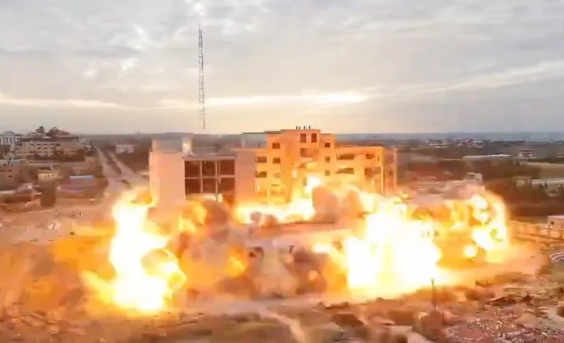
3/8
Challenges in Gaza during war
Impact on Women
Lack of safe learning environments
Loss of practical lab-based education
Isolation from academic networks and mentors
Fewer opportunities for study and career growth
Reduced access to research and leadership roles
Destruction of universities and educational infrastructure
Damage to labs and research facilities
Disruption of higher education and academic programs
Destruction of Al-Israa University in Gaza
Limited access to learning materials and research tools
Collapse of research and scientific collaboration
3

Slide 4




4/8
AI Solutions for STEM Access
Online Learning Platforms
Research Collaboration Tools
Skills Development Programs
4

Slide 5

Women in STEM Palestine
5/8
5%
NREN: Connecting Despite Barriers
Connecivity Boost
of Palestinian universities now connected through NREN, enabling international research colaboration.
National Research and Education Networks (NRENs) provide critical infrastructure enabling Palestinian researchers and students to access global academic resources despite physical restrictions and occupation barriers.
Key Benefits
High-speed connectivity enables access to AI tools, online courses, and global research databases.
Overcoming physical barriers to education
Enabling cross-border academic collaboration
5

Slide 6


Women in STEM Palestine
6/8
Success Stories & Achievements
Women-Led Initiatives: Palestinian women have launched coding bootcamps reaching 500+ students across Gaza and the West Bank despite connectivity challenges.
Educational Milestones: 12 universities offer AI courses, with female enrollment increasing by 40% since 2022.
These achievements demonstrate resilience and innovation under challenging circumstances.
Research Breakthroughs: Collaborative AI projects between Palestinian and international researchers produced 25 peer-reviewed publications in 2023.
6

Slide 7

Women in STEM Palestine
7/8
Expanding Access
Building Partnerships
Increase connectivity to Palestinian universities through NREN infrastructure, enabling remote learning and research collaboration despite movement restrictions.
Forge international academic partnerships to share AI resources, expertise, and research opportunities with women researchers in Palestine.
Future Vision: Strategic Roadmap
Sustainable Development Pathways:
• Establish local AI training centers
• Create mentorship networks
• Develop funding mechanisms for continued growth
• Build resilient digital infrastructure
7

Slide 8

Empowering Women in STEM in Palestine
8/8
Thank You - Join Us in Empowering Women in STEM
Together, we can break barriers and create opportunities for Palestinian women in technology and science. Your support and collaboration can make a lasting difference in transforming lives through education and innovation.
Get Involved
Amaal Zain Al-deen
Director of scientific Research
Ministry of Education and higher education
Palestine
TNC 26
Contact Us
8

