Slide 1
CACAO_IA
Transforming Climate Data into
Actionable Decisions
MONSAN APO CHIMENE
Université Virtuelle de Cote d’Ivoire (UVCI)
Thursday, June 11, 2026

Slide 2
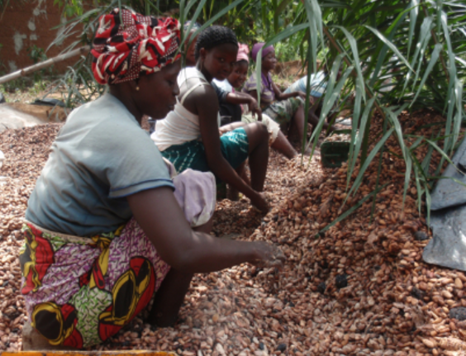
GLOBAL COCOA LEADER
40 % Global Production share
Economic backbone of Nation
1 Million + farmer families

Slide 3

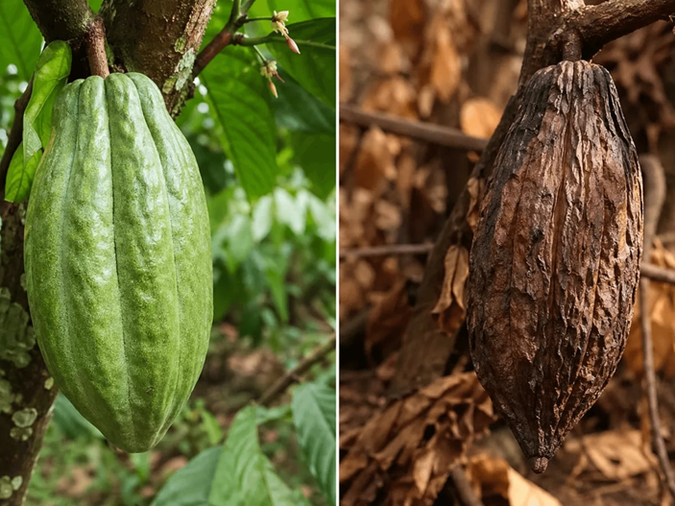
CLIMATE UNCERTAINTY
Unpredictable weather
Threatens global supply chains
In 2022, + 40 DAYS

Slide 4

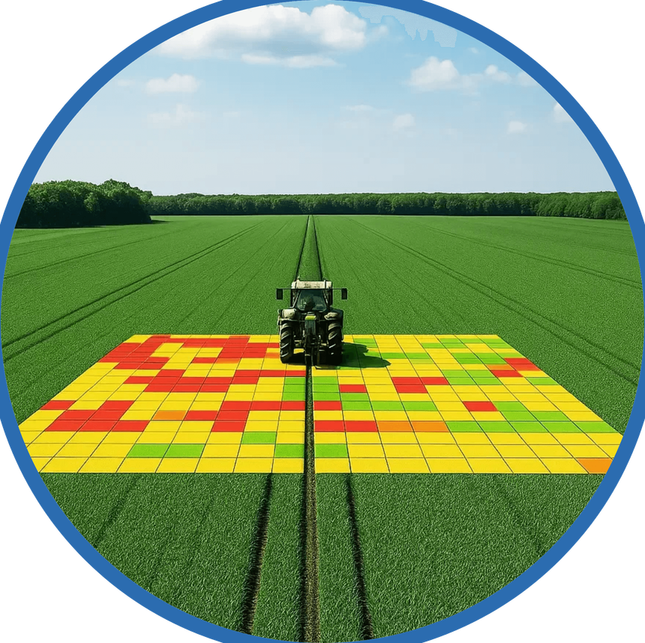
DATA WITHOUT DIRECTION
Weather data is too general
Farmers rely on intuition
Poor timing in farming operations

Slide 5

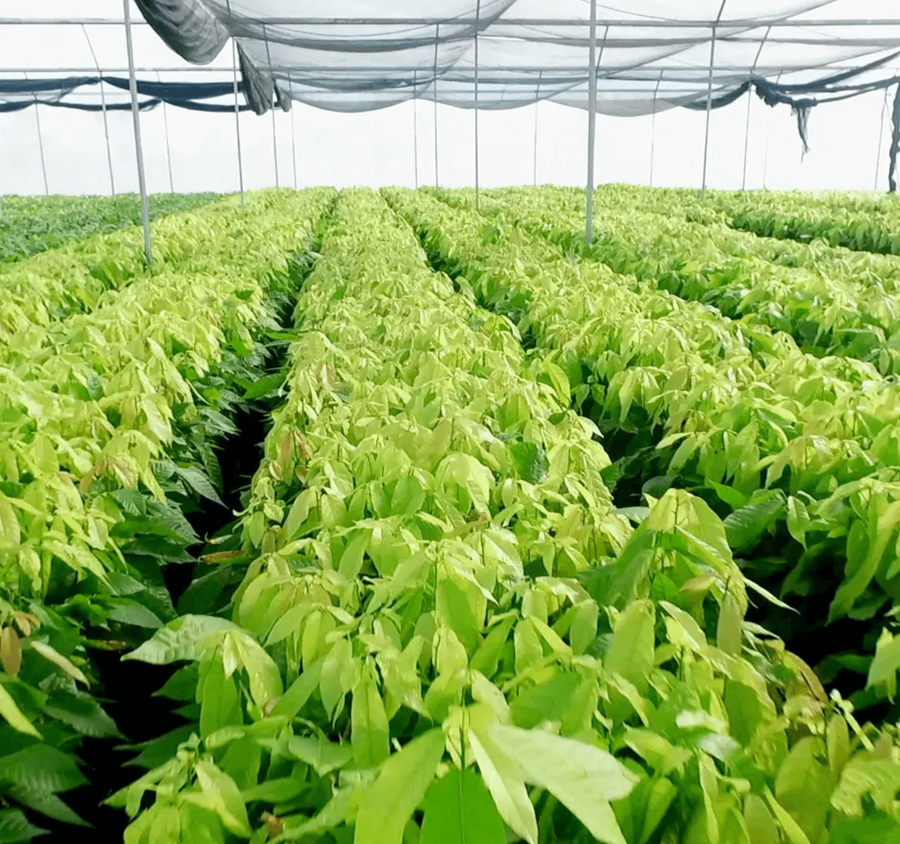
KEY INSIGHT: MICROCLIMATE MATTERS
Each farm is unique
Plot-Level Action
Plot level Variations

Slide 6
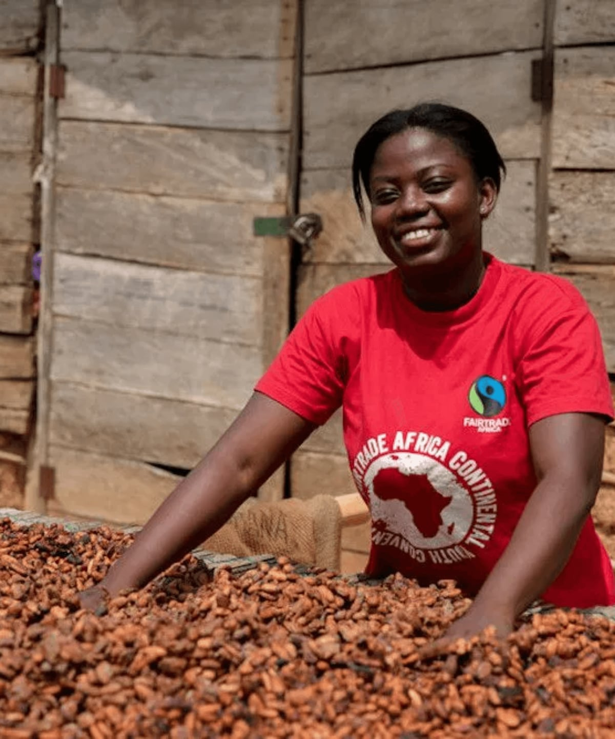
CACAO_IA SOLUTION:
PRECISION AT SCALE
Simple and clear decisions.
Plot-specific recommendations.
Real-time farmer empowerment.
-
-.

Slide 7

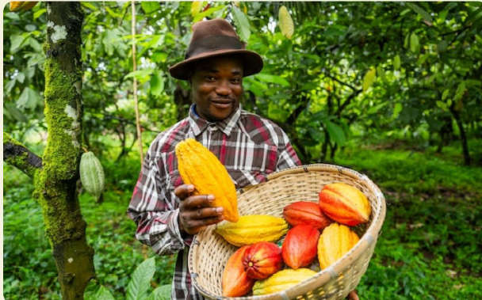
EXPECTED IMPACT
Reducing resource waste; chemical runoff
More sustainable agriculture
Intuitive technology; Enhanced expertise
Respect for traditional knowledge
higher productivity

Slide 8

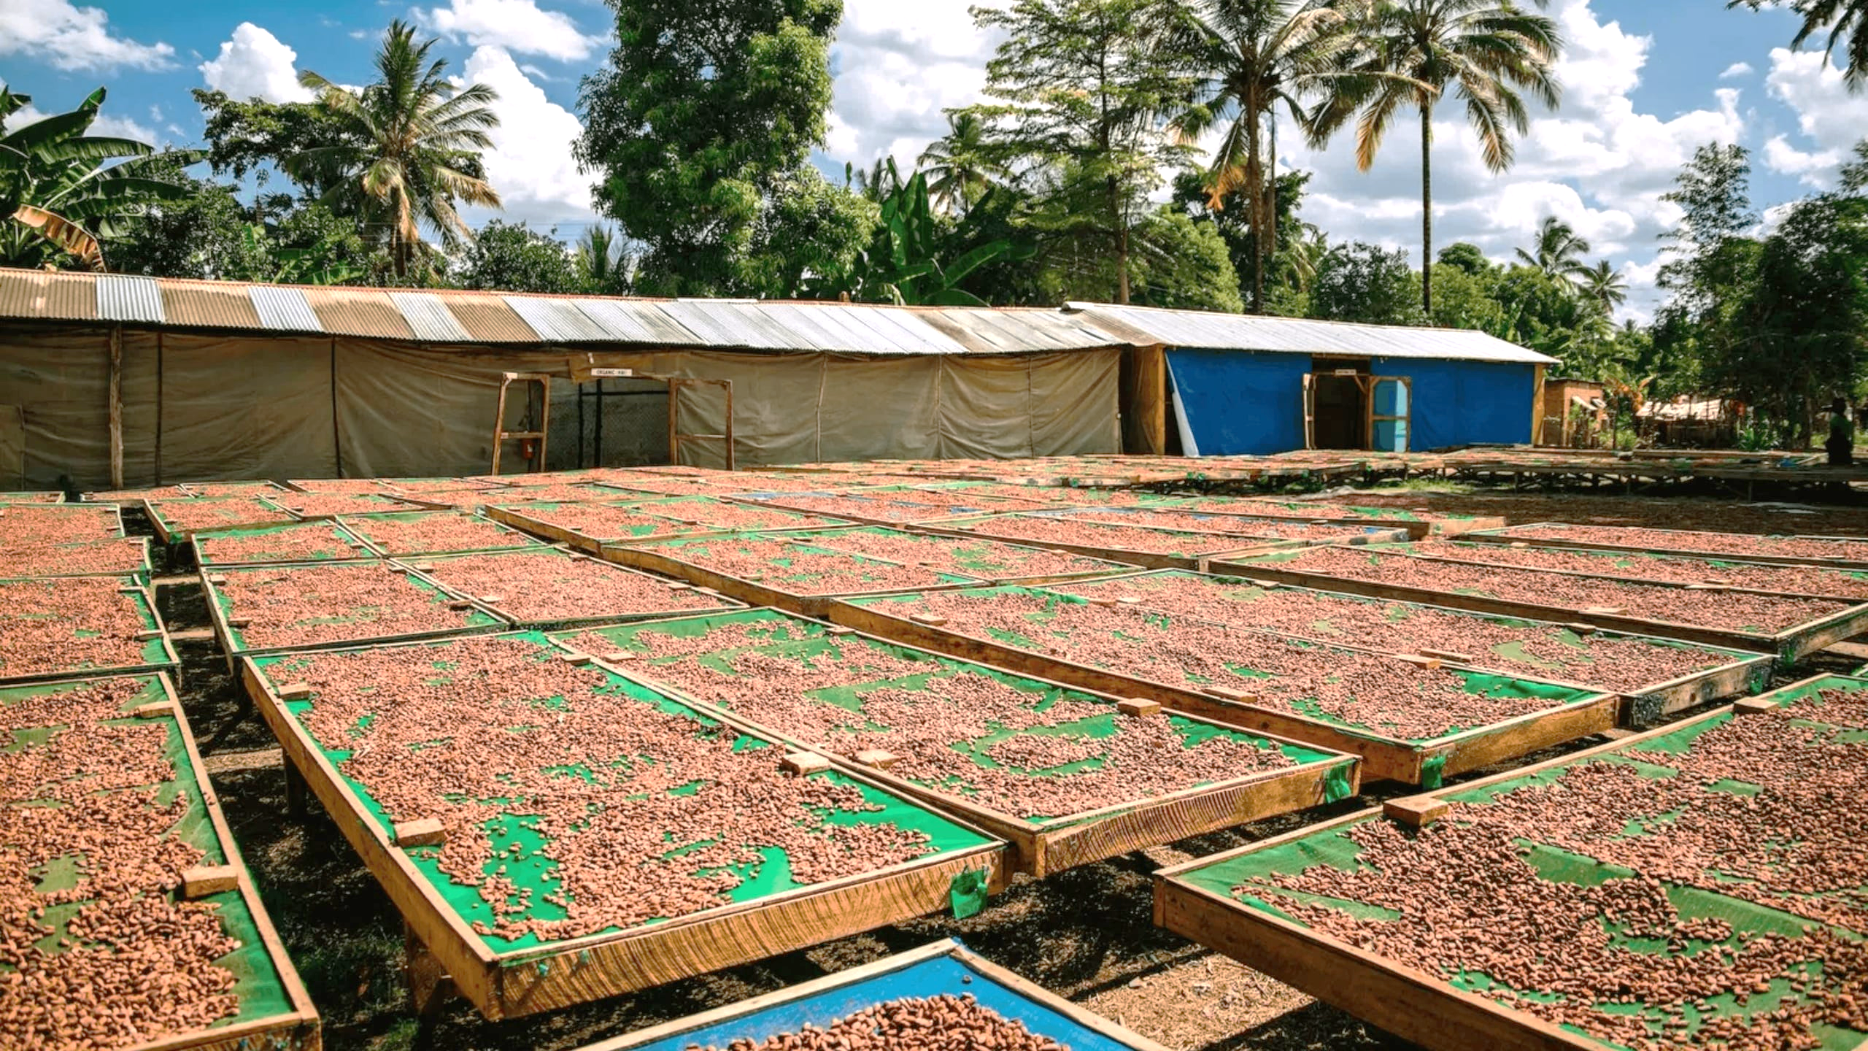
JOIN THE REVOLUTION
With Cacao_IA
👉 Stop suffering
👉 Make the right decisions
👉 Anticipate risks
👉 Adopt Cacao_IA now
.

Slide 9
Thank you
Any questions?
Apo.monsan@uvci.edu.ci

