Slide 1


TNC26 Innovation Programme Spotlight Lightning Talk
CHAMELEON-REN
Adaptive Web Honeypots for NREN Threat Intelligence

Slide 2



About Us
Adrian Winckles
Adrian Winckles is an independent Cyber Security Academic (Open University & Warwick), Security Researcher and IT Professional with over 32 years of experience in developing and implementing cyber security strategies and robust, resilient IT infrastructure solutions. A proven leader in driving digital transformation initiatives and a Board member in multiple organizations such as OWASP Cambridge Chapter Leader, OWASP Europe Board Member, Chair of OWASP Education and Training Committee and is on the Board of the Cyber East Cluster.
Gautam Juvarajiya
Cyber Security Research Associate at the Open University, UK with a background in IT and also hold a MSc in Cyber Security Engineering from the University of Warwick, UK (NCSC Certified, BCS Accredited) and 2+ Years of Work Experience in IT and Cyber Security.
CHAMELEON-REN
2

Slide 3
The Problem
The Behavioural Visibility Gap
Diverse Systems: Higher education runs complex web-facing systems (VLEs, SIS, Research Portals).
The Reality
Generic Intelligence: Commercial feeds rarely capture early-stage recon targeting university logic.
We see the late-stage alerts and incidents, but we lack insight into the attacker's intent, tooling, and progression across the kill chain.
Static Failure: Traditional honeypots are rapidly fingerprinted, deprioritised and ignored by botnets.
CHAMELEON-REN
3

Slide 4
The Insight
Attackers adapt based on the perceived target.
Unique Motivations: When adversaries see "University" infrastructure, they hunt for PII, Intellectual Property, and stage ransomware.
Cross-Border Campaigns: Empirically, attackers reuse infrastructure and techniques across multiple universities and NRENs.
Reframing the Challenge: Instead of asking how to block every attack, we must ask: How do we safely observe and understand attacker behaviour at scale?
CHAMELEON-REN
4

Slide 5


The Solution: CHAMELEON-REN
An adaptive, stimulus-driven web application honeypot designed specifically for the Research & Education sector.
Dynamic Identity: Changes its persona based on how it is being probed.
Maintains "Freshness"
Sector Realism: Mimics Moodle, WordPress, Odoo, and Gibbon SIS.
Cloud-Safe: Observational focus with zero-egress controls and strict isolation.
Extends attacker dwell time by presenting the exact vulnerabilities the scanner is hunting for.
CHAMELEON-REN
5

Slide 6

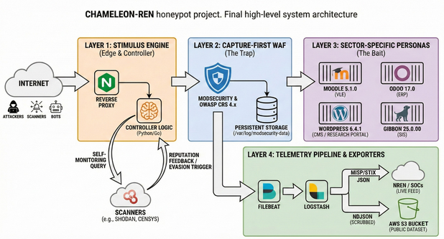
Architecture Overview
1. Edge: Stimulus Engine Inspects incoming traffic path & agents.
2. WAF: OWASP CRS logs payloads without blocking (Capture-First)
3. Traps: Deception Personas safely absorb the attack.
4. Telemetry: Normalised data into JSON for STIX export.
CHAMELEON-REN
6

Slide 7

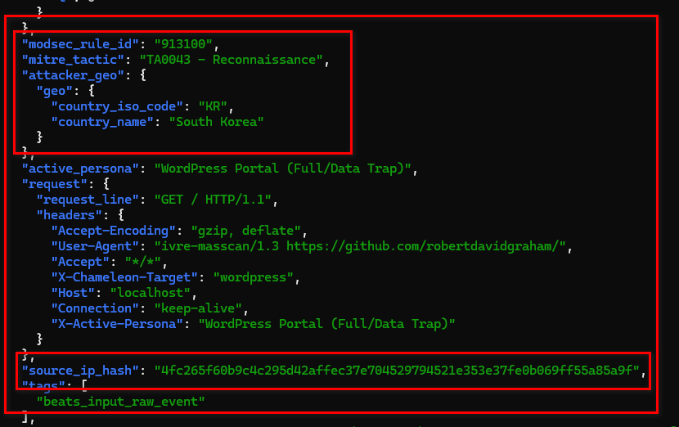

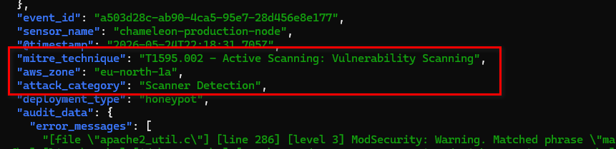
Visual Evidence: Raw Telemetry
Machine-Readable Telemetry
The system generates structured NDJSON. We utilise Salted SHA-256 IP Pseudonymisation to ensure strict GDPR compliance, tracking the actor while destroying the PII.
CHAMELEON-REN
7

Slide 8

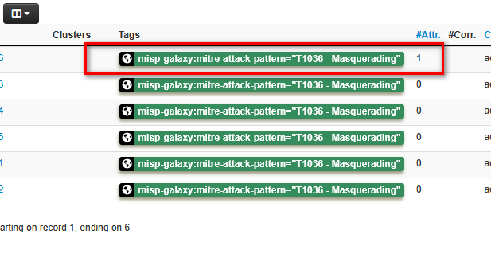
Threat Intel Export (MISP)
Actionable STIX 2.1
Telemetry is only valuable if it can be shared. A custom Python bridge extracts data from the AWS S3 Data Lake and dynamically constructs STIX 2.1 compliant MISP Event objects.
•
Automated MISP-Galaxy tagging.
•
Ready for SIEM/SOAR ingestion.
CHAMELEON-REN
8

Slide 9





What Makes It Different?
Dynamic Persona Switching
Education-Sector Realism
Self-Healing Components
Ensures collected data reflects attacks that matter to universities, eliminating generic CMS noise.
Stateless design allows operators to reset environments instantly after destructive attacks (like ransomware) without manual intervention.
Actively counters fingerprinting. Reduces the time infrastructure remains 'burned' by rotating identities while maintaining session consistency.
CHAMELEON-REN
9

Slide 10
Threat Intel Value & OWASP Alignment
Value for NRENs
OWASP Alignment
•
Identify common scanning patterns and campaigns across borders.
•
Builds directly on the OWASP Web Honeypot Project and Core Rule Set.
•
Inform detection tuning and firewall adjustments proactively.
•
Open-source licensing and community-driven development.
•
Derived from realistic interaction, not theoretical models.
•
Ensures project sustainability as attacker techniques evolve.
CHAMELEON-REN
10

Slide 11

Call to Action
Build Sector-Wide Intelligence Together
CHAMELEON-REN is not a finished product; it is a shared capability. Effective defence in research and education depends on openness and community ownership.
Deploy Sensors: Use Terraform IaC to deploy within your NREN.
Contribute Telemetry: Integrate anonymised outputs into your SOC pipelines.
Extend the Platform: Contribute new university personas via OWASP.
GITHUB LINK : https://github.com/OWASP/Honeypot-Project/tree/master/CHAMELEON-REN
CHAMELEON-REN
11

