Slide 1







From Identity to Impact: Building Trust Under Constraint — BonafID and the AfricaConnect Model
Leïla Dekkar, GÉANT
Abigail Essel, WACREN

Slide 2
Setting the scene –NRENs & RRENs in Africa

Slide 3
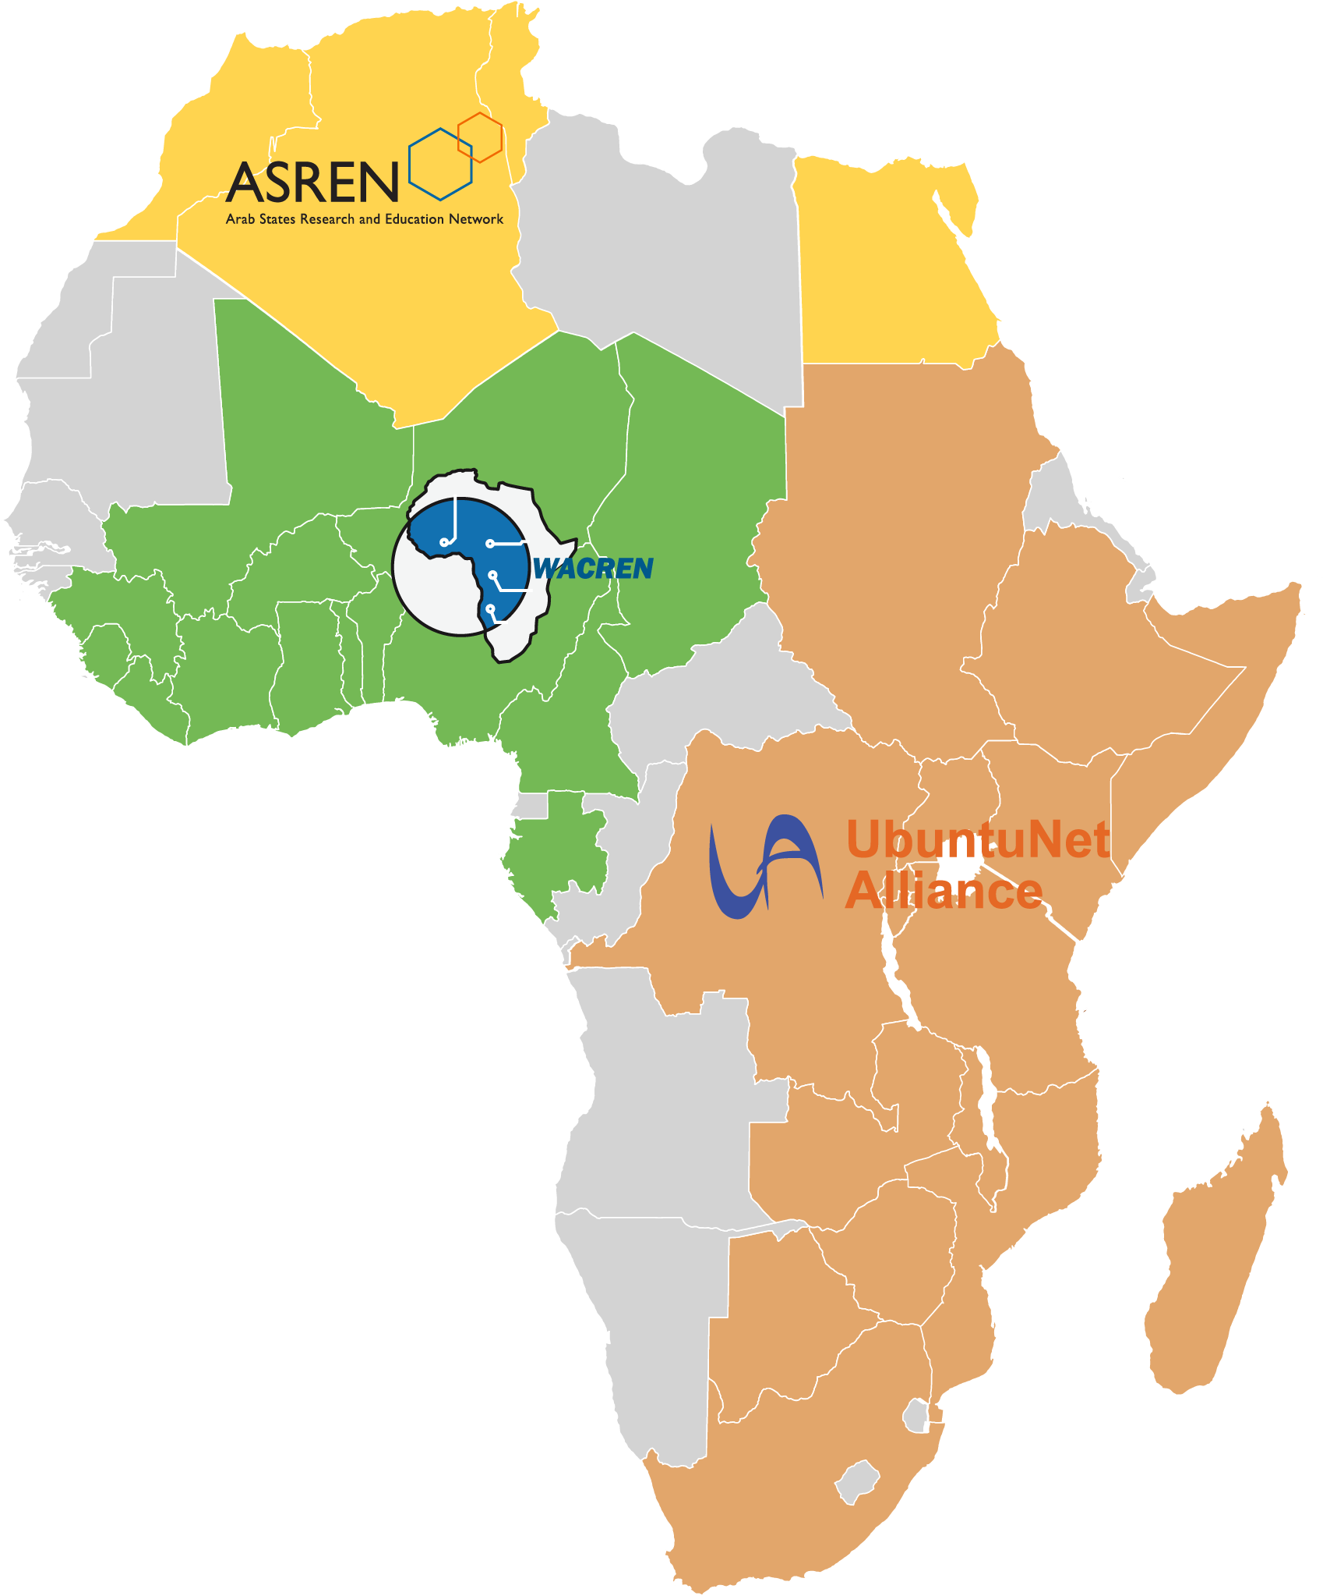
NRENs are a non-for-profit organisations dedicated to supporting research and education nationally and internationally through high-capacity connectivity and other value-added services.
38 NRENs in Africa and 3 RRENs
ASREN
WACREN
UbuntuNet Alliance
Algeria, ARN
Egypt, EUN
Morocco, MARWAN
Tunisia, CCK
Bénin, RerBénin and RBER
Burkina Faso, FasoREN
Cameroon, RIC
Tchad, TchadREN
Côte d’Ivoire, RITER
Gambia, GAMREN
Ghana, GARNET and GhREN
Guinea, Gn-REN
Liberia, LRREN
Mali, MaliREN
Nigeria, NgREN and Eko-Konnect
Niger, NigerREN
Sierra Leone, SLREN
Togo, TogoRER
Botswana, BotsREN
Burundi, BERNET
DRC, Eb@le
Ethiopia, EthERNet
Kenya, KENET
Leshoto, LesREN
Madagascar, iRENALA
Malawi, MaREN
Mozambique, MORENET
Rwanda, RWEDNET
Somalia, SomaliREN
South Africa, TENET, SANREN,SABEN
Sudan, SudREN
Tanzania, TERNET
Uganda, RENU
Zambia, ZAMREN
Zimbabwe, ZIMREN

Slide 4




More than 20 years of European Comission support to NRENs in Africa
Project Duration | Budget
2001-2007 2008-2011 | 12.4M -80%EC funding 7.4M 54% EC funding
2011-2015 | 14.75M -80%EC funding
2015-2021 | 26,6M - (75%/80%/60%) EC funding
2019-2025 2026-2029 | 37,5M – 80% EC funding 40M – Approx: 95%/100% EC funding
AfricaConnect4
Notes:
Late 90’s, African universities and research institutions, feel the stronger/urgent/essential need for global connectivity, journal databases and other online resources to participate to global research.
A Bandwidth Consortium (BWC) funded by the US-based Foundations' Partnership for Higher Education in Africa (PHEA) was among the first initiatives to aggregate the purchase of connectivity for higher education.
NRENs in Africa started to be created by their institutional communities (Bottom-Up) in the early 90’s in North Africa and from late 90’s onwards in Eastern and Southern Africa

Slide 5
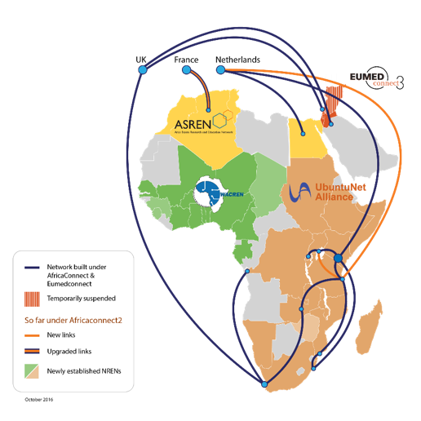
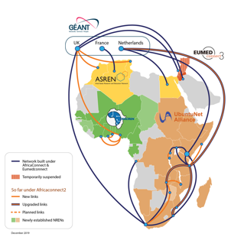
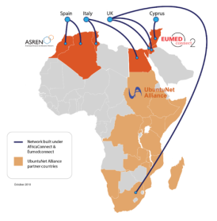
Connectivity of NRENs in Africa 2010-2019
– Initial Focus on Regional Connectivity
Before AfricaConnect - 2010
5 Countries Connected
End of AfricaConnect1 -2015
9 Coutries connected
End of AfricaConnect2 -2019
19 countries connected

Slide 6
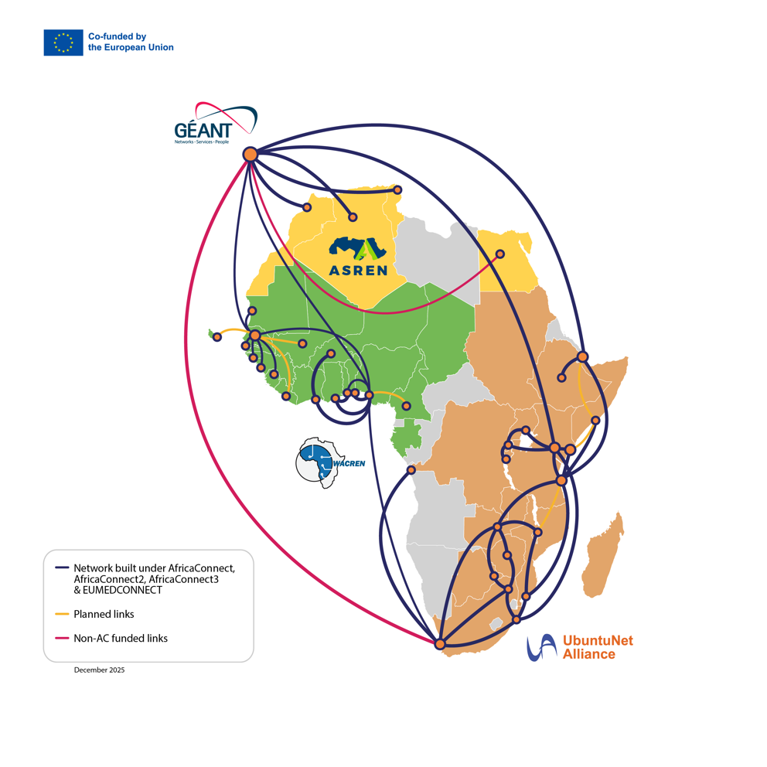
Connectivity of NRENs in Africa
Since AfricaConnect started in 2011, 31 out of 38 African NRENs have been connected to their regional network:
UbuntuNet Alliance 14: Etiophia, Botswana, Burundi, DRC, Kenya, Lesotho, Malawi, Mozambique, Rwanda, Somalia, South Africa, Tanzania, Uganda, Zambia and Zimbabwe.
WACREN 12: Benin, Burkina Faso, Côte d’Ivoire, Ghana, Guinea, Guinea-Bissau, Mauritania, Nigeria, Senegal, Sierra Leone, The Gambia, Togo.
ASREN 4: Algeria, Egypt, Morocco and Tunisia.

Slide 7



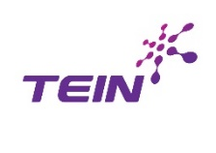









Together we connect 3000+ institutions and 9+ million users in Africa
RRENs
NRENs
R&E Institutions
Universidad Técnica “Luis Vargas Torres” de Esmerelda
Universidad de Cuenca
Institut Jules Bordet
Universiteit Antwerpen
Virtual
University of Uganda
Infectious Diseases Institute
University of Ghana
Ashesi University College
Université de Ghardaia
Centre de Recherche en Atronomie, Astrophique et Géophysique
University Of Dhaka
Sylhet Agricultural University

Slide 8
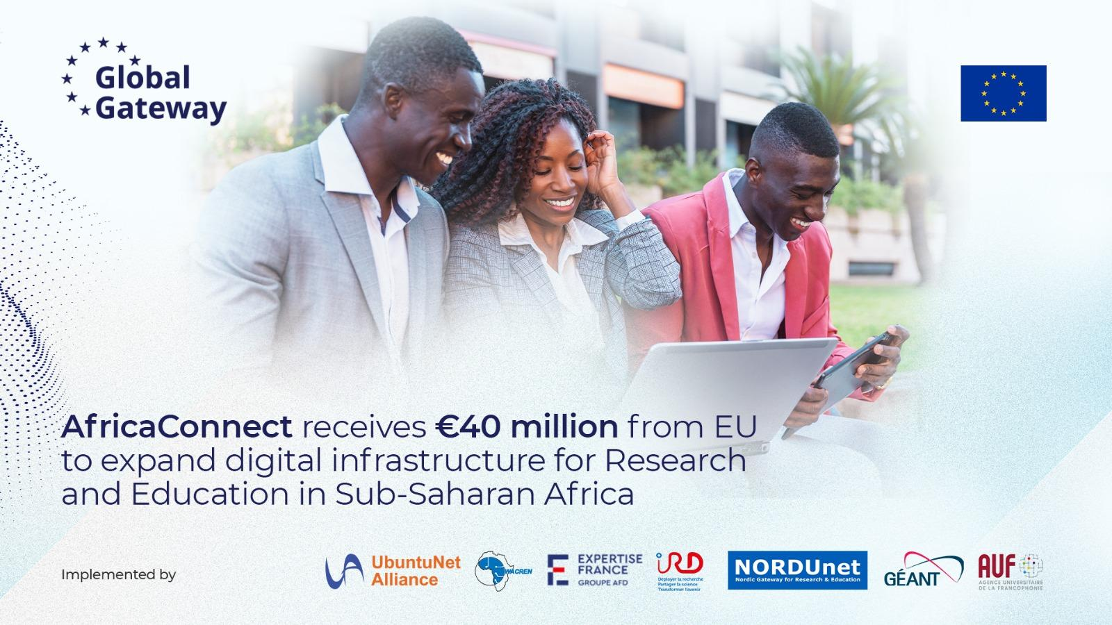

Slide 9
What is AfricaConnect4?
Objectives 2026-2029
Enhance the delivery capacity and the financial and institutional sustainability of African Regional and National Research and Education Networks (RENs).
Ensure African R&E communities’ access to affordable, reliable, high-speed connectivity infrastructure and connection to the global R&E community.
Strengthen the delivery of above-the-network services by RRENs and NRENs to R&E communities in Sub-Saharan Africa (SSA), with particular focus on supporting e-learning and climate change science and related disciplines.
Overall Objective: increase African Research and Education (R&E) communities’ access to and use of information and communications technology, and to enhance international cooperation on science, technology and innovation to address global challenges.
€40M from DG INTPA

Slide 10
Project profile
€15M for West Africa
€25M for Eastern and Southern Africa
EU Grant Contract
4 GRANTS 4 CONTRACTS
*NEW*
UbuntuNet Alliance Grant
€24.3M tbc
GÉANT Grant
€7.155M
WACREN Grant
€5M
*NEW*
Expertise France / IRD/ AUF Grant
€4M
€40M from DG INTPA
WACREN Co-beneficiary
Benin, Togo, Côte d’Ivoire
UA co-beneficiary
Nordunet
Support

Slide 11
Summary of GÉANT role and Grant in AC4
Overall coordination of AC4
Regional Procurement
  WACREN Contracts (3 Links + pop equipment + connecting 5 HPC to WACREN network + WMO-Certified weather stations + cloud + consultancy contract + Cybersecurity Threat Intelligence Platform)
  Advice / Compliance for UA
Ad hoc support / Thematic expertise
  0.24FTE for UA and WACREN
  0.4 FTE NORDUNet support for WACREN
Knowledge Management and Outreach
New: Africa-Europe NREN Twinning Programme – to be launched end of the year

Slide 12
Building Trust Where It Cannot Be Assumed
Identity, Access, and Digital Resilience in AfricaConnect
Presented by: Abigail Essel
Project Manager, WACREN

Slide 13


Trust: The Missing Infrastructure
Imagine a researcher in Ghana trying to:
The infrastructure exists.
Access a shared research platform in other Africa countries or across Europe
Join a regional project
Use institutional Wi-Fi abroad
Access cloud resources from another university
The internet connection exists.
The platform exists.
The partnership exists.
But access fails — because systems do not know who to trust.
WACREN · AfricaConnect4 · GÉANT | TNC2026

Slide 14
Connectivity Without Trust Creates Friction
Root Causes
The Result
User records are fragmented
Identity systems are inconsistent
Authentication processes differ
Some institutions lack digital identity entirely
Multiple accounts and passwords
Limited service adoption
Slow onboarding
Poor user experience
Reduced collaboration
→
Connectivity alone does not create a digital ecosystem. Trust infrastructure is essential.
WACREN · AfricaConnect4 · GÉANT | TNC2026

Slide 15





The Cost of Weak Digital Identity
Researchers
lose time
Services remain
underused
Collaboration
becomes difficult
Institutions stay
digitally isolated
Ecosystems struggle
to scale
No identity → No trusted access → Limited collaboration → Isolated ecosystems
The result: infrastructure exists, but participation remains limited.

Slide 16

The Environment We Build In
Challenges
Yet expectations increase
High connectivity costs
Fragile infrastructure
Uneven institutional readiness
Limited technical capacity
Rapidly growing digital demand
More collaboration
More mobility
More shared services
More global integration
Digital Sisu
This is where resilience becomes necessary — building when conditions are not in your favour.

Slide 17



The Goal Is Simple
Enable trusted and seamless participation in digital research ecosystems.
Access services
securely
Move across institutions
easily
Collaborate
across borders
Use shared infrastructure
confidently
Participate fully in global
research communities
Trusted digital access should not depend on geography.

Slide 18
Introducing BonafID
What is BonafID?
WACREN's identity-as-a-service platform — now moving from pilot into operational deployment.
Trust
Infrastructure
Strengthen identity assurance
Support institutional onboarding
Enable federated identity
Improve interoperability
Simplify access to services
BonafID transforms fragmented identity environments into trusted ecosystems.
WACREN · AfricaConnect4 · GÉANT | TNC2026

Slide 19
Building a Federated Trust Model
Institutions
Digital Services
→
→
→
BonafID
Researchers
Regional Infrastructure
Federation Hub
→
Services trust institutions · Institutions trust the federation · Users access services seamlessly
WACREN · AfricaConnect4 · GÉANT | TNC2026

Slide 20


What Trusted Identity Unlocks
eduroam
Federated Collaboration
This Means:
Easier access to services
Better user experience
Increased adoption
Stronger regional collaboration
Shared Research Platforms
Regional Digital Platforms
Open Science Infrastructure
Identity is the bridge between connectivity and usability.
WACREN · AfricaConnect4 · GÉANT | TNC2026

Slide 21
Start Small. Build Trust. Scale Gradually.
WACREN NREN Academy Model
1
2
3
4
5
Introduce
Build
Support
Strengthen
Scale
One service accessible to all NRENs
Institutional capability
Operational adoption
Trust relationships
Progressively
This approach avoids:
Unsustainable deployments · Technology overload · Low adoption rates
WACREN · AfricaConnect4 · GÉANT | TNC2026

Slide 22
What This Creates
For Researchers
For Institutions
For the Ecosystem
Easier access to services
Better collaboration opportunities
Reduced barriers to participation
Stronger digital capacity
Improved interoperability
Access to regional & global services
Increased trust
Higher service adoption
Stronger research communities
Sustainable digital growth
WACREN · AfricaConnect4 · GÉANT | TNC2026

Slide 23
AfricaConnect Is Evolving
FROM
INTO
A trusted service ecosystem
→
A collaboration platform
A connectivity initiative
evolving
Focused on connecting networks and infrastructure
A digital community framework
Connecting people, services, and institutions through trust.
WACREN · AfricaConnect4 · GÉANT | TNC2026

Slide 24


Building Under Constraint Creates Stronger Systems
In many environments, trust is assumed.
In ours, trust must be intentionally designed.
Build Progressively
Design for Sustainability
Focus on Adoption
Gradual rollout ensures sustainability
Long-term thinking over quick wins
Unused services create no value
Prioritise Operational Reality
Treat Trust as Infrastructure
Build for your context, not ideal conditions
Trust enables everything else
WACREN · AfricaConnect4 · GÉANT | TNC2026

Slide 25
Digital Sisu in Practice
Even when systems are fragmented
Even when institutions are unevenly prepared
Even when trust cannot be assumed
One institution.
One trusted identity.
Let's Compare Notes
One operational service.
One research community at a time.
Working on identity, federation, or service adoption? We're building this together with GÉANT — the harder lessons travel.
WACREN · AfricaConnect4 · GÉANT | TNC2026

Slide 26



Q & A
THANK YOU!
Email: pmo@wacren.net
WACREN · AfricaConnect4 · GÉANT | TNC2026

