Slide 1
RIPE Governance
Anna Wilson, Mirjam Kühne (RIPE Chair Team)
Anna Wilson | TNC 26| June 2026

Slide 2
AGENDA
What is RIPE
RIPE and the RIPE NCC
RIPE Governance
What’s going on
How can you participate
Questions
Anna Wilson | TNC 26 | June 2026

Slide 3
Connecting people and networks since 1989
Réseaux IP Européens (RIPE)

Slide 4
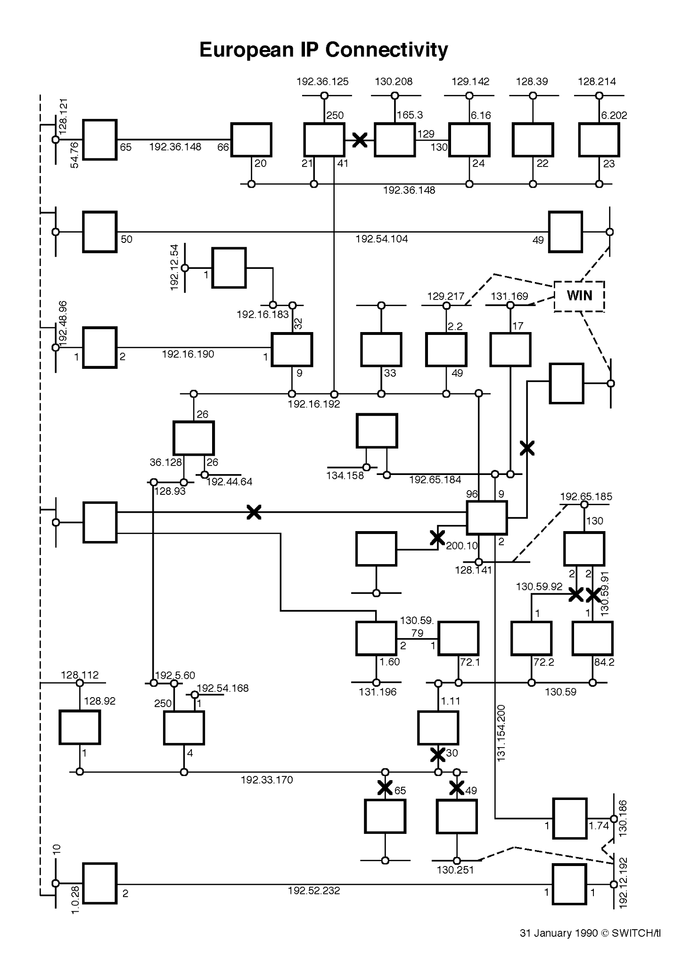
RIPE History
Anna Wilson | TNC 26 | June 2026
Notes:
Placeholder for the fact that RIPE was created in the academic world
First participants: NRENs (see https://www.ripe.net/publications/docs/ripe-002/ )
RIPE NCC started as a project under RARE; then later became independent membership association

Slide 5
RIPE History
RARE
RIPE NCC
EARN
TERENA
GÉANT Association
DANTE
Anna Wilson | TNC 26 | June 2026
Notes:
RIPE started in 1989, a few years after RARE
RIPE NCC started (1992) as a project under RARE - at the time most RIPE members were academic/NRENs so it was the logical choice
then later (1997) became independent membership association after RARE became TERENA

Slide 6


RIPE and the RIPE NCC
Formed in 1989
Open Community; volunteers
Information Exchange
Technical Coordination
Policy Development
Formed in 1992
Membership Organisation
Run by staff; overseen by Board
Secretariat for RIPE
Implements policies and other community decisions
Anna Wilson | TNC 26 | June 2026
Notes:
Difference between RIPE and the RIPE NCC

Slide 7
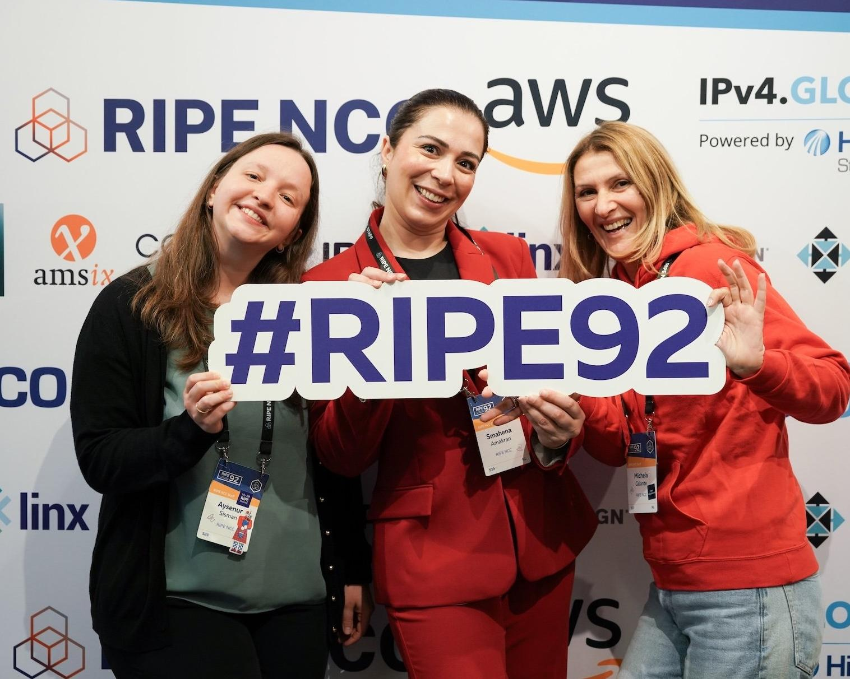
RIPE Operations
Two RIPE Meetings per year
Working Groups, plenary, mailing lists
Open discussions
Consensus Process
Anna Wilson | TNC 26 | June 2026
Notes:
Who does RIPE operate even though it is not a legal entity
Two meetings a year, smaller than TNC, but with continuous discussions around certain topics (in WGs)
People communicate mostly on mailing lists
We have open discussions, all lists are open, recordings of meetings are published
Decisions are made by consensus.

Slide 8
RIPE Governance
RIPE Chair Team, PC, WG chairs (Leadership)
Consensus Process
Decisions are published and freely available (ripe-documents)
  Code of Conduct
  Leadership appointments
  Relation between RIPE and RIPE NCC
  Policy Development Process
Anna Wilson | TNC 26 | June 2026
Notes:
RIPE has a solid governance foundation
All decisions are made by consensus and are available as RIPE documents
Examples are: how leadership is chosen, relationship between RIPE and the RIPE NCC, CoC, the PDP (which is a pretty formal document because it has implications for network operations)

Slide 9
What’s going on

Slide 10
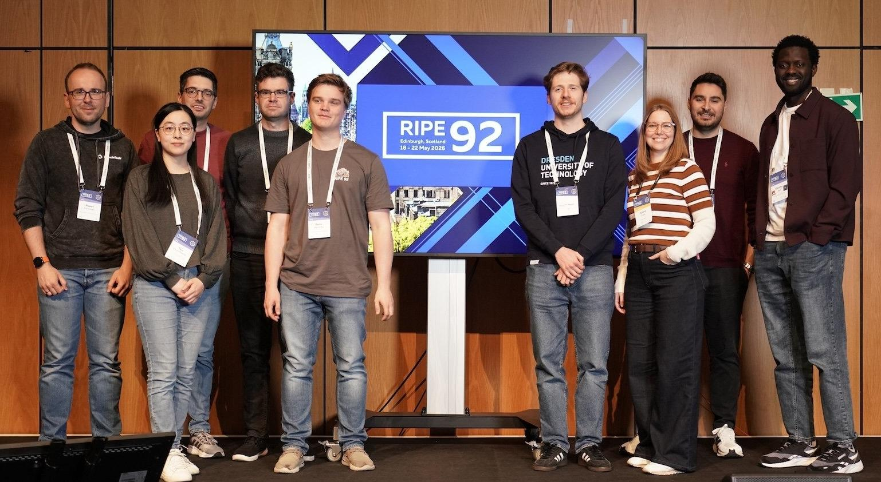
Why is this relevant for NRENs
Research topics
  Measurements, Analysis and Tools (MAT) WG
  Routing Security, IPv6 WGs
  RIPE Academic Fellowship programme
Governance and Policy Topics
  Legacy Address space
  Charging scheme
  (for NCC members)
Anna Wilson | TNC 26 | June 2026
Notes:
Photo: RACI fellows at RIPE 92
Many NREns involved in RIPE

Slide 11
How to participate

Slide 12
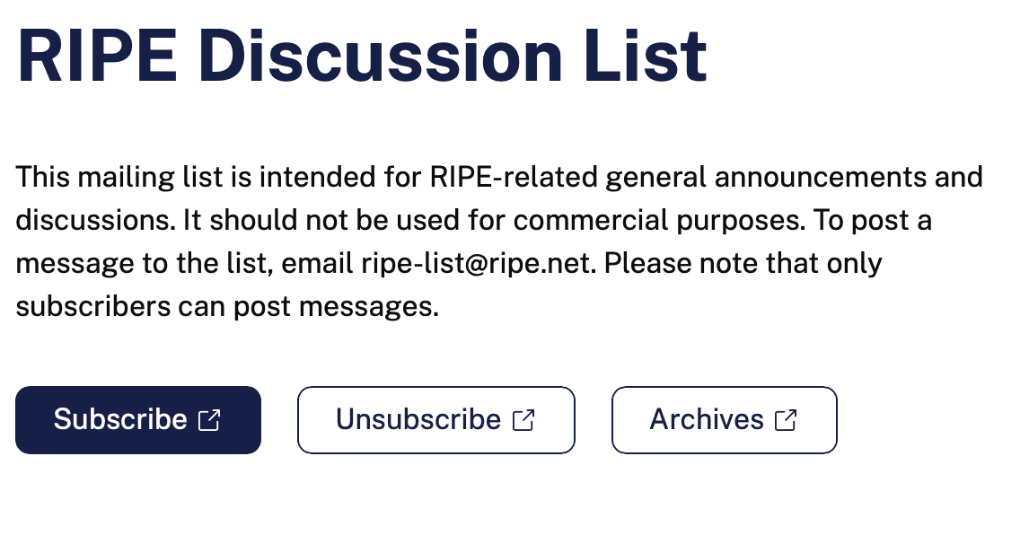
Join a Mailing list
RIPE Discussion List
Working Group Lists
https://www.ripe.net/membership/mail/ripe-mailing-lists/
Anna Wilson | TNC 26 | June 2026
Notes:
All WGs have mailing lists

Slide 13

RIPE Meetings: Save the Dates!
RIPE 93 (Sofia): 26-30 October 2026
RIPE 94 (Vilnius): 24-28 May 2027
RIPE 95 (Location TBC): 15-19 Nov 2027
The dates until RIPE 100 are already announced.
  https://www.ripe.net/meetings/ripe-meetings/upcoming-ripe-meetings/
Anna Wilson | TNC 26 | June 2026
Notes:
Join our meetings!

