Slide 1
Global Cloud Café
Can OCRE Become Global ?
Luiz Coelho (RNP Brazil)
Helsinki, Finland
Tue 9 Jun

Slide 2
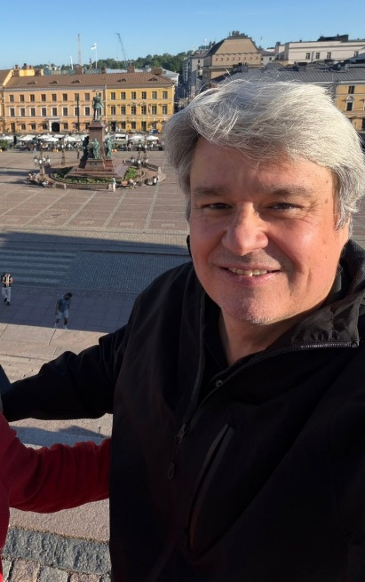
Luiz Coelho (RNP)
Digital Services Director at RNP, leading initiatives focused on advanced digital infrastructure, research support services, cloud and data center strategy, cybersecurity, and innovation for Brazil’s education and research community.
Develop service portfolios, expanding colocation and national data center initiatives, fostering international collaboration with other NRENs, and exploring emerging areas including sovereign cloud, AI, open science, digital education, and liquid cooling technologies.
Connecting researchers, public policy initiatives, funding agencies, and technology providers to strengthen Brazil’s national research and education ecosystem through scalable digital services and strategic partnerships.
Notes:
At RNP, we are not just buying cloud
-Cloud is available, but not accessible at scale
-The bottleneck is procurement + funding + governance, not technology
—we are trying to make cloud usable, affordable, and compliant for an entire national research ecosystem.

Slide 3
Three structural barriers
Funding mismatch
  Capex mindset vs Opex cloud consumption
Legal & compliance friction
  Public procurement rules not designed for elastic services
90/10
  90% IaaS/PaaS
  10% Integrator services
Notes:
Our challenge is not choosing between AWS, Azure, or GCP.
It’s enabling institutions to legally and sustainably consume any of them.

Slide 4
Why OCRE Matters ? The Strategic Opportunity
OCRE is not just a contract, it’s a system
Aggregated demand → real bargaining power
Pre-negotiated compliance → removes legal friction
Multi-cloud ecosystem → avoids lock-in
Discounts up to ~30% and better contractual terms
Standardized agreements reduce legal uncertainty
Free/optimized data transfer out is a major value
Notes:
OCRE is less about cloud procurement and more about market design for research.

Slide 5
What OCRE Does NOT Solve
Your own study is clear:
Access ≠ adoption
Contracts ≠ usage
Availability ≠ impact
Three limits:
No funding → no consumption
No skills → no usage
No governance → no scale
Notes:
“OCRE solves the supply side.
But the real bottleneck in Latin America is still the demand side.

Slide 6
RNP Cloud Strategy
RNP is positioning itself as:
Aggregator (procurement + demand)
Integrator (network + cloud + data infrastructure)
Enabler (training, onboarding, support)
“We are not importing OCRE. We are testing how to translate it into a different institutional reality.”

Slide 7
Can OCRE Become Global ?
OCRE can scale globally — but not as a copy-paste model.
Three conditions for global viability:
Legal adaptability (public procurement varies widely)
Regional aggregation layers (e.g. RedCLARA)
Coupling with funding mechanisms (credits, grants, vouchers)
Notes:
Without funding instruments, a global OCRE risks becoming a global contract with local irrelevance.
How much of your OCRE usage is actually incremental research, vs migration of existing workloads?
Are we solving procurement efficiency, or actually enabling new science?
Is sovereignty about where data sits, or who controls access and economics?
]

Slide 8
Thank you
Any questions?
luiz.coelho@rnp.br
https://www.rnp.br/

Slide 9
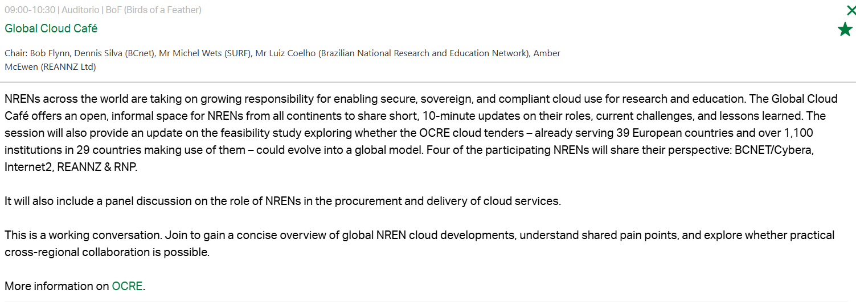
TNC26

