Slide 1
Global Cloud Café
What’s up in the US R&E Cloud Community?
Bob Flynn, Internet2
TNC Auditorio
Tuesday 9 June 2026

Slide 2
Agenda
  Introduction
  A snapshot from the annual State of the Cloud Survey
  Feeding Higher Education’s Superpower: Collaboration

Slide 3
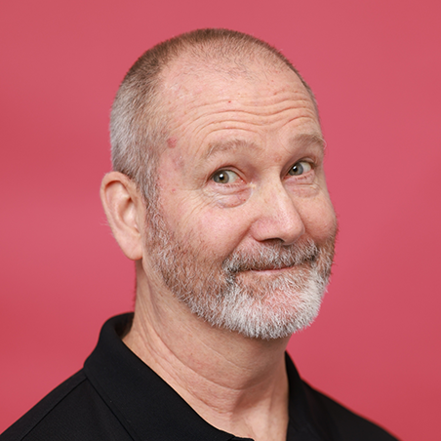
Who am I?
Currently
  Senior Program Manger for Cloud Infrastructure & Platform Services at Internet2
  Director of the Cloud Infrastructure Community Program (CICP) and the Cloud Learning and Skill Sessions (CLASS) training program
  Chair of the Higher Education Cloud Forum
Previously
  25 years in various IT roles at Indiana University, 7 years running the enterprise cloud infrastructure
  Co-chair Higher Education Cloud Computing Community Group (CCCG)
Way Back
  Russian teacher in US, English teacher in Hungary, Ultimate Frisbee evangelist worldwide

Slide 4
The State of the Cloud in US Higher Ed

Slide 5



The Basics
The Good
  Cloud maturity is accelerating. What was level 5 two years ago is level 3 now. (e.g., Infrastructure as Code, FinOps)
  Cloud strategy language is shifting from mandate to judgment call
  Growth in Cloud is driven by actual rather than perceived strengths
  Sustainability has entered the conversation about computing choices
The Bad
  There is a national shortage of cloud skills
  FinOps: the problem is visibility, not willpower
  New standards for secure research are causing confusion and poorly-informed decisions
The Ugly
  AI cost overruns – 24-hour billing lag in the platforms is insufficient
  Unpredictability of research funding

Slide 6
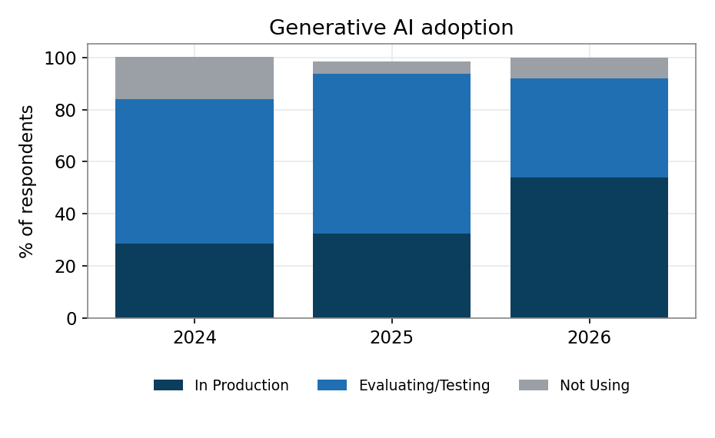
AI Has Moved from Evaluation to Production

Slide 7
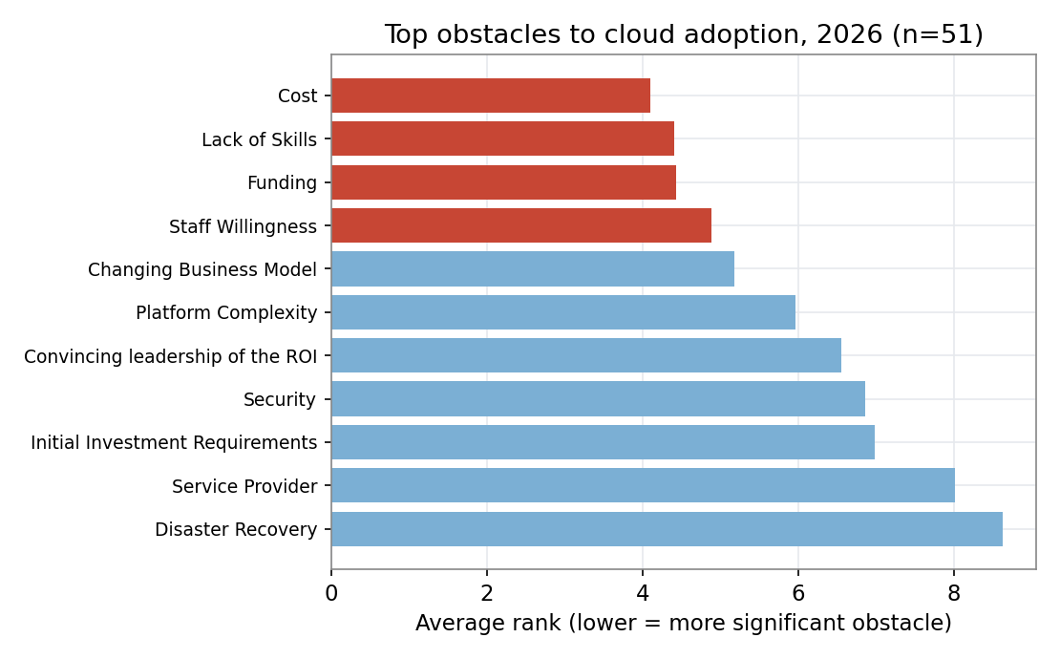
Top Obstacles to Cloud Adoption

Slide 8
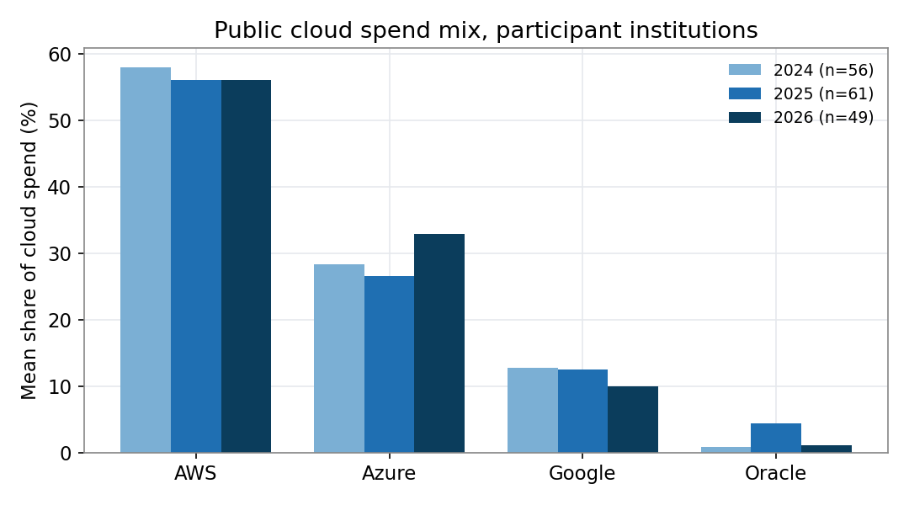
Where Are US Institutions Spending Their Money in the Public Cloud?

Slide 9
How Do We Try to Make a Difference?

Slide 10
The Community – A Workforce Multiplier
Higher Education Cloud Computing Community Group (CCCG)
  Started over a decade ago and now has 2,200+ subscribers
  Run by volunteer cloud professionals from the community who serve 3 years as co-chair
  Monthly community calls (4th Wednesday, 16:00 GMT in summer)
  They highlight the work being done by community members. Vendors never present.
  Internet2 provides logistical and staffing support
  https://internet2.edu/cccg
Cloud Infrastructure Community Program (CICP)
  Formally started in 2024
  85 subscribing institutions
  4-5 community calls/month, focused on the specific technology (AWS & GCP for now)
  CICP details at Tuning into the Community: Cloud, Trust, and Funding today at 14:00
  https://internet2.edu/cicp

Slide 11
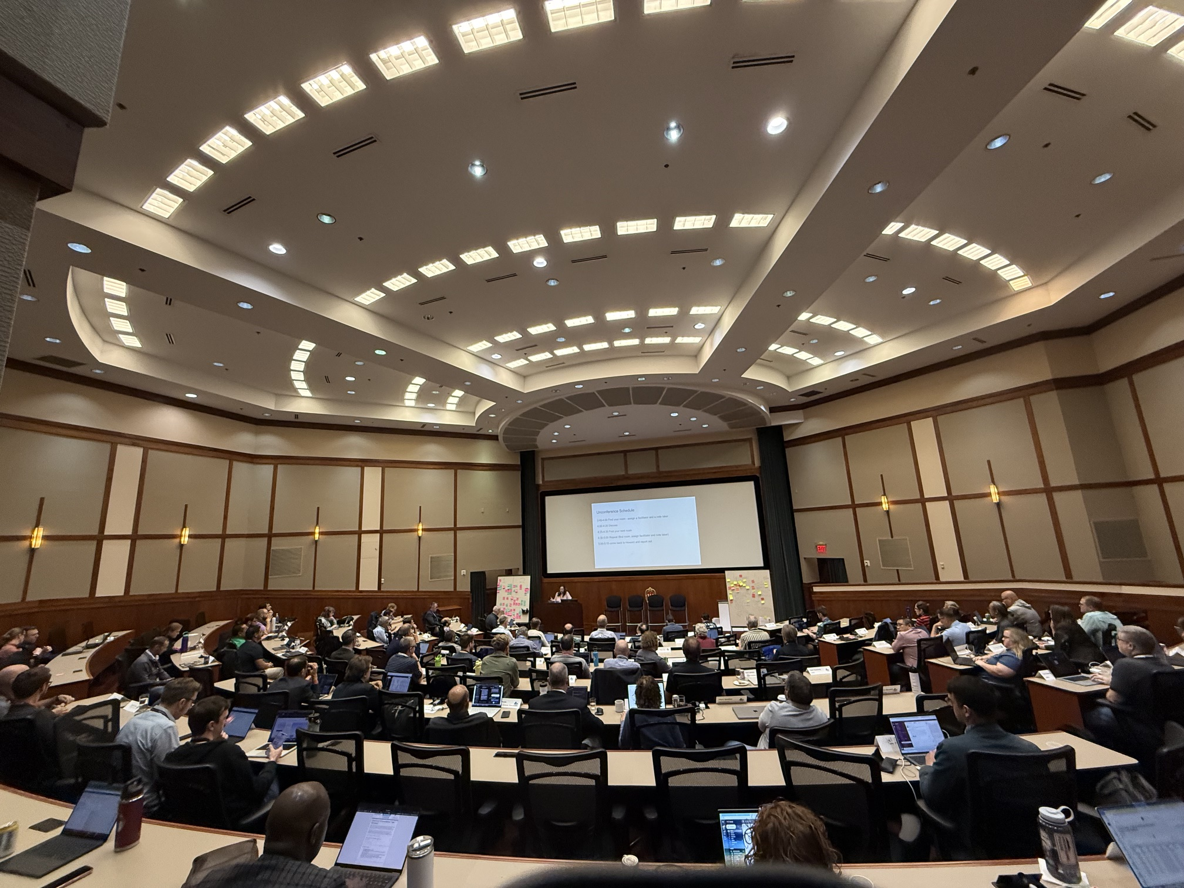
The Higher Education Cloud Forum
Begun in 2015 at Cornell University with a goal of fostering conversations about cloud strategy in R&E
Free but limited registration
CSPs invited to send two representatives to listen
Management and support shifted to Internet2 in 2022
Hosted by a different institution each year
Cloud Forum 2026 was held at the University of Wisconsin – Madison from May 19-22
In addition to US institutions and a few federal agencies, we’ve had attendees from CERN, RNP, SURF, SWITCH, and SingAREN
Cloud Forum 2026 will be held at the University of Virginia in late May or early June 2027
https://internet2.edu/cloud-forum

Slide 12
The Higher Education Cloud Maturity Model - Overview
 | Level 1 | Level 2 | Level 3 | Level 4 | Level 5
Domains | Ad Hoc & Experimental | Opportunistic & Project-Based | Systematic & Defined | Managed & Quantified | Strategic & Optimized
Governance & Policy
Workforce & Culture
Architecture & Security
Operations & Automation
Financial Management (FinOps)

Slide 13
The Higher Education Cloud Maturity Model – Domain View
Financial Management | Level 1 | Level 2 | Level 3 | Level 4 | Level 5
Subdomains | Ad Hoc & Experimental | Opportunistic & Project-Based | Systematic & Defined | Managed & Quantified | Strategic & Optimized
Billing/ Chargeback
Rate Optimization
Understanding usage/cost
Understanding business value
Billing/ Chargeback

Slide 14
What’s Next – The Cloud Incubator
What is it?
  A guided, year-long foundations program for schools that are still moving from exploration to execution
  It is designed to help institutions build a production-ready foundation in one year, with a clear account structure, integrated identity and access, billing and cost visibility, governance guardrails, security monitoring, and at least one real workload deployed
  Best-practice guidance from the collective experience of seasoned cloud professionals in the community helps schools focus on what is fundamental to long-term success
  Incubator schools are matched with experienced community members who serve as mentors for the year
  Whether a school has big plans for the cloud or small it helps them set the right foundations

Slide 15
What’s Next – The Cloud Incubator
Who is it for?
1 – New to Cloud - Cloud literacy is a bigger gap than cloud skills
  Many schools don’t know what they don’t know
  What would motivate you to choose cloud tools if you don’t know what they do
  How do they get started?
  Surely someone else has figured this out
2 – Professionalizing Organic Cloud - Early adoption can come at a price
  ”Free-range” account growth goes unchecked
  Individual users setting up organizations, sometimes claiming your domain
  No one can tell you how much the institution is spending
  Missing out on aggregate spend discounts
  No central management of cloud

Slide 16
Thank you
Any questions?
bflynn@internet2.edu

