Slide 1
TNC 101
Newcomers Guide to TNC
Ariela Herček and Joost Gadellaa, TNC26 Programme Committee
TNC26
9 June 2026

Slide 2
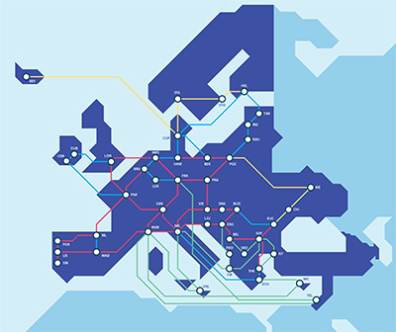


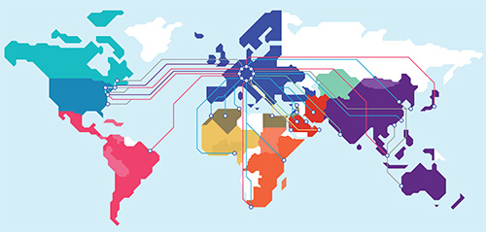


Who is GÉANT?
Network & Connectivity
Security
Trust & Identity
Cloud
Supporting and representing
38 NRENs + NORDUnet across Europe
Interconnecting research and education communities worldwide
Managing a portfolio of advanced research and education services

Slide 3
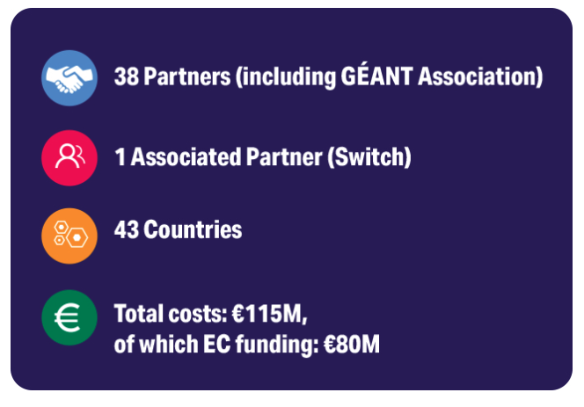

The GÉANT Project
GN5-2 is the latest phase of the long-running and highly successful GÉANT Project, supporting Europe’s research and education communities for over 25 years in close collaboration with the European Commission.

Slide 4
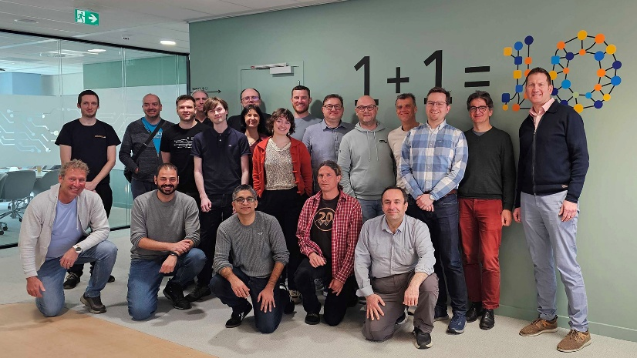
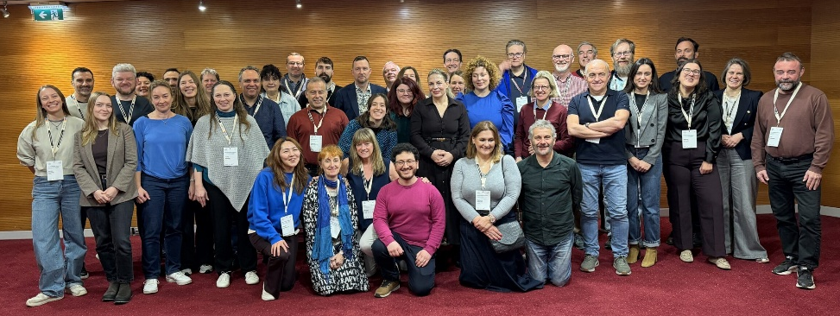
The GÉANT Community Programme
A voluntary based initiative for collaboration between community experts
A forum to exchange knowledge
Who can join?
NRENs staff
Staff of member research organisations or user institutions

Slide 5
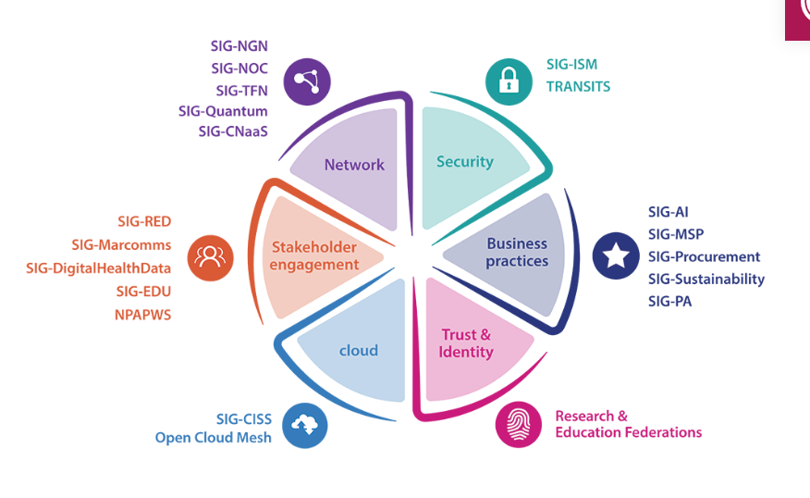

Slide 6

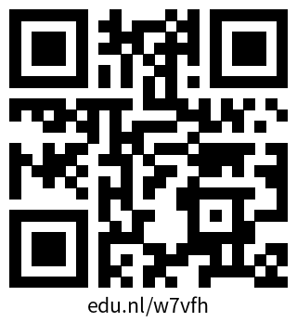
…and so much more you can take part in!
GÉANT’s Mentoring Programme
Innovation Programme
Future Talent Programme
Trust & Identity Incubator Mentorship
GLAD eAcademy
Check out the community website via this QR code

Slide 7
What is TNC?
What did you do at your first TNC?
Over 900 participants
Over 70 countries represented

Slide 8
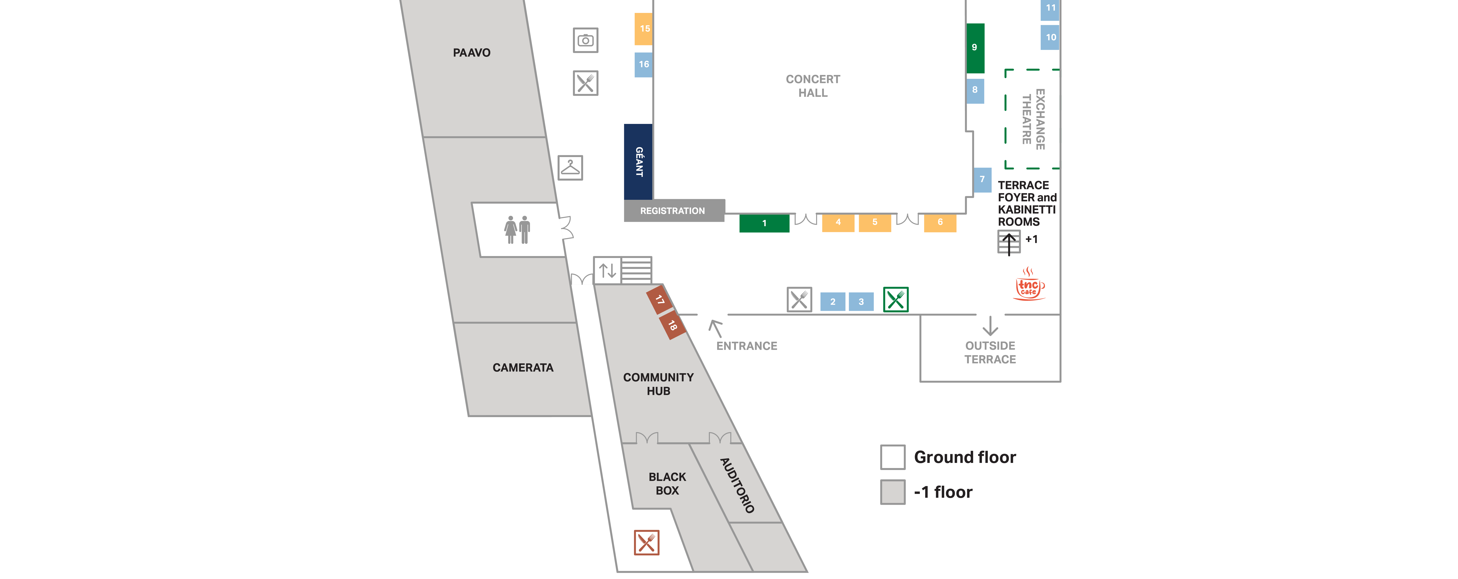
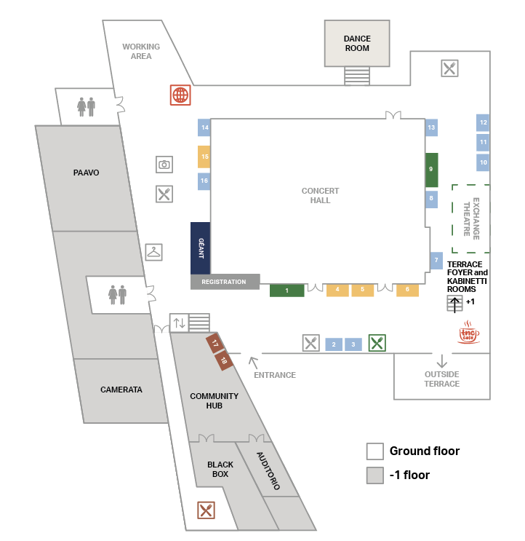
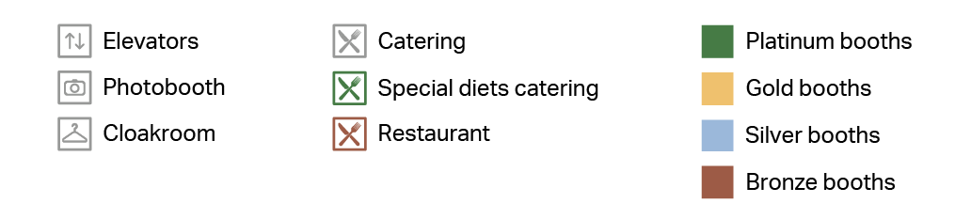
Making your way around the venue
Notes:
To highlight:
- TNC Exchange/Partners booth, including GÉANT lounge
Exchange Theatre
TNC Café and Networking Lounge
Working station
Heading downstairs
Community Hub
Bronze partner

Slide 9
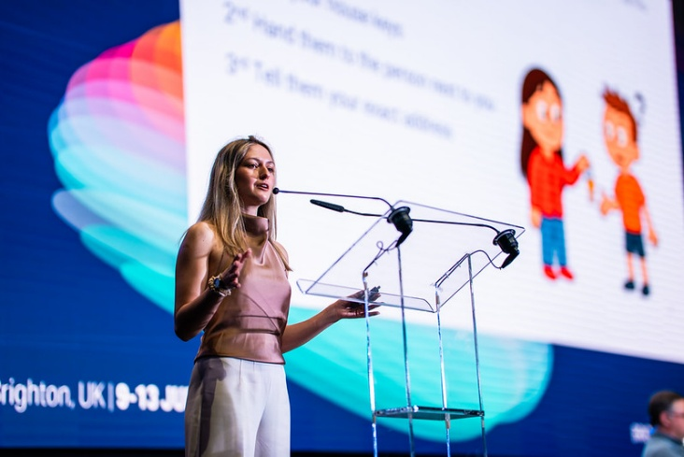
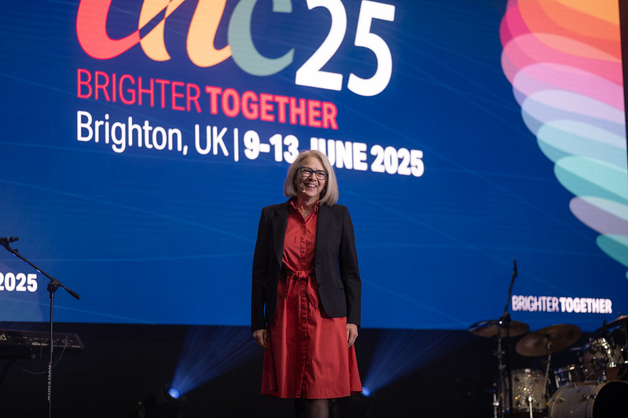
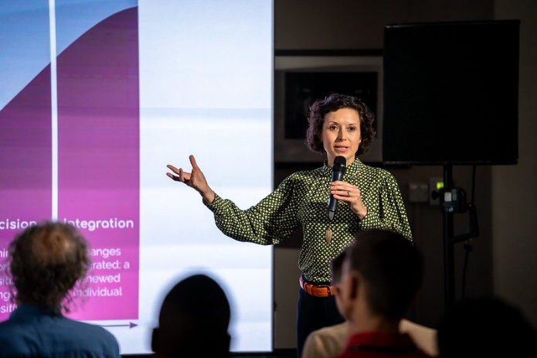
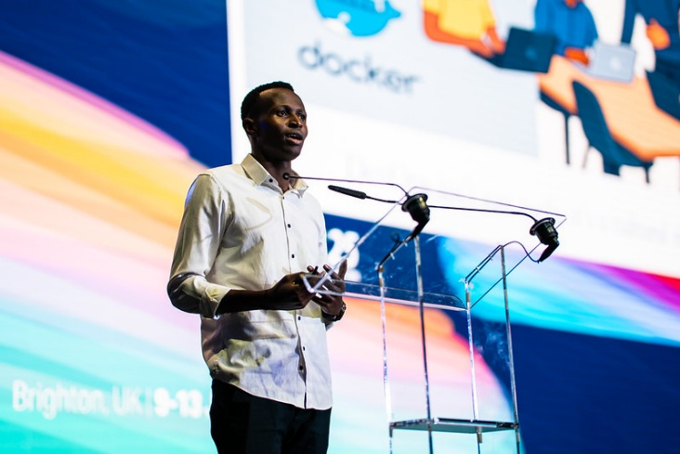
TNC26 Programme
Plenaries
Sessions
Lightning Talks
Notes:
To highlight:
- TNC Exchange/Partners booth, including GÉANT lounge
Exchange Theatre
TNC Café and Networking Lounge
Working station
Heading downstairs
Community Hub
Bronze partner

Slide 10
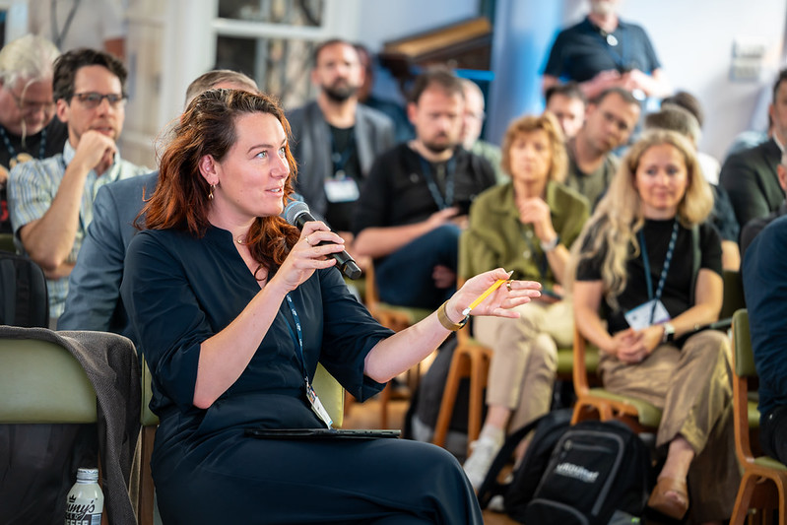
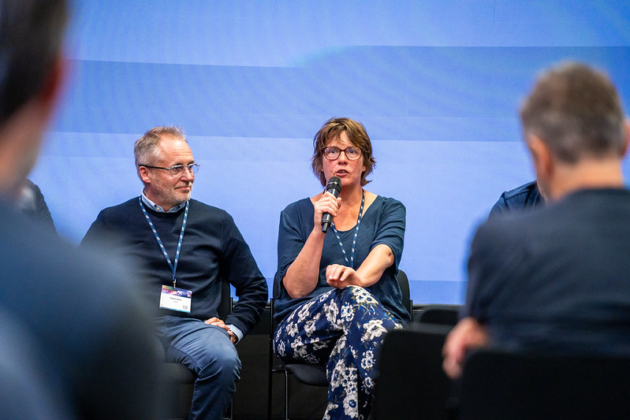
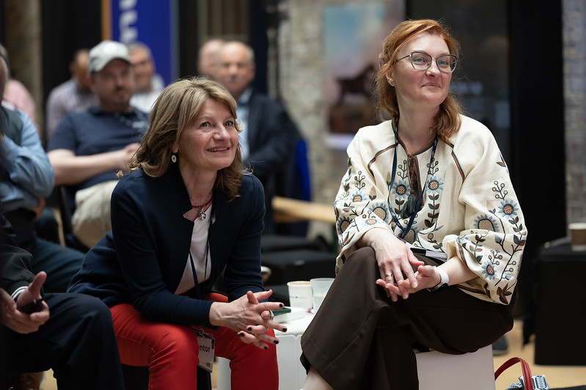
TNC26 Programme
BoFs​
Side Meetings​
Notes:
To highlight:
- TNC Exchange/Partners booth, including GÉANT lounge
Exchange Theatre
TNC Café and Networking Lounge
Working station
Heading downstairs
Community Hub
Bronze partner

Slide 11
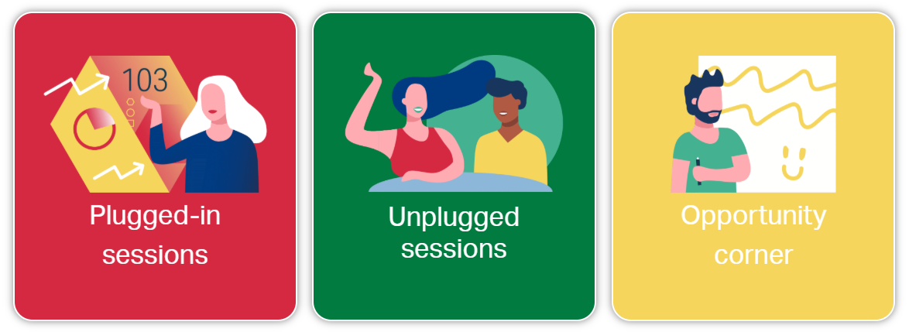
Community Hub
Notes:
To highlight:
- TNC Exchange/Partners booth, including GÉANT lounge
Exchange Theatre
TNC Café and Networking Lounge
Working station
Heading downstairs
Community Hub
Bronze partner

Slide 12
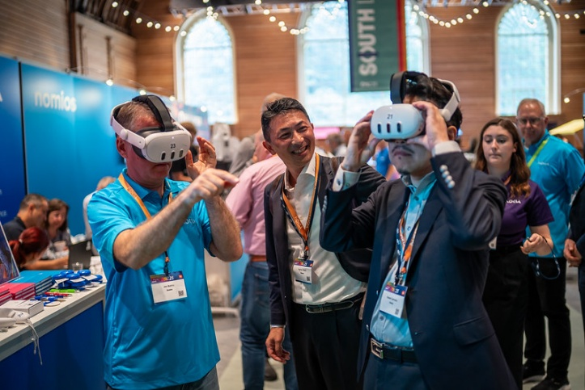
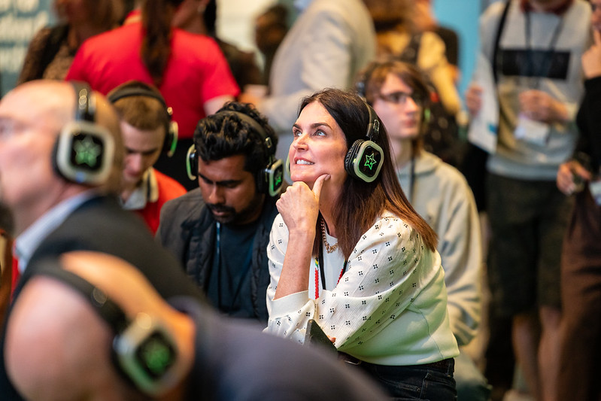
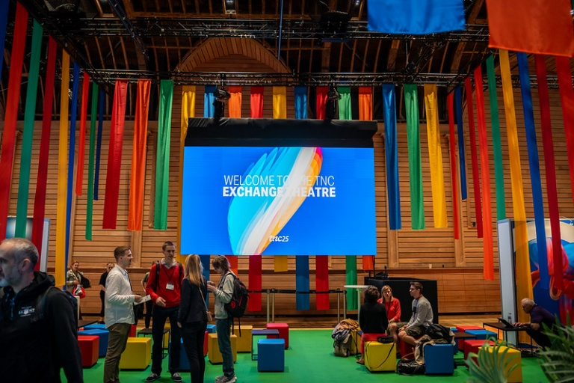
TNC Exchange
Partners
Exchange Theatre
TNC Café
Networking Lounge
Catering
Notes:
To highlight:
- TNC Exchange/Partners booth, including GÉANT lounge
Exchange Theatre
TNC Café and Networking Lounge
Working station
Heading downstairs
Community Hub
Bronze partner

Slide 13

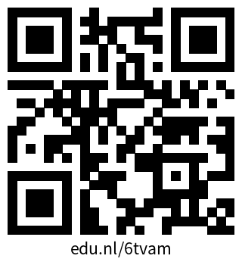
TNC26 App
You can access your personal event app through the link in your e-ticket email or this QR code.
No download
needed!
View your e-ticket
Connect with other participants
Plan your agenda
Browse the exhibitors
Notes:
To highlight:
- TNC Exchange/Partners booth, including GÉANT lounge
Exchange Theatre
TNC Café and Networking Lounge
Working station
Heading downstairs
Community Hub
Bronze partner

Slide 14
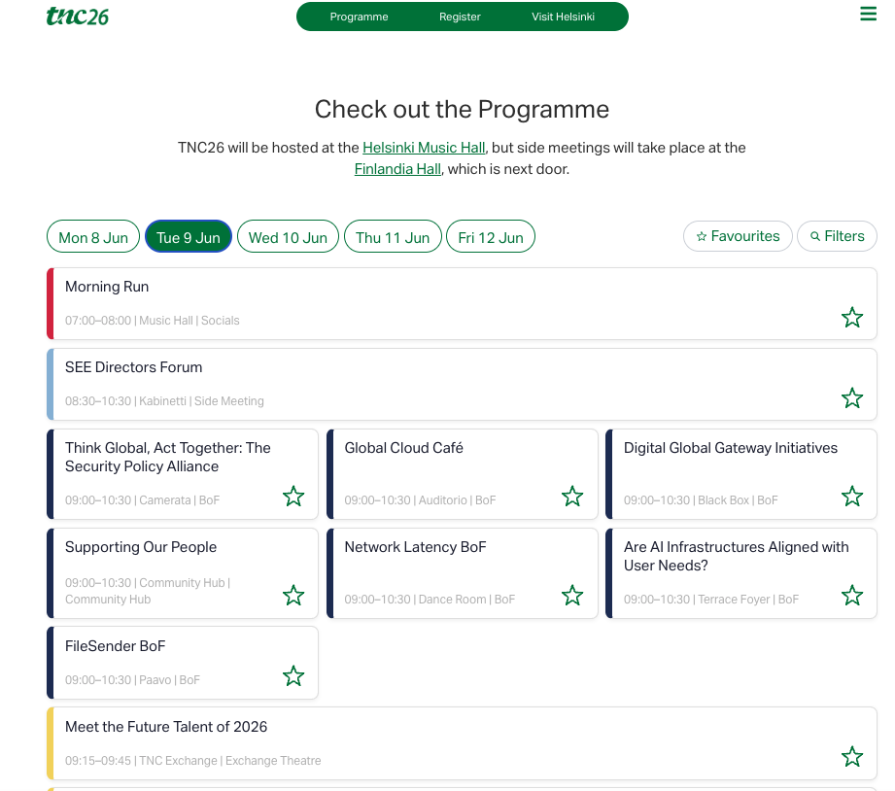

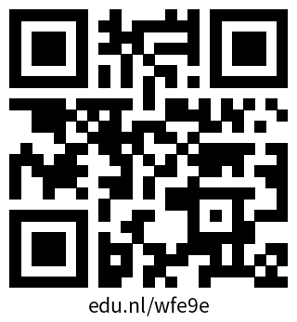
Where can you find the full programme?
QR code in your booklet
tnc26.geant.org
Notes:
To highlight:
- TNC Exchange/Partners booth, including GÉANT lounge
Exchange Theatre
TNC Café and Networking Lounge
Working station
Heading downstairs
Community Hub
Bronze partner

Slide 15
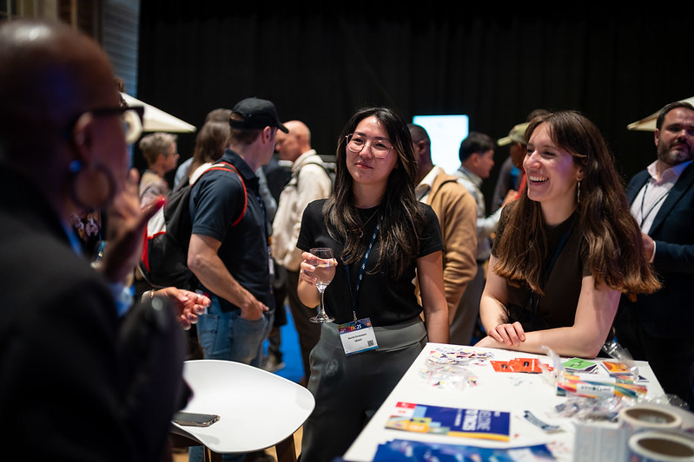
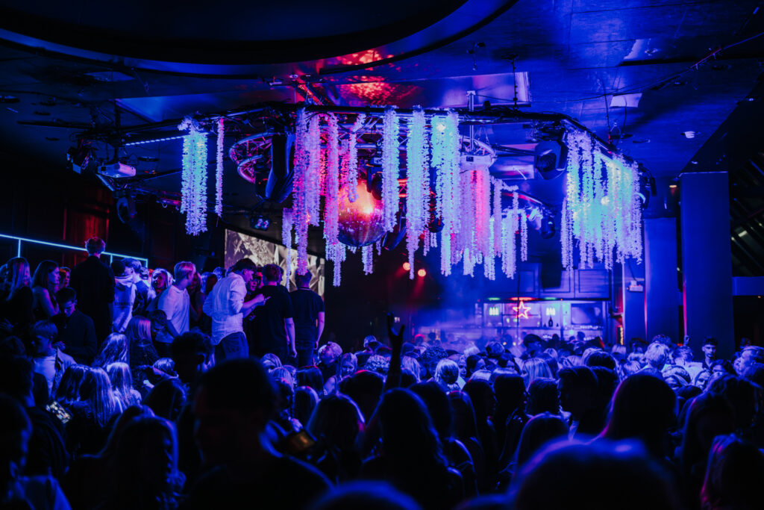

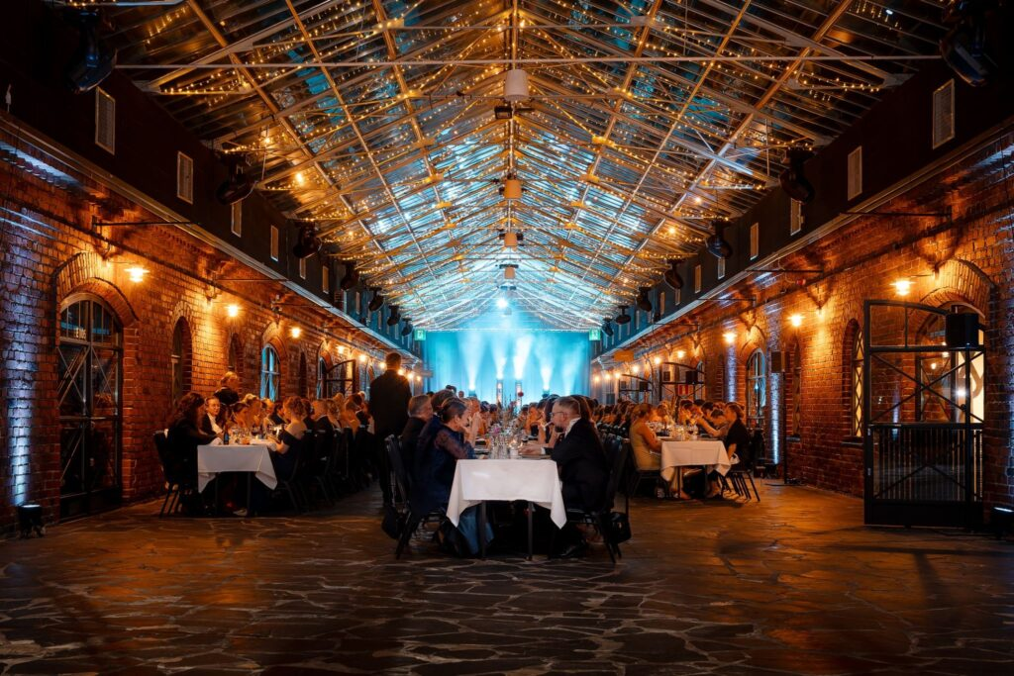
…and don’t forget the Social Events!
Opening Reception
17:30 – 19:00 Tuesday 9, Music Hall
including Open Mic Night!
Kick Off Party
20:30 – 00:00 Tuesday 9, Club Maxine
Conference Dinner
19:00 – 22:30 Wednesday 10, Wanha Satama
Notes:
To highlight:
- TNC Exchange/Partners booth, including GÉANT lounge
Exchange Theatre
TNC Café and Networking Lounge
Working station
Heading downstairs
Community Hub
Bronze partner

Slide 16
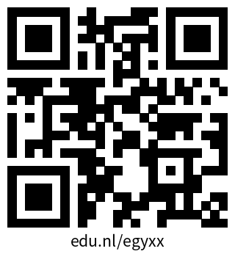
GÉANT Community Code of Conduct
Participants at TNC26 enjoy an environment of respectful and encouraging behaviour, so that everyone feels welcome, comfortable and equal.
If you feel that you have been subjected to behaviour that is contrary to such an environment, or if you have any other concerns, please speak to one of the TNC26 Event Organisers at the TNC26 Registration Desk or contact directly Steffie Bosman or Nicole Harris. They will discuss and help resolve your concerns in the strictest of confidence.
Notes:
To highlight:
- TNC Exchange/Partners booth, including GÉANT lounge
Exchange Theatre
TNC Café and Networking Lounge
Working station
Heading downstairs
Community Hub
Bronze partner

Slide 17
Thank you
Any questions?

