Slide 1
Asiera Strategy 2026-2030 Journey
TNC26
10 June 2026
Helsinki

Slide 2


Slide 3


Slide 4



Strategy Development

Slide 5




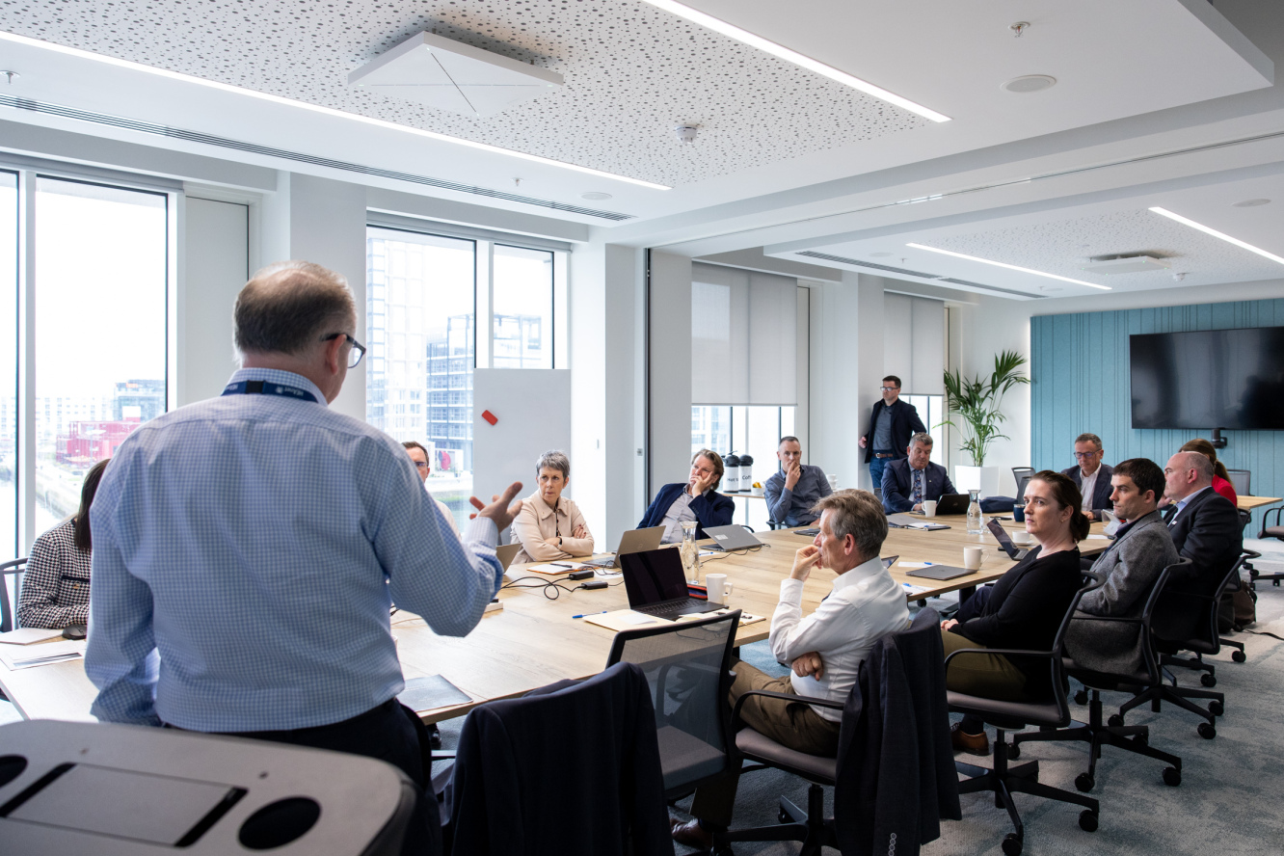
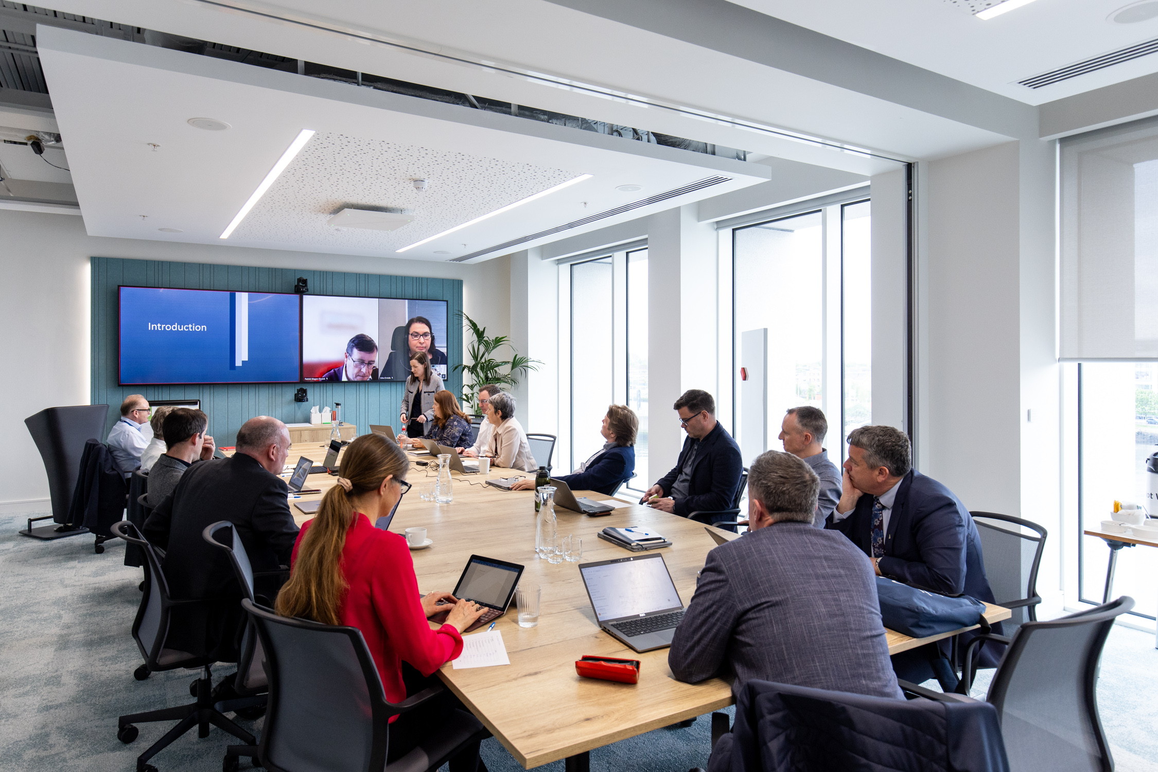
Strategic Considerations
Assess key achievements
Organisational changes
Current strategic context
Key influences
Client feedback
Stakeholder engagement

Slide 6






National Policies and Strategies

Slide 7



Vision, Mission and Tagline

Slide 8
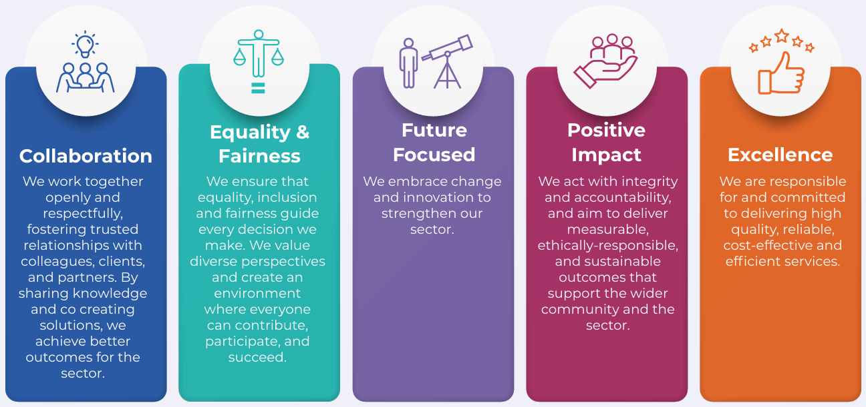
Values

Slide 9
Strategy Construct
Focus Areas
Values
Priorities
2028 and 2030 Targets

Slide 10
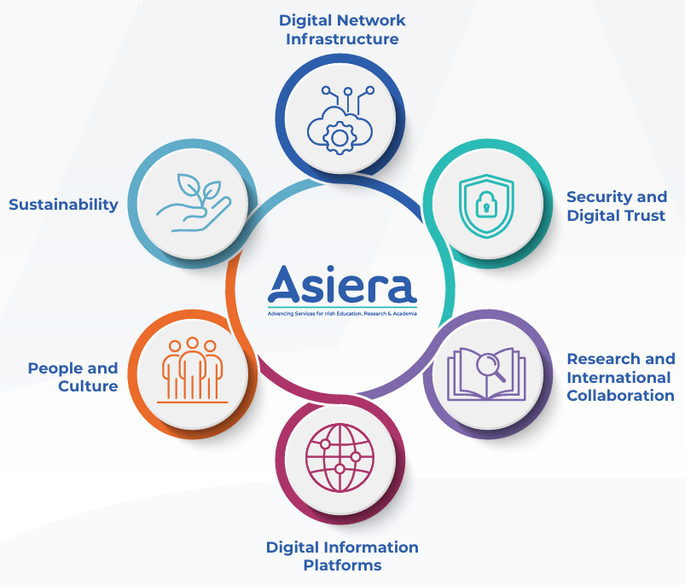
Focus Areas

Slide 11
Focus Area Priorities
Future Network Delivery
Future Network Delivery
Security and Digital Trust
Research and International Collaboration
Expand Connection Capacity and Resilience
Connecting Learners at All Levels of Education
Expand our Security Services Portfolio
Advancing Security Awareness and Knowledge in Education and Research
Reduce Digital Risk Through Trusted Partnership
National Research Data Infrastructure
Research Engagement
International Connectivity and Collaboration
Digital Information Platforms
Digital Information Platforms
Service Delivery Model Expansion
Data Interoperability and Intelligence
People and Culture
Impactful Culture
Building a Future‑Ready Workforce
Valuing Community
Sustainability
Environmental Responsibility
Social Impact
Financial Viability

Slide 12

Strategy Execution

Slide 13
Strategy Execution
Embed strategic objectives in our annual company plan
Build strategic objectives into employee performance targets
Monitor the company plan monthly
CEO reports progress to the Board and Government departments

Slide 14


Slide 15
Thank you

