Slide 1

Strategy @ CSC
How do we prepare it and keep it fresh?
10.6.2026
Kimmo Koski, Managing Director

Slide 2
Some approaches from the past…
“OK, strategies are nice things, but more important is what concrete we achieve”
“Good to have a great vision for 5 years away, any idea how do we get there?”
“Our strategy got accepted in our board, now we do not have to bother about it for a year”
“Are you now sure that all the right buzzwords are included?”
“Strategy now done, let’s continue the real work”
Today a bit different … at least I hope so ☺

Slide 3
Briefly about CSC’s past
2005
Haka identity federation was established​
2012
CSC data center was founded in Kajaani​
Digivisio 2030 project office at CSC established
1989
First supercomputer (Cray X-MP) came to CSC
CSC began to host higher education institutions’ library materials​
2025
LUMI AI Factory begins operations, CSC prepares to acquire its own quantum computer
1983
Funet network was designed and developed​
CSC began representing Finland in ELIXIR network​
1970s
1980s
1990s
2000s
2010s
2020s
2030s
1971
CSC’s story begins
1988
CSC connected Finland to the Internet
Scientist’s User Interface was created​
Services for open science and research were born​
2022
LUMI supercomputer inaugurated in Kajaani​
Linux was uploaded to FTP server hosted by CSC​

Slide 4
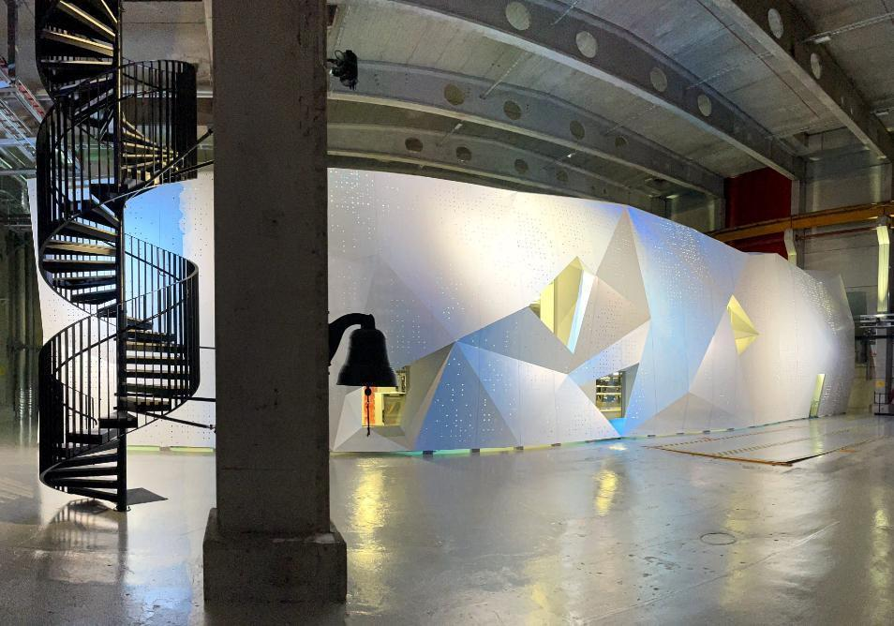

CSC’s strategy today
STRATEGIC GOALS
We provide the most impact generating HPC and data ecosystem in the world
We are a pacesetter for responsible adoption of artificial intelligence
We bridge silos to enhance customer success​
OVERARCHING THEMES
Security, preparedness, resilience
Customer centricity
Sustainability at the core of our operations
OUR VISION
Together we build world-class environments for research, learning and innovation
Notes:
The bridge to our future is built on strategy and the goals we have set. Our strategic goals are steps that we take to realize our vision:
Competitive advantage in research ecosystems:
We build one of the world's leading data management and computing ecosystems for researchers. This makes it possible for Finnish research to be a world leader in fields of data and computing-intensive research.
Our expertise, international cooperation and infrastructure promote the utilization of large datasets, the use of artificial intelligence methods and expertise in high-performance computing.
Our low-carbon solutions support the national and EU targets.
We explore the possibilities of quantum technology together with customers.
Benefits from well-managed data
We help our customers open and disseminate their data and data warehouses for use in research and education, individuals and society in a manner required by the nature of the data.
Our services are used to make open data available, protect sensitive and licensed data, manage continuous data streams, and store unique data so that it is properly accessible.
We provide support for ensuring the quality of data throughout its entire lifecycle.
Digitality makes daily life better
Working in cooperation with its customers, we aim to ensure that Finland is one of the world's leading countries in utilizing digital services, data and analytics.
Our experts help customers reach a point where each learner, researcher, citizen and official seamlessly use digital services and analyzed data as a rule. They no longer see development as digitalization, i.e. a process they are in the middle of, but as user-friendly and interoperable services and expertise.
We enable innovations and synergies by combining the resources of the public and private sectors and replicating workable solutions.
Competent, accommodating and responsible CSC
CSC’s open and diverse company culture nurtures collaboration and learning, and appeals to and engages top experts
Responsibility and customer-orientation have rooted deeply in our principles and can be seen as sustainable value-adding and impact
Our vision for 2030 aims at a better future for all of us, based on digitalization and sustainable development. Our goal is shared, and we are moving towards it with our owners, customers and partners. To achieve this goal, we:
We operate in close dialogue with our customers and stakeholders.
We roll up our sleeves and work side-by-side with our customers.
We reach to the vanguard of the progress for the best of the Finnish society.
We support research, education, learning and collaboration between public and private sector.
We build environments where customers can operate easily.

Slide 5
Strategy preparation @ CSC :
Steps to create strategy
Setting the scene
Tough choices
Priorities
Breakthrough goals
Implementation via OKRs
Future proofing with
scenario work when
needed
Trends and impacts
(PESTLE factors)
Strengths
Weak-
nesses
Undertanding
the playground
(Market analysis)
Oppor-
tunities
Develop-
ment
strategy
Winning
strategy
Threats
Understanding
our capabilities
Mitigation
strategy
Three workshops for analysis
Trends and impacts
Playground
Capabilities
Horizon and heritage
Dreams and paranoia
Challege current thinking

Slide 6
Some challenges?
Turbulent times, external environment changes all the time -> Strategy work is continuous
  at CSC for example OKR method (Objectives and Key Results) based on strategy, tertiary periods (4 months)
How to implement the strategy?
  Influencing the whole company, not only those parts that are mentioned
  How is my work visible in the strategy?
How to convert strategy to action?
  OKRs help shorter term priority-driven planning
  OKRs help aligning activities across the whole company (priorities are commonly understood and strategy not implemented in silos)

Slide 7
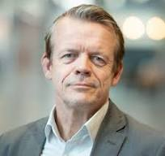
Thank you!
KIMMO KOSKI
MANAGING DIRECTOR

