Slide 1

Making strategy adaptive
Esther Seidl-Nussbaumer
Member of the Executive Board
Lead Business Innovation & Product Management
TNC Strategy Day, Helsinki · 10 June 2026
Notes:
Thank you very much for inviting SWITCH into this conversation.
I am in a slightly different role compared to some of the other speakers today. I am not the CEO of SWITCH, but as Lead Business Innovation and Product Management, I was closely involved in shaping and embedding our strategy.
So my perspective today is not only: what is our strategy? But rather: how did we make strategy something people can work with?
For us, one important learning was that strategy cannot be a static document. In a volatile and ambiguous environment, strategy has to become more adaptive. It has to help an organisation listen, decide, measure and learn.
That is why we approached our strategy development as an innovation process: outside-in, collaborative, hypothesis-based and iterative.

Slide 2

Strategy as an innovation process
  Outside-in
  Collaborative
  Hypothesis-based
  Iterative
Bild: Unsplash
Notes:
We treated strategy not as a linear planning exercise, but as a learning process.
Outside-in meant that we did not start only with our internal view of SWITCH. We started with signals from our community.
Collaborative meant involving customers, stakeholders, leadership and employees.
Hypothesis-based meant that we formulated assumptions, tested them, compared perspectives and refined them.
And iterative meant that the strategy was not finished at launch. It needs to stay alive through regular review and adaptation.

Slide 3

Listening to the community
  SWOT with customers and stakeholders
  Internal reflection / mirroring
  Consolidation and validation with key stakeholders (SBFI, Geant, …)
Notes:
We started very deliberately with the community.
Together with an external consultant, we worked through a role-based strategy process. One important element was a SWOT analysis with customers and stakeholders. We wanted to understand: What challenges do universities, research institutions and other parts of our community see? What do they expect from SWITCH? Where do they see our strengths, and where do they see gaps?
At the same time, we did the same reflection internally. We then compared both perspectives and consolidated them.
This was important because strategy often starts with what an organisation thinks it is good at. But for us, the more relevant question was: what value does the community need from us now and in the future?
We also mirrored our thinking with key stakeholders, including SBFI and international partners. This helped us validate the direction and create dialogue.
A short hint: Our funding model also influences our strategic choices. We combine a shared foundation through membership fees with product and service sales. This forces us to be very clear about where we create collective value and where we operate more commercially.

Slide 4



Three roles to clarify our value
ICT Provider
Guardian
Enabler
Notes:
From this outside-in process, we derived three roles that describe how SWITCH creates value.
First, SWITCH as an enabler: helping our community innovate, collaborate and use digital opportunities.
Second, SWITCH as a guardian: protecting trust, security, identity and digital sovereignty in the research and education environment.
And third, SWITCH as an ICT provider: delivering reliable, high-quality services and infrastructure.
These roles made the strategy tangible. They also helped us explain that SWITCH is not only a technology provider. We are also a trusted partner, a guardian of shared values, and an enabler of future possibilities.
For us, these roles became the bridge between community needs and internal strategic choices.

Slide 5
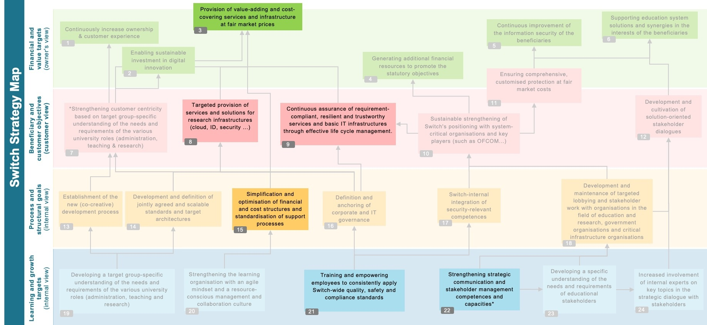
Strategy map and measurable outcomes
Scaling and Efficiency
Maturity
Cyber Expertise
Networking and Dialogue
Financial and
value targets
(owner's view)
Beneficiary and customer objective
(customer view)
Switch Strategy Map
Process and structural goals (internal view)
Learning and growth targets
(internal view)
Notes:
The next challenge was focus and developing this strategy map.
I don’t want to walk you through every detail — the important point is how we used it.
The map helped us make the strategy visible across different perspectives: financial value, customer and beneficiary needs, internal processes, and learning and growth. It also showed dependencies between goals.
In total, we identified 22 strategic goals. But we knew that a strategy with 22 priorities is not really a strategy. So we prioritised six focus goals.
Very briefly, these six focus goals are about value-adding and cost-covering services, targeted services for research infrastructures, resilient and trustworthy basic IT infrastructures, simplified financial and support processes, employee empowerment around quality, security and compliance, and stronger strategic communication and stakeholder management.
The key step was then to translate these focus goals into our value streams. Each value stream had to define: How do we contribute? What are our objectives? What are the expected outcomes? And how do we know whether we are making progress?
This is where OKRs became important. Not as a bureaucratic reporting tool, but as a way to create alignment, transparency and discipline.
Every quarter, we review progress at corporate level. And one of our biggest learnings was: it is easy to describe activities, but much harder to define measurable outcomes. Yet this is exactly where strategy becomes useful — because it forces us to define what success really means.

Slide 6



What made it real
Bild: Unsplash
  Strategy breakfasts
  Townhalls
  Team-level OKRs
  Confluence pages for all employees
  Videos for each strategic goal
Notes:
A major learning for us was that communication is not something that happens after the strategy is finished. Communication is part of making the strategy real.
We used several formats: strategy breakfasts, where members of the executive board presented and discussed parts of the strategy; townhalls, where the strategy regularly comes back as a topic; and Confluence pages where all employees can access the content.
For each of the six focus goals, we created short videos explaining the expected outcomes. This helped people understand not only the wording of the goals, but the intention behind them.
From there, each team and value stream worked on its own contribution through OKRs.
This made the strategy more concrete. It helped people see where they contribute. And it helped leadership have better conversations: Does this initiative support our strategic goals? Does it contribute to our outcomes? If not, maybe it is a good idea — but not for now.

Slide 7
Challenges
Learnings
  Moving from reactive work to strategic discipline
  Defining measurable outcomes
  Keeping strategy alive beyond launch
  Outside-in perspective
  Iterative review
  Transparency
  Shared language
  Leadership commitment
  We are ALL measurable (also BoD)
Helps to say no, too
Helps for external com, too
Notes:
Of course, this was not always easy.
One challenge was cultural. Like many organisations, we are used to reacting to needs, requests and opportunities. That is important, especially as an NREN close to its community. But strategy also requires discipline. It asks us to focus.
Another challenge was measurability. Defining good outcome metrics is hard. But it creates clarity and transparency. It also makes leadership and teams more accountable.
A third challenge is keeping the strategy alive beyond the launch. A strategy presentation is only the beginning. The real work starts when the strategy enters daily routines, leadership conversations and team decisions.
What helped us was the outside-in perspective, iterative review, transparency, a shared language and strong leadership commitment.

Slide 8




Strategy grows stronger through international reflection
Universiities
SBFI
  National feedback explains local relevance
  Exchange with NRENs and GÉANT challenges our assumptions
  Different maturity levels reveal dependencies
  Product collaboration accelerates collective learning
  Shared reflection strengthens the positioning of the R&E community
CH
NRENs
Swiss institutions
e
International
Notes:
Although SWITCH has a national mandate in Switzerland, many of the challenges our community faces are no longer purely national.
Our national stakeholders help us understand local relevance and immediate needs — for example universities, research institutions or public stakeholders such as SBFI.
But the exchange with GÉANT and other NRENs gives us a different perspective. It challenges our assumptions.
Different NRENs operate at different maturity levels, with different funding models, governance structures and strategic priorities. That helps us better understand dependencies, identify blind spots, and recognise opportunities we might not see from a purely national perspective.
Especially at product level, this exchange is extremely valuable. We learn from each other’s approaches and experiences, and this accelerates learning across the community.
One important insight for us was that international feedback is often very different from national stakeholder feedback. National discussions are usually closer to immediate operational needs, while international exchange often highlights longer-term developments and broader ecosystem dynamics.
For us, strategy therefore becomes stronger through reflection and connection — not only within Switzerland, but across the international R&E community.
Strategy becomes more adaptive when it is continuously reflected through different perspectives and realities — and this shared reflection ultimately strengthens the collective positioning of research and education as a whole.

Slide 9

Strategy as a living network.
Outside-in
Collaborative
Measurable
Adaptive
Bild: Unsplash
Notes:
If I had to summarise our learning in one sentence, I would say: strategy works best when we treat it as a living system.
It starts outside-in, with signals from the community. It becomes meaningful when people inside the organisation can see their contribution. It becomes powerful when progress is measurable. And it stays relevant when we review and adapt it continuously.
For SWITCH, strategy is therefore not a fixed roadmap. It is a living network that connects signals, people, decisions and outcomes.
And maybe this is also where we as NRENs can reinforce each other: by making our individual strategies more transparent, more connected and more useful for the collective future of research and education.

Slide 10
«Strategy becomes powerful
when we keep
learning, measuring and adapting.»
Esther Seidl-Nussbaumer
Member of the Executive Board
Lead Business Innovation & Product Management
Notes:
So, to close with the sentence on this slide:
Strategy becomes powerful when we keep learning, measuring and adapting.
And for us, this is exactly the point: strategy is not something we finish. It is something we keep practising — together with our people, our community and our international partners.
Thank you.

