Slide 1
The NREN Strategy Journey
Panel Discussion Moderator - Beatrix Weber, Head of Partner Relations GÉANT

Slide 2

Strategy @ CSC
How do we prepare it and keep it fresh?
10.6.2026
Kimmo Koski, Managing Director

Slide 3
Some approaches from the past…
“OK, strategies are nice things, but more important is what concrete we achieve”
“Good to have a great vision for 5 years away, any idea how do we get there?”
“Our strategy got accepted in our board, now we do not have to bother about it for a year”
“Are you now sure that all the right buzzwords are included?”
“Strategy now done, let’s continue the real work”
Today a bit different … at least I hope so ☺

Slide 4
Briefly about CSC’s past
2005
Haka identity federation was established​
2012
CSC data center was founded in Kajaani​
Digivisio 2030 project office at CSC established
1989
First supercomputer (Cray X-MP) came to CSC
CSC began to host higher education institutions’ library materials​
2025
LUMI AI Factory begins operations, CSC prepares to acquire its own quantum computer
1983
Funet network was designed and developed​
CSC began representing Finland in ELIXIR network​
1970s
1980s
1990s
2000s
2010s
2020s
2030s
1971
CSC’s story begins
1988
CSC connected Finland to the Internet
Scientist’s User Interface was created​
Services for open science and research were born​
2022
LUMI supercomputer inaugurated in Kajaani​
Linux was uploaded to FTP server hosted by CSC​

Slide 5
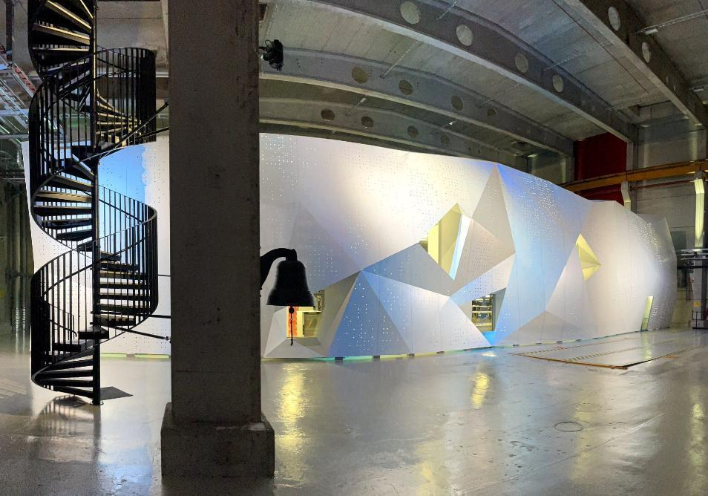

CSC’s strategy today
STRATEGIC GOALS
We provide the most impact generating HPC and data ecosystem in the world
We are a pacesetter for responsible adoption of artificial intelligence
We bridge silos to enhance customer success​
OVERARCHING THEMES
Security, preparedness, resilience
Customer centricity
Sustainability at the core of our operations
OUR VISION
Together we build world-class environments for research, learning and innovation
Notes:
The bridge to our future is built on strategy and the goals we have set. Our strategic goals are steps that we take to realize our vision:
Competitive advantage in research ecosystems:
We build one of the world's leading data management and computing ecosystems for researchers. This makes it possible for Finnish research to be a world leader in fields of data and computing-intensive research.
Our expertise, international cooperation and infrastructure promote the utilization of large datasets, the use of artificial intelligence methods and expertise in high-performance computing.
Our low-carbon solutions support the national and EU targets.
We explore the possibilities of quantum technology together with customers.
Benefits from well-managed data
We help our customers open and disseminate their data and data warehouses for use in research and education, individuals and society in a manner required by the nature of the data.
Our services are used to make open data available, protect sensitive and licensed data, manage continuous data streams, and store unique data so that it is properly accessible.
We provide support for ensuring the quality of data throughout its entire lifecycle.
Digitality makes daily life better
Working in cooperation with its customers, we aim to ensure that Finland is one of the world's leading countries in utilizing digital services, data and analytics.
Our experts help customers reach a point where each learner, researcher, citizen and official seamlessly use digital services and analyzed data as a rule. They no longer see development as digitalization, i.e. a process they are in the middle of, but as user-friendly and interoperable services and expertise.
We enable innovations and synergies by combining the resources of the public and private sectors and replicating workable solutions.
Competent, accommodating and responsible CSC
CSC’s open and diverse company culture nurtures collaboration and learning, and appeals to and engages top experts
Responsibility and customer-orientation have rooted deeply in our principles and can be seen as sustainable value-adding and impact
Our vision for 2030 aims at a better future for all of us, based on digitalization and sustainable development. Our goal is shared, and we are moving towards it with our owners, customers and partners. To achieve this goal, we:
We operate in close dialogue with our customers and stakeholders.
We roll up our sleeves and work side-by-side with our customers.
We reach to the vanguard of the progress for the best of the Finnish society.
We support research, education, learning and collaboration between public and private sector.
We build environments where customers can operate easily.

Slide 6
Strategy preparation @ CSC :
Steps to create strategy
Setting the scene
Tough choices
Priorities
Breakthrough goals
Implementation via OKRs
Future proofing with
scenario work when
needed
Trends and impacts
(PESTLE factors)
Strengths
Weak-
nesses
Undertanding
the playground
(Market analysis)
Oppor-
tunities
Develop-
ment
strategy
Winning
strategy
Threats
Understanding
our capabilities
Mitigation
strategy
Three workshops for analysis
Trends and impacts
Playground
Capabilities
Horizon and heritage
Dreams and paranoia
Challege current thinking

Slide 7
Some challenges?
Turbulent times, external environment changes all the time -> Strategy work is continuous
  at CSC for example OKR method (Objectives and Key Results) based on strategy, tertiary periods (4 months)
How to implement the strategy?
  Influencing the whole company, not only those parts that are mentioned
  How is my work visible in the strategy?
How to convert strategy to action?
  OKRs help shorter term priority-driven planning
  OKRs help aligning activities across the whole company (priorities are commonly understood and strategy not implemented in silos)

Slide 8
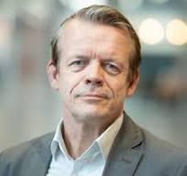
Thank you!
KIMMO KOSKI
MANAGING DIRECTOR

Slide 10
The NREN (/RNP) Strategy Journey
Lisandro Zambenedetti Granville
CEO RNP

Slide 11

Strategy Act #1 – Childhood
1989 ~ 2008

Slide 12
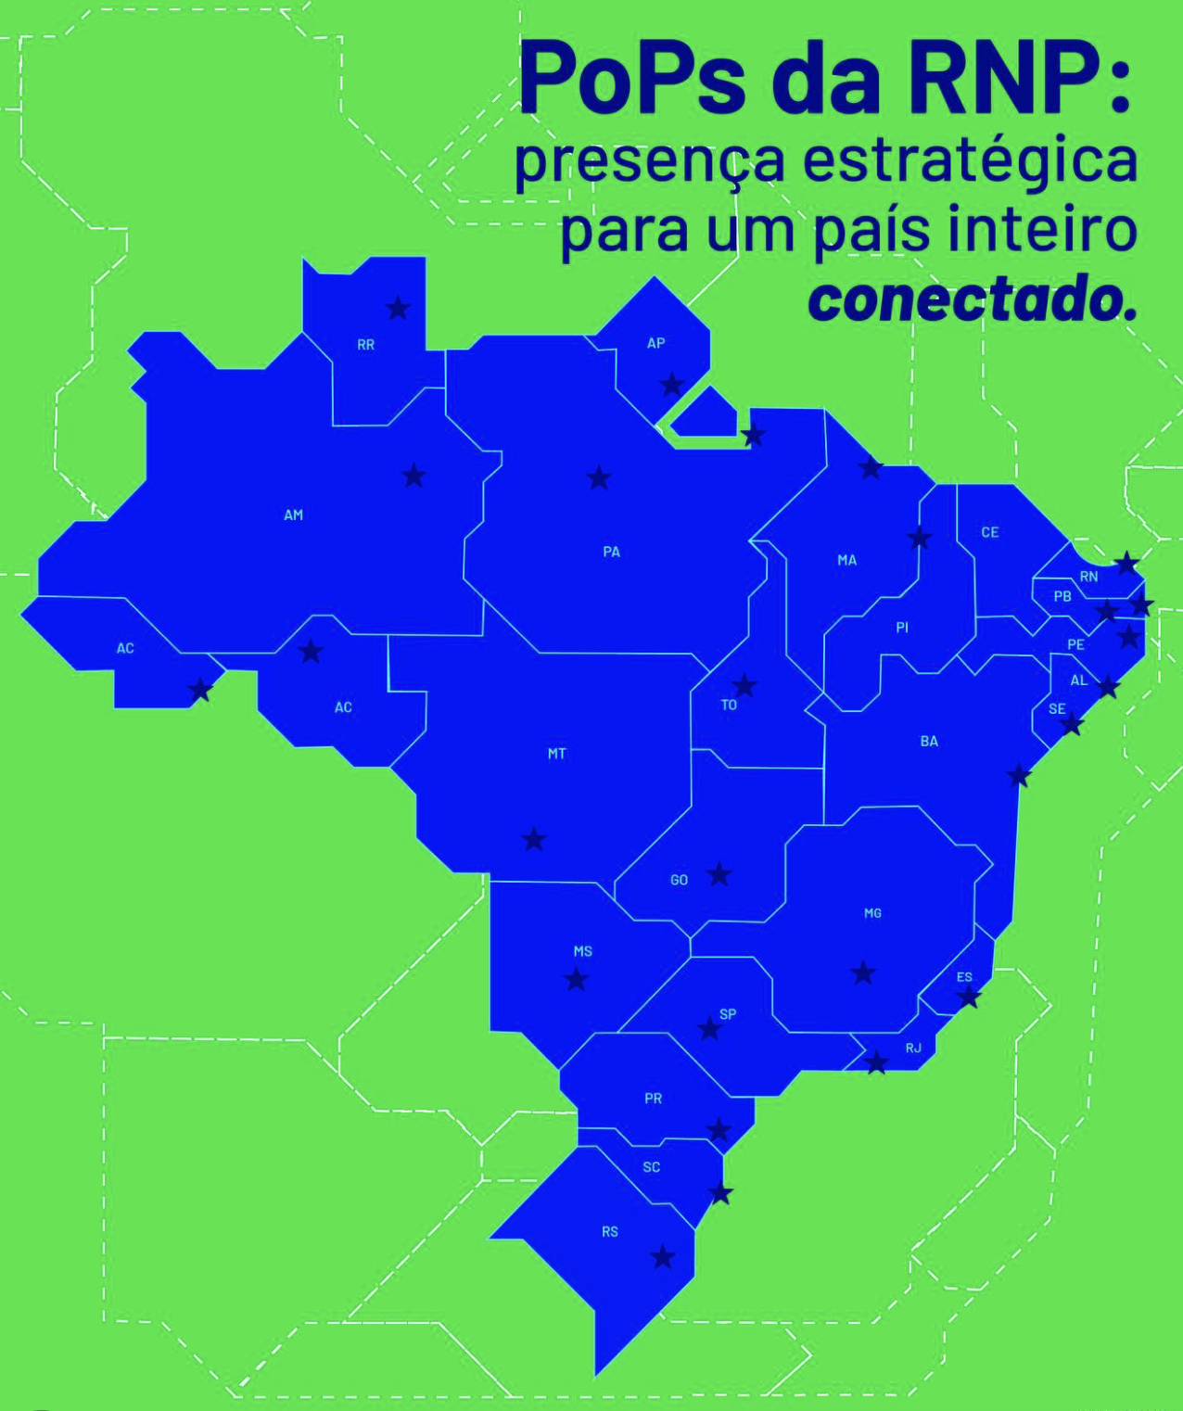
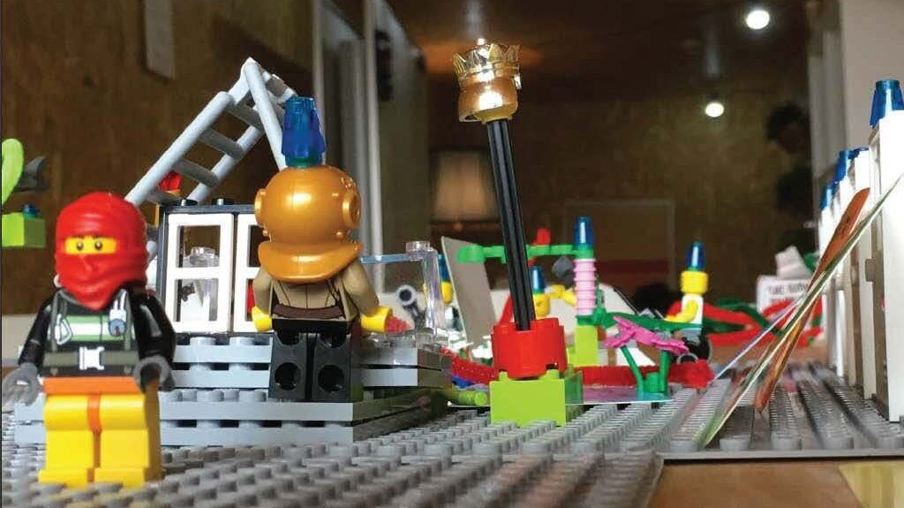

Strategy Act #1 - 1989 ~ 2008
Building up the very first network
  Experiencing in deploying the country's Internet → together with universities
  Integrators along POPs → in recollection, that was a smart move
  Partners with the R&D community → asking for help from the experts in place

Slide 13

Strategy Act #2 – Teenage years
2009-2022

Slide 14



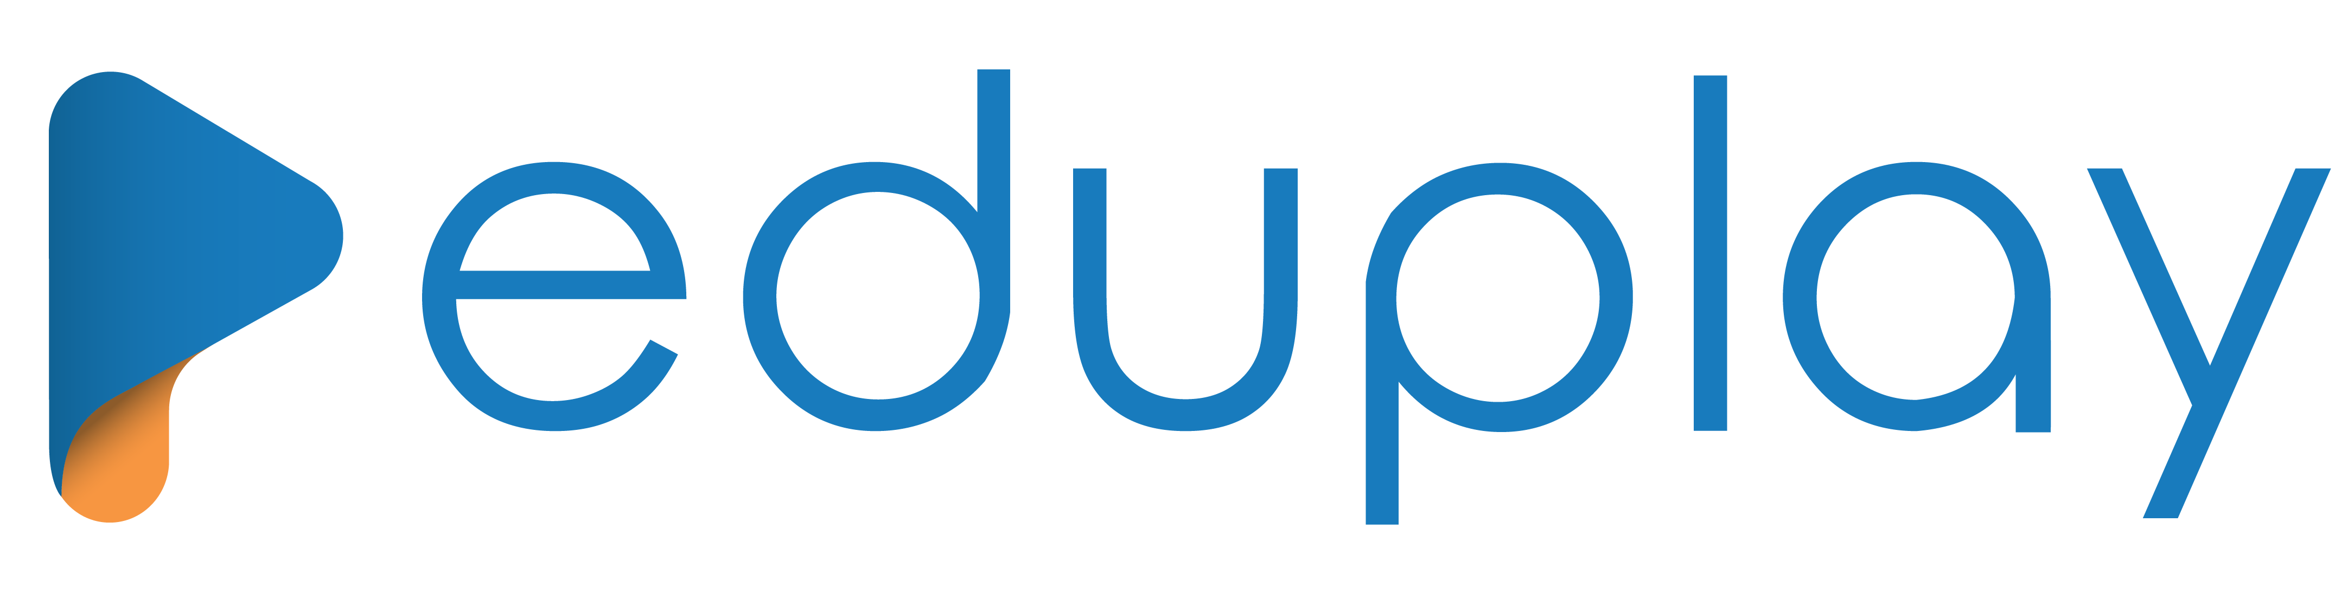

Strategy Act #2 – 2009 ~ 2022
Network and services expansion
  Establishing the swapping model → because money matters!
  R&D leading to production services → risky yet smart move
  Expanding the international cooperation → joint R&D projects

Slide 15
Strategy Act #3 – College years
2023 ~ 2025…

Slide 16
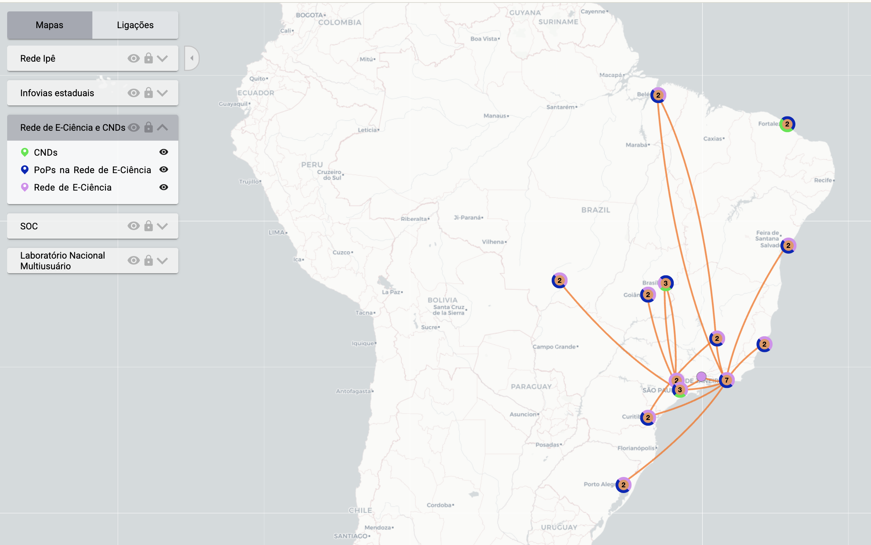
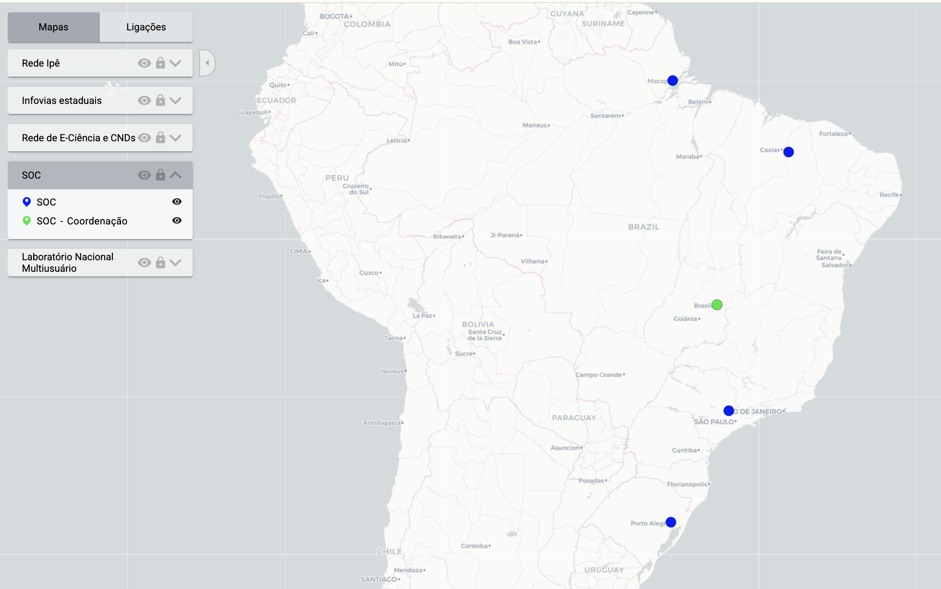
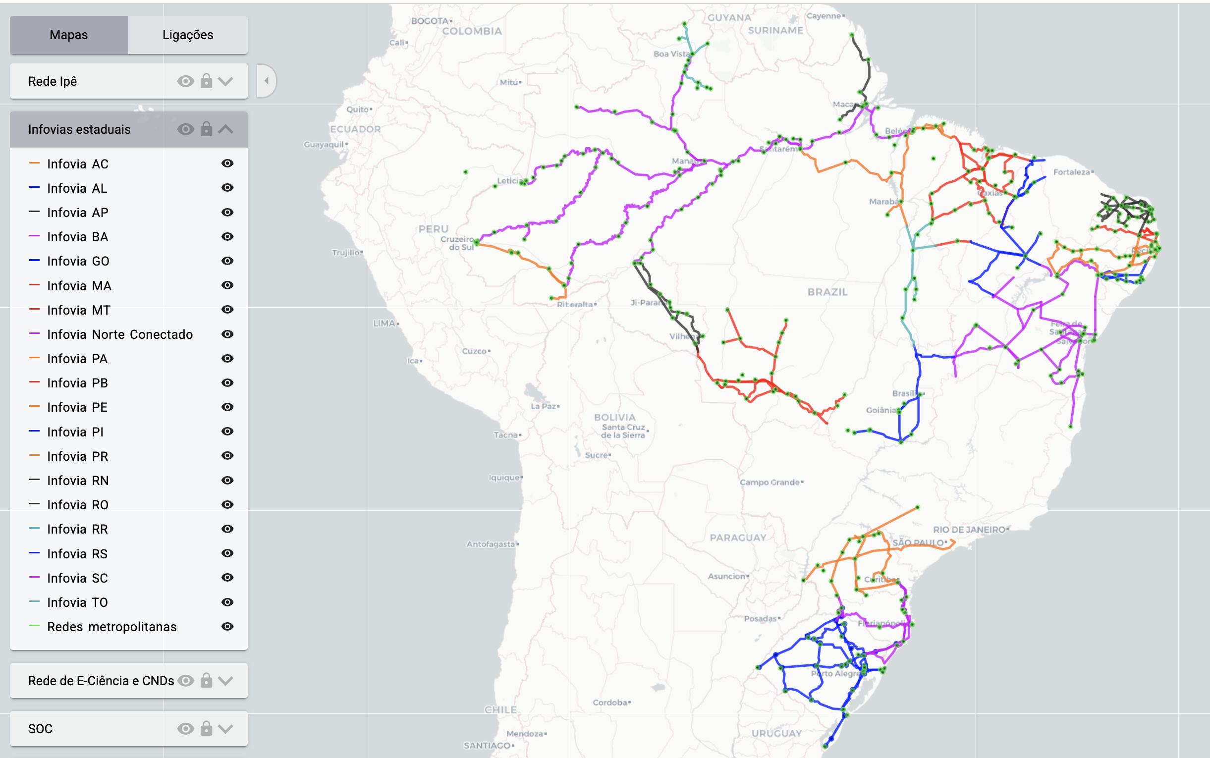
Strategy Act #3 – 2023 ~ 2025…
The sudden great growth
  Deployment of communication infrastructures to reach the unattended → areas where commercial exploitation is not yet present
  e-Science network → because the regular Internet is not sufficient
  CNDs → absorbing commodity services, swapping everywhere
  SOCs towards POPs → spreading security
https://mapas.rnp.br

Slide 17

Strategy Act #4 – Adulthood
2026…

Slide 18
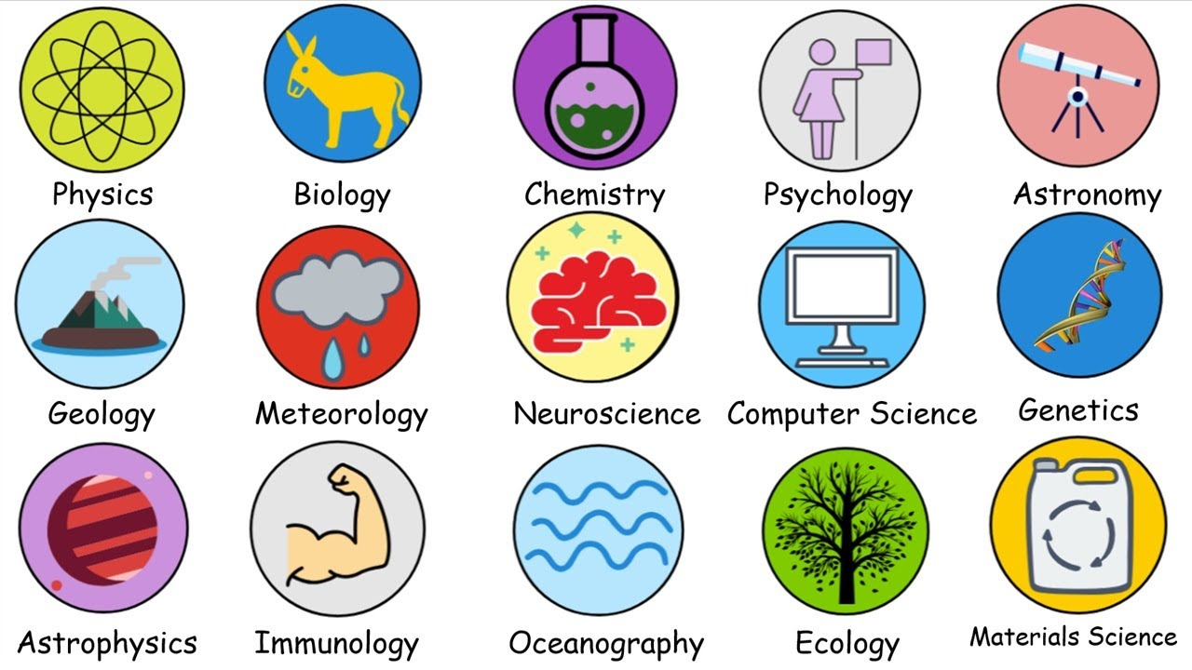

Strategy act #4 – 2026...
The network is no longer just links
  It’s also storage, HPC, models, and governance
Those who want to use it are not only the STEAM fauna anymore
  It’s social sciences, health, government, … digital untrained users in general
The interested parties are bi(tri..) polar individuals and organizations
  Universities, scientific societies, government, the civil society in general

Slide 19
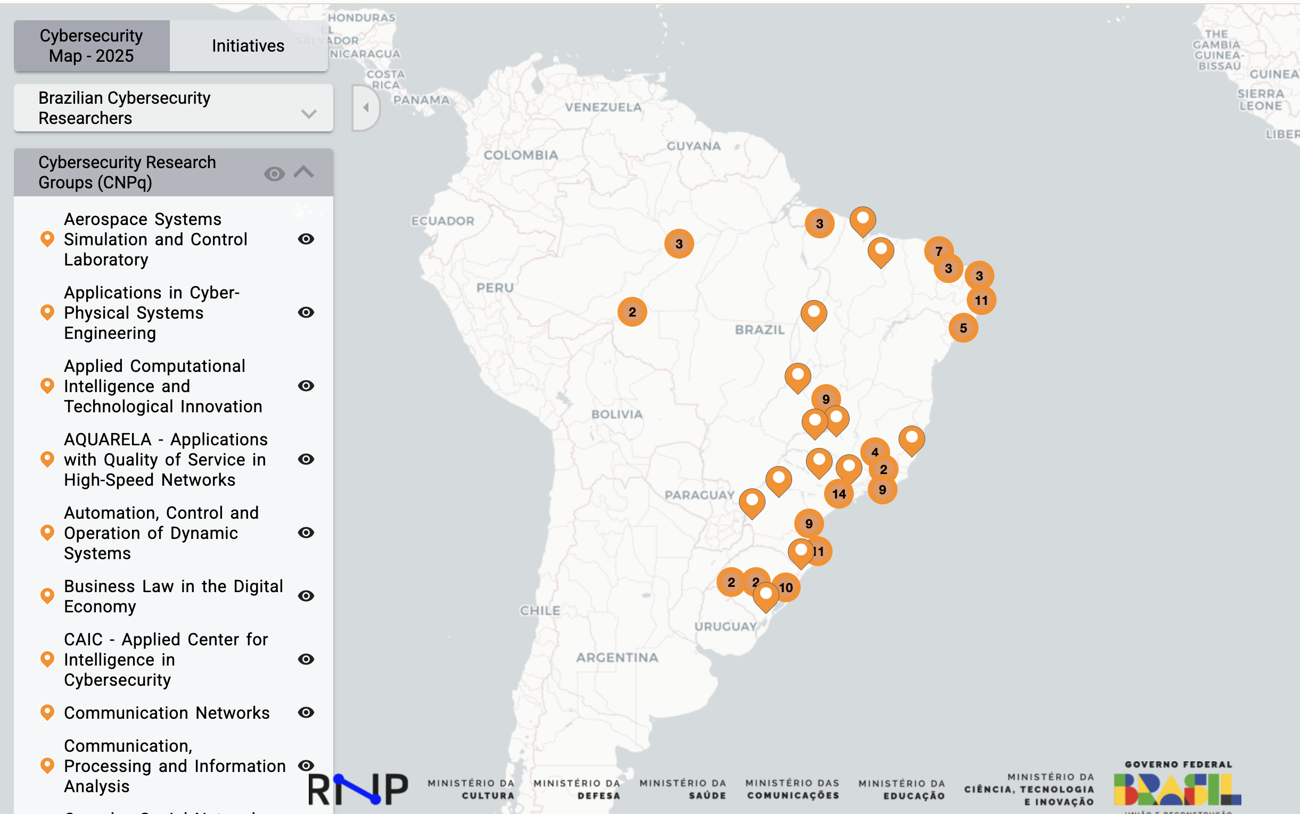
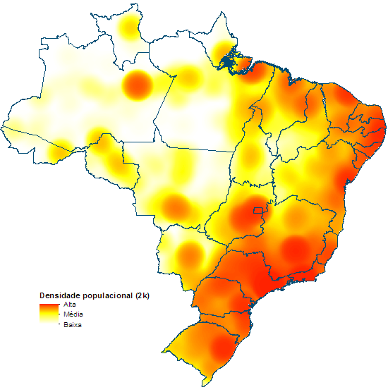

Strategy act #4 – 2026...
Pillars to accomplish our mission as an NREN
  Embrace new technologies with care and courage; our past proves we can do it
  Serve new communities and actors in unprecedent scales; the world is much more IT dependent and aficionado
  In partnership with those that have the mission of advancing the state of the art
https://cybersecmap.rnp.br

Slide 20
Thank you!

Slide 22

Making strategy adaptive
Esther Seidl-Nussbaumer
Member of the Executive Board
Lead Business Innovation & Product Management
TNC Strategy Day, Helsinki · 10 June 2026
Notes:
Thank you very much for inviting SWITCH into this conversation.
I am in a slightly different role compared to some of the other speakers today. I am not the CEO of SWITCH, but as Lead Business Innovation and Product Management, I was closely involved in shaping and embedding our strategy.
So my perspective today is not only: what is our strategy? But rather: how did we make strategy something people can work with?
For us, one important learning was that strategy cannot be a static document. In a volatile and ambiguous environment, strategy has to become more adaptive. It has to help an organisation listen, decide, measure and learn.
That is why we approached our strategy development as an innovation process: outside-in, collaborative, hypothesis-based and iterative.

Slide 23

Strategy as an innovation process
  Outside-in
  Collaborative
  Hypothesis-based
  Iterative
Bild: Unsplash
Notes:
We treated strategy not as a linear planning exercise, but as a learning process.
Outside-in meant that we did not start only with our internal view of SWITCH. We started with signals from our community.
Collaborative meant involving customers, stakeholders, leadership and employees.
Hypothesis-based meant that we formulated assumptions, tested them, compared perspectives and refined them.
And iterative meant that the strategy was not finished at launch. It needs to stay alive through regular review and adaptation.

Slide 24

Listening to the community
  SWOT with customers and stakeholders
  Internal reflection / mirroring
  Consolidation and validation with key stakeholders (SBFI, Geant, …)
Notes:
We started very deliberately with the community.
Together with an external consultant, we worked through a role-based strategy process. One important element was a SWOT analysis with customers and stakeholders. We wanted to understand: What challenges do universities, research institutions and other parts of our community see? What do they expect from SWITCH? Where do they see our strengths, and where do they see gaps?
At the same time, we did the same reflection internally. We then compared both perspectives and consolidated them.
This was important because strategy often starts with what an organisation thinks it is good at. But for us, the more relevant question was: what value does the community need from us now and in the future?
We also mirrored our thinking with key stakeholders, including SBFI and international partners. This helped us validate the direction and create dialogue.
A short hint: Our funding model also influences our strategic choices. We combine a shared foundation through membership fees with product and service sales. This forces us to be very clear about where we create collective value and where we operate more commercially.

Slide 25



Three roles to clarify our value
ICT Provider
Guardian
Enabler
Notes:
From this outside-in process, we derived three roles that describe how SWITCH creates value.
First, SWITCH as an enabler: helping our community innovate, collaborate and use digital opportunities.
Second, SWITCH as a guardian: protecting trust, security, identity and digital sovereignty in the research and education environment.
And third, SWITCH as an ICT provider: delivering reliable, high-quality services and infrastructure.
These roles made the strategy tangible. They also helped us explain that SWITCH is not only a technology provider. We are also a trusted partner, a guardian of shared values, and an enabler of future possibilities.
For us, these roles became the bridge between community needs and internal strategic choices.

Slide 26
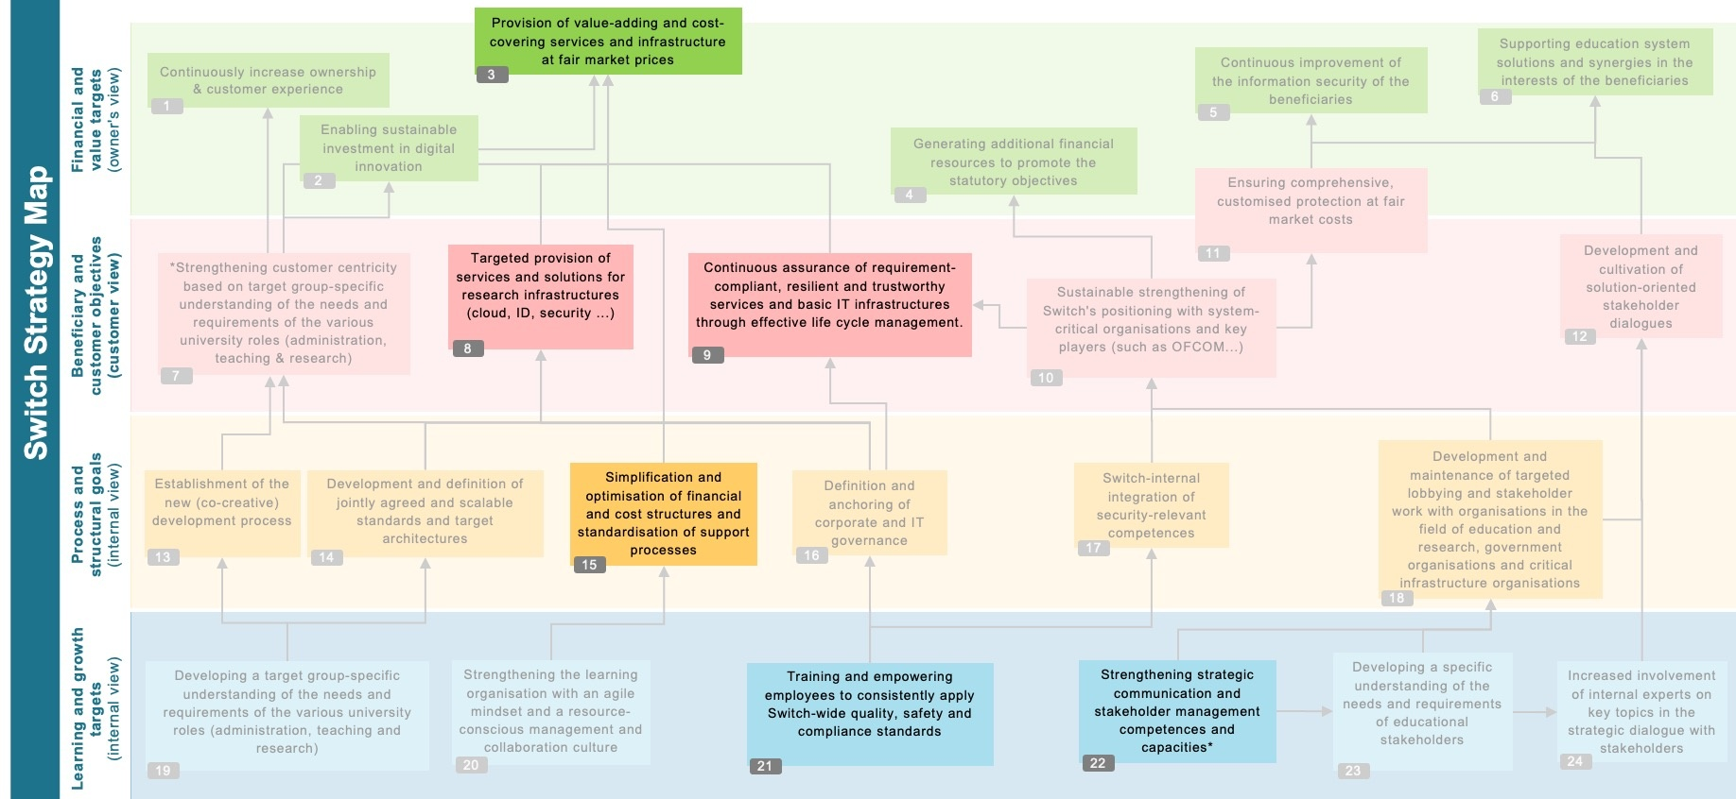
Strategy map and measurable outcomes
Scaling and Efficiency
Maturity
Cyber Expertise
Networking and Dialogue
Financial and
value targets
(owner's view)
Beneficiary and customer objective
(customer view)
Switch Strategy Map
Process and structural goals (internal view)
Learning and growth targets
(internal view)
Notes:
The next challenge was focus and developing this strategy map.
I don’t want to walk you through every detail — the important point is how we used it.
The map helped us make the strategy visible across different perspectives: financial value, customer and beneficiary needs, internal processes, and learning and growth. It also showed dependencies between goals.
In total, we identified 22 strategic goals. But we knew that a strategy with 22 priorities is not really a strategy. So we prioritised six focus goals.
Very briefly, these six focus goals are about value-adding and cost-covering services, targeted services for research infrastructures, resilient and trustworthy basic IT infrastructures, simplified financial and support processes, employee empowerment around quality, security and compliance, and stronger strategic communication and stakeholder management.
The key step was then to translate these focus goals into our value streams. Each value stream had to define: How do we contribute? What are our objectives? What are the expected outcomes? And how do we know whether we are making progress?
This is where OKRs became important. Not as a bureaucratic reporting tool, but as a way to create alignment, transparency and discipline.
Every quarter, we review progress at corporate level. And one of our biggest learnings was: it is easy to describe activities, but much harder to define measurable outcomes. Yet this is exactly where strategy becomes useful — because it forces us to define what success really means.

Slide 27



What made it real
Bild: Unsplash
  Strategy breakfasts
  Townhalls
  Team-level OKRs
  Confluence pages for all employees
  Videos for each strategic goal
Notes:
A major learning for us was that communication is not something that happens after the strategy is finished. Communication is part of making the strategy real.
We used several formats: strategy breakfasts, where members of the executive board presented and discussed parts of the strategy; townhalls, where the strategy regularly comes back as a topic; and Confluence pages where all employees can access the content.
For each of the six focus goals, we created short videos explaining the expected outcomes. This helped people understand not only the wording of the goals, but the intention behind them.
From there, each team and value stream worked on its own contribution through OKRs.
This made the strategy more concrete. It helped people see where they contribute. And it helped leadership have better conversations: Does this initiative support our strategic goals? Does it contribute to our outcomes? If not, maybe it is a good idea — but not for now.

Slide 28
Challenges
Learnings
  Moving from reactive work to strategic discipline
  Defining measurable outcomes
  Keeping strategy alive beyond launch
  Outside-in perspective
  Iterative review
  Transparency
  Shared language
  Leadership commitment
  We are ALL measurable (also BoD)
Helps to say no, too
Helps for external com, too
Notes:
Of course, this was not always easy.
One challenge was cultural. Like many organisations, we are used to reacting to needs, requests and opportunities. That is important, especially as an NREN close to its community. But strategy also requires discipline. It asks us to focus.
Another challenge was measurability. Defining good outcome metrics is hard. But it creates clarity and transparency. It also makes leadership and teams more accountable.
A third challenge is keeping the strategy alive beyond the launch. A strategy presentation is only the beginning. The real work starts when the strategy enters daily routines, leadership conversations and team decisions.
What helped us was the outside-in perspective, iterative review, transparency, a shared language and strong leadership commitment.

Slide 29




Strategy grows stronger through international reflection
Universiities
SBFI
  National feedback explains local relevance
  Exchange with NRENs and GÉANT challenges our assumptions
  Different maturity levels reveal dependencies
  Product collaboration accelerates collective learning
  Shared reflection strengthens the positioning of the R&E community
CH
NRENs
Swiss institutions
e
International
Notes:
Although SWITCH has a national mandate in Switzerland, many of the challenges our community faces are no longer purely national.
Our national stakeholders help us understand local relevance and immediate needs — for example universities, research institutions or public stakeholders such as SBFI.
But the exchange with GÉANT and other NRENs gives us a different perspective. It challenges our assumptions.
Different NRENs operate at different maturity levels, with different funding models, governance structures and strategic priorities. That helps us better understand dependencies, identify blind spots, and recognise opportunities we might not see from a purely national perspective.
Especially at product level, this exchange is extremely valuable. We learn from each other’s approaches and experiences, and this accelerates learning across the community.
One important insight for us was that international feedback is often very different from national stakeholder feedback. National discussions are usually closer to immediate operational needs, while international exchange often highlights longer-term developments and broader ecosystem dynamics.
For us, strategy therefore becomes stronger through reflection and connection — not only within Switzerland, but across the international R&E community.
Strategy becomes more adaptive when it is continuously reflected through different perspectives and realities — and this shared reflection ultimately strengthens the collective positioning of research and education as a whole.

Slide 30

Strategy as a living network.
Outside-in
Collaborative
Measurable
Adaptive
Bild: Unsplash
Notes:
If I had to summarise our learning in one sentence, I would say: strategy works best when we treat it as a living system.
It starts outside-in, with signals from the community. It becomes meaningful when people inside the organisation can see their contribution. It becomes powerful when progress is measurable. And it stays relevant when we review and adapt it continuously.
For SWITCH, strategy is therefore not a fixed roadmap. It is a living network that connects signals, people, decisions and outcomes.
And maybe this is also where we as NRENs can reinforce each other: by making our individual strategies more transparent, more connected and more useful for the collective future of research and education.

Slide 31
«Strategy becomes powerful
when we keep
learning, measuring and adapting.»
Esther Seidl-Nussbaumer
Member of the Executive Board
Lead Business Innovation & Product Management
Notes:
So, to close with the sentence on this slide:
Strategy becomes powerful when we keep learning, measuring and adapting.
And for us, this is exactly the point: strategy is not something we finish. It is something we keep practising — together with our people, our community and our international partners.
Thank you.

Slide 34
Asiera Strategy 2026-2030 Journey
TNC26
10 June 2026
Helsinki

Slide 35


Slide 36


Slide 37



Strategy Development

Slide 38



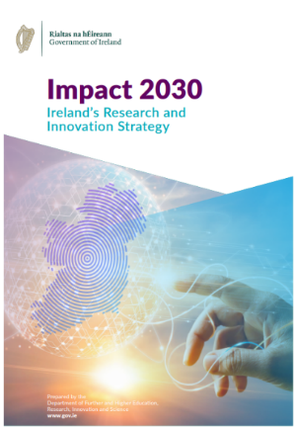
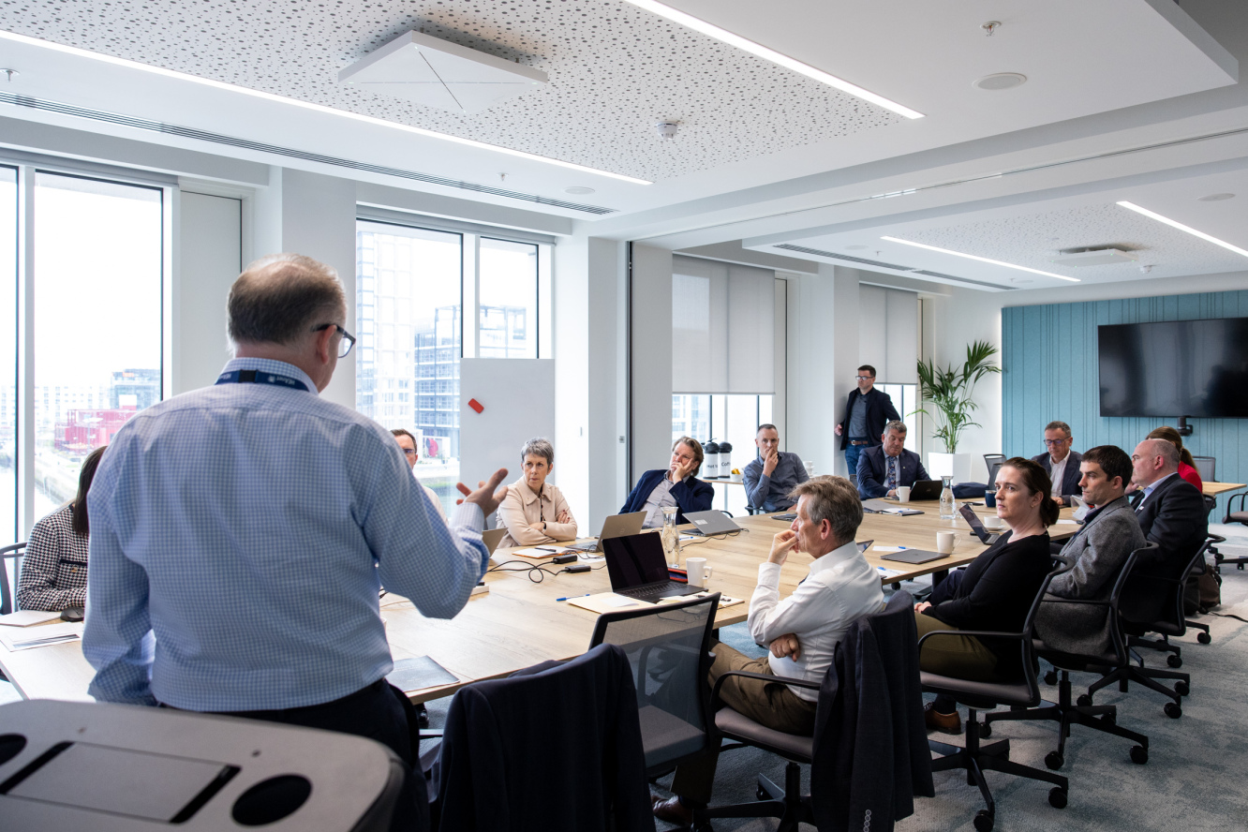
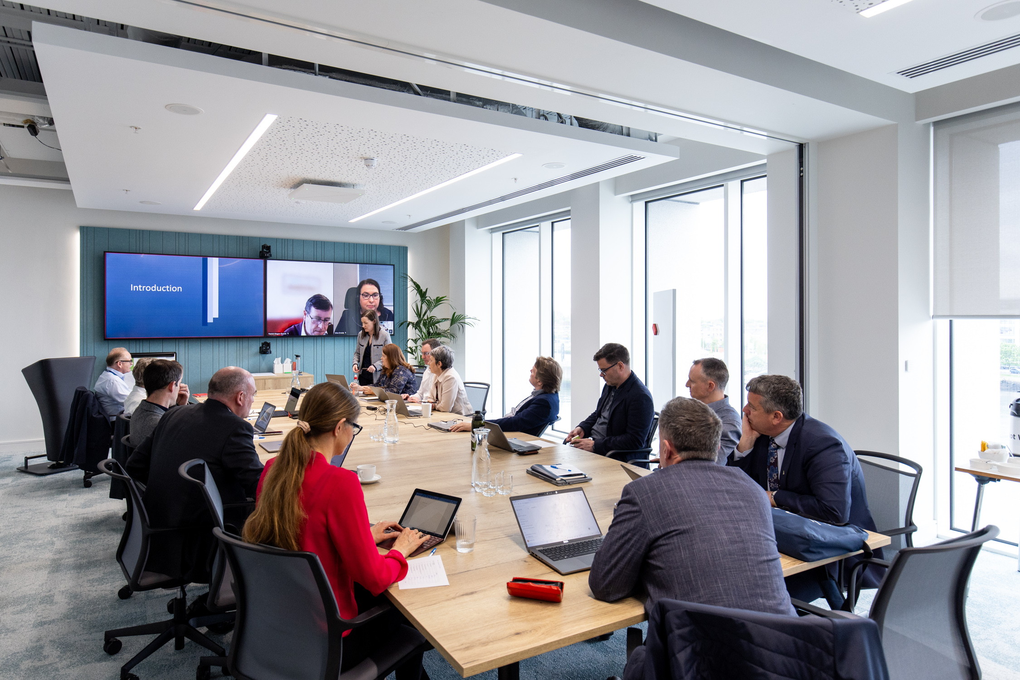
Strategic Considerations
Assess key achievements
Organisational changes
Current strategic context
Key influences
Client feedback
Stakeholder engagement

Slide 39
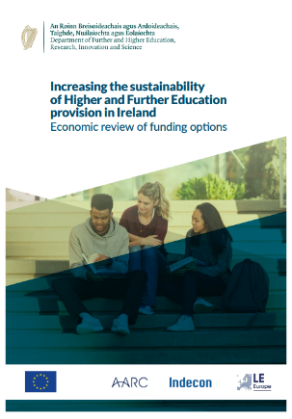


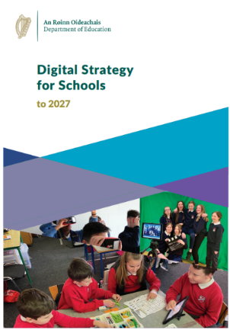


National Policies and Strategies

Slide 40

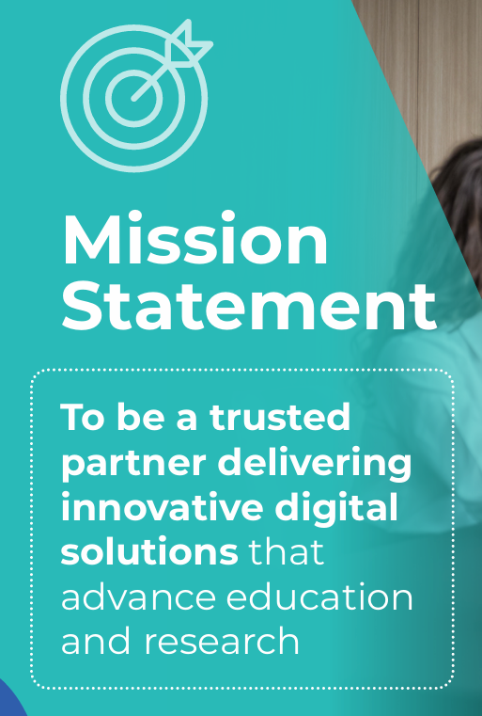
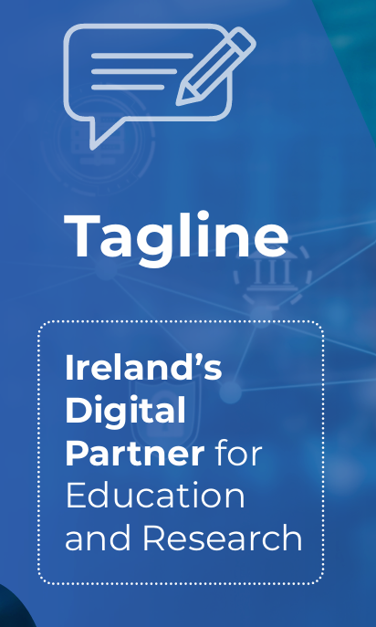
Vision, Mission and Tagline

Slide 41
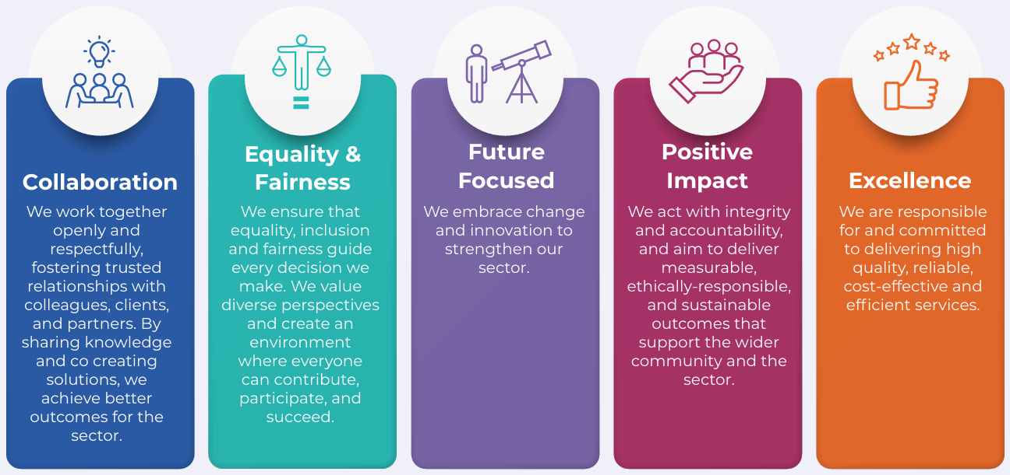
Values

Slide 42
Strategy Construct
Focus Areas
Values
Priorities
2028 and 2030 Targets

Slide 43
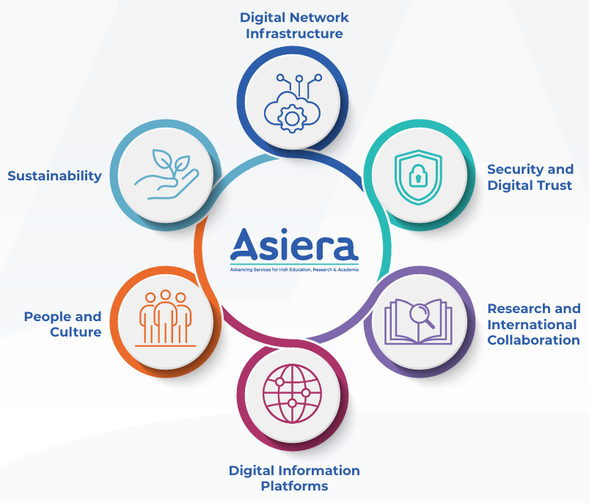
Focus Areas

Slide 44
Focus Area Priorities
Future Network Delivery
Future Network Delivery
Security and Digital Trust
Research and International Collaboration
Expand Connection Capacity and Resilience
Connecting Learners at All Levels of Education
Expand our Security Services Portfolio
Advancing Security Awareness and Knowledge in Education and Research
Reduce Digital Risk Through Trusted Partnership
National Research Data Infrastructure
Research Engagement
International Connectivity and Collaboration
Digital Information Platforms
Digital Information Platforms
Service Delivery Model Expansion
Data Interoperability and Intelligence
People and Culture
Impactful Culture
Building a Future‑Ready Workforce
Valuing Community
Sustainability
Environmental Responsibility
Social Impact
Financial Viability

Slide 45

Strategy Execution

Slide 46
Strategy Execution
Embed strategic objectives in our annual company plan
Build strategic objectives into employee performance targets
Monitor the company plan monthly
CEO reports progress to the Board and Government departments

Slide 47


Slide 48
Thank you

Slide 50
GÉANT strategy
Inspiration and process
Lise Fuhr
TNC26 – Helsinki, Finland
10 June 2026

Slide 51
Inspiration and Structure
Strategy needs be revisited and prioritized every year
Inspiration
  Red Cross International strategy
  ISOC strategy
  Both organisations with international memberships or offices
Structure
Main Strategy
  3 strategic goals built on:
  What do we try to solve – the challenges
  What outcome do we want - what are the transformation needed
Then added our own structure
Strategic framework to give directions to the specific services
    Guiding principles
    Strategic service portfolio

Slide 52

Strategy
Vision
Powering knowledge for Europe.
Mission
The GÉANT Association provides and advances the digital infrastructure and services required to accelerate research, education, and innovation for a secure and competitive Europe.

Slide 53
Three main pillars – strategic goals
1.
Collaborate to strengthen physical and human networks across Europe and beyond.
2.
Create scalable, innovative services prioritised by the community.
3.
Build a sustainable financial model.

Slide 54
Strategic Service Portfolio
Technical Services
  Network Infrastructure
  Identity and Access Management (IAM)
  Security
Emerging Services
  Data
  Education
  AI
Professional Services
  Events Management
  Advisory
  Learning and Talent Development

Slide 55
GÉANT Association Strategy Process
Small lean strategy team
  Lise (owner/sponsor), Dawn (project lead), Lars Fischer, NORDUnet (board liaison), Anastas Mishev, UKIM and Alberto Pérez Goméz, RedIRIS (GA liaisons)
Thorough process with the organisation: every team had to give input, an in-person All-Hands event with facilitators - all fed into the strategy.
Several consultations and iterations with GA, members, our peers, European Commission, and other stakeholders.
Discussed with working groups and CTO workshop
In total:
18 months
125 pages of input
75 meetings
10 iterations
3 framework approaches
Main strategy locked in early on.

Slide 56
Key Learnings – prepare, listen, validate
Strong project management is essential – Dawn allocated to lead the process made the it all possible
Patience, patience, patience - several iterations and repetitions are necessary
Early staff involvement is important and demanding due to different interests and uneven strategic understanding, but worth it.
Strong and early membership involvement is important and demanding due to diversity in membership scope and different requests to strategy detail levels, but important for the buy-in and legitimacy in an association.
Strategy needs a detailed implementation plan – including transformation and culture

Slide 57
Thank you
Any questions?
lise.fuhr@geant.org

