Slide 1

Road to the EDI Strategy
(not particularly linear )
Mira Stanic (she/her)
Veronika Di Luna (she/her)
Helsinki
11 June 2026
Notes:
Mira

Slide 2



Initial steps
Mapping of existing policies/ practices
EDI Strategy team
Staff Survey
2025
5 – 7 members
Executive sponsor
Volunteer based, lack of time and expertise is challenging
Established a baseline
Identified key topics
Better understanding of our org
Opportunity for all staff to have a voice
Working Conditions, Recruitment, Remuneration, Harassment… policies analysed (14)
Identifying gaps & Informing future strategy
Notes:
Mira

Slide 3


Not a Straight Road – Previous Initiatives
Mapping of existing policies/ practices
EDI Strategy team
Company-wide training
Increased number of female employees in technical roles
Established the Succession and Diversity Committee
Staff Survey
2025
GEC established with CEO as Executive Sponsor
Priority Areas and GEP defined
Wrangling compliance to make gender equality a priority topic and formalise efforts
2022
Horizon Europe GEP requirement
2022 - 2025
Gender Equality Committee (GEC)
2022 - ongoing
Gender Equality Plan
+ annual Action Plans
Notes:
Veronika: This was not ground 0 > there was ongoing work at GEANT that raised awareness of EDI topics, and a lot of that came through gender equality focused activities

Slide 4



Seeing Opportunity
Mapping of existing policies/ practices
EDI Strategy team
Staff Survey
2025
Lessons learned
+ timing
In-house
expertise
2025 - 2026
Broader Strategies in development: GÉANT Association Strategy
People & Culture sub-strategy
2022
Horizon Europe GEP requirement
2022 - 2025
Gender Equality Committee (GEC)
2022 - ongoing
Gender Equality Plan
+ annual Action Plans
Notes:
Mira

Slide 5
Seeing Opportunity
Lessons learned
+ timing
In-house
expertise
2025 - 2026
Broader Strategies in development: GÉANT Association Strategy
People & Culture sub-strategy
Years of GEC activities
Independent committee that feels representative
GEC members’ mandates ending
Project management
Impact, monitoring and data insights
Communication
Training
Advocating to have diversity of our community recognised
EDI Committee embedded in broader People&Culture efforts
Notes:
Mira

Slide 6

Seizing Opportunity
Mapping of existing policies/ practices
Feb 2026
Joint EDI Committee
May 2026
EDI Strategy Draft
EDI Strategy team
Staff Survey
2025
Lessons learned
In-house
expertise
2025 - 2026
Broader Strategies in development: GÉANT Association Strategy
People & Culture sub-strategy
2022
Horizon Europe GEP requirement
2022 - 2025
Gender Equality Committee (GEC)
2022 - ongoing
Gender Equality Plan
+ annual Action Plans
Notes:
Veronika

Slide 7
Joint Equity Diversity and Inclusion Committee
Feb 2026
Joint EDI Committee
May 2026
EDI Strategy Draft
EDI Committee – 6 people
2 members (any) have Gender Equality focus
Chair
HR
representative
L&D
representative
Member 1
Member 2
Member 3
Strong interest and ideally knowledge of EDI, representing diverse streams
How to ensure focus and attention is maintained?
Broader teams help to implement the annual Action Plan:
HR, L&D, PMO, Comms, Works Council, Community Programme,
other as needed
Time allocation supported and recognised by the Executive Team
Employees
All employees are considered as contributors; activities and initiatives will seek active participants, allies and ambassadors
Notes:
Veronika. Mention a few learnings: contributions more embedded in people’s regular role, but equally important that the Committee is independent and representative of all staff, with the chair not being from the HR team

Slide 8
Focus Areas
Feb 2026
Joint EDI Committee
May 2026
EDI Strategy Draft
As mandated
by the EC
EDI Strategy
Gender Equality Plan
Public GEP
Dedicated resource
Annual action plan
Reporting
and
Monitoring
Data collection
Joining the EU Diversity Charter
Training
Leading the Community
Notes:
Veronika

Slide 9





Draft EDI Strategy
Feb 2026
Joint EDI Committee
May 2026
EDI Strategy Draft
Action Plan
(12 months)
STRATEGIC
GOALS
Psychological
Safety
Inclusive Work Environment
Fairness
STRATEGIC PILLARS
Gender Equality Plan
(revised)
GUIDING PRINCIPLES
Inclusive Communication
Awareness
EDI STRATEGY
PEOPLE & CULTURE STRATEGY
GÉANT STRATEGY
Notes:
Mira

Slide 10
Thank you
Any questions?
mira.stanic@geant.org
veronika.diluna@geant.org

Slide 11
Discussion topics

Slide 12
Topics for discussion
Tools and meeting cadence
Sharing best practice
Who can help?
  Need volunteers!

Slide 13
Tools
Put some structure into NREN (and friends) EDI community to support common activities and approaches
Clear appetite for additional tools to support this work, alongside examples of existing work and its impact
  Link to mailing list at the end
  Collaboration space?
  Issue tracker?
  Shared document area?

Slide 14
Meeting cadence
Potential for annual meeting at or around TNC
  Identify need for more activity
Aim for ~3 meetings per year?
  2 online, one in person
  Online in Autumn/Spring
Important to have topics and good attendance!

Slide 15
Sharing experience
Work by NRENs in terms of regulations in the EU
  Pay transparency and gender pay gap
Monitoring and evaluation
Governance - how to ensure engagement with senior leadership alongside grass roots
  Where are the problems?
  How to make real, demonstrable impact
Connections to related activities

Slide 16
Volunteers
Really need people to get involved – on the mailing list, but leading activities
  Same as everywhere
We can start small - thoughts on individual topics is already useful
Ideally have people that can commit some time with agreement from their organisation
  Coming in with ideas is even better

Slide 17
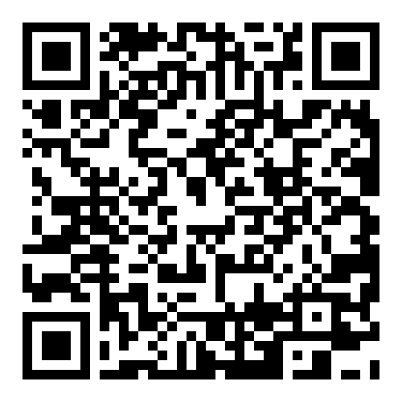
Mailing list and contacts
edi-geantcommunity@lists.geant.org
https://lists.geant.org/sympa/subscribe/edi-geantcommunity
Direct contacts
  veronika.diluna@geant.org
  mira.stanic@geant.org
  david.crooks@stfc.ac.uk

Slide 18
Thank you
Any questions?
veronika.diluna@geant.org
mira.stanic@geant.org
david.crooks@stfc.ac.uk

Slide 19
Next time
If we’re able to have another BoF next year, what are some big topics?
If we had an ideal structure, what would it look like?
  How does that map to reality

